Slide 1
Bienvenidos a nuestra clase español 3
Hoy es jueves, el cinco de abril
Edit the text boxes on the slides, not in the notes below. You may need to ‘save as’ to enable editing. Upload slides to CANVAS when complete.

Slide 2
Pon tu respuesta aquí….

Slide 3
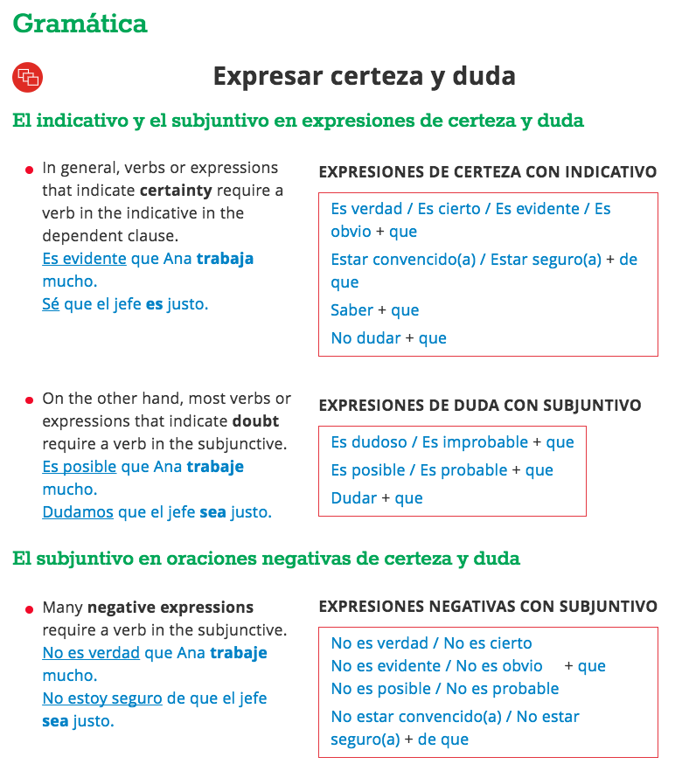

Slide 4
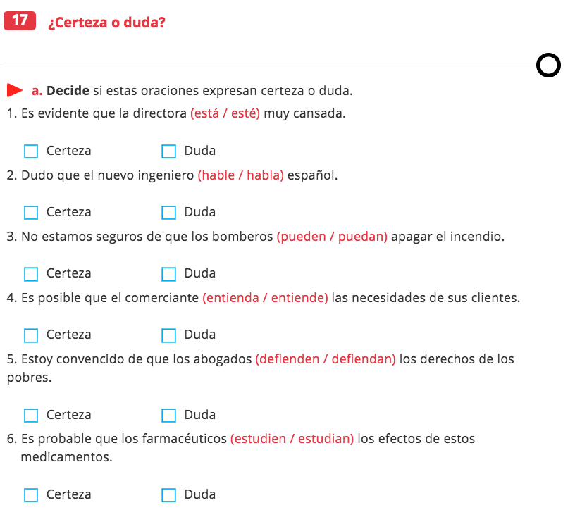
Click the circles to put them on the right words.
Click the Xs to mark the correct squares – certain or doubtful?
X
X
X
X
X
X
X

Slide 5
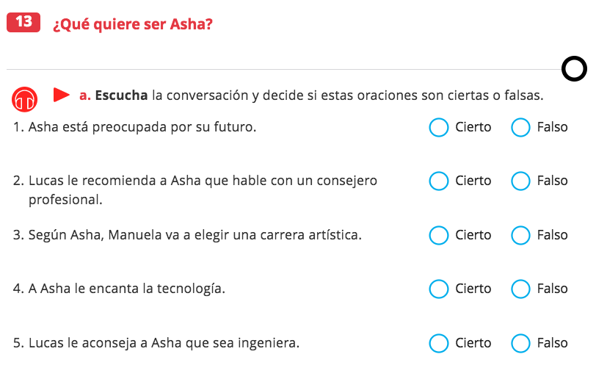
Click the Xs to mark T/F
X
X
X
X
X
X

Slide 6
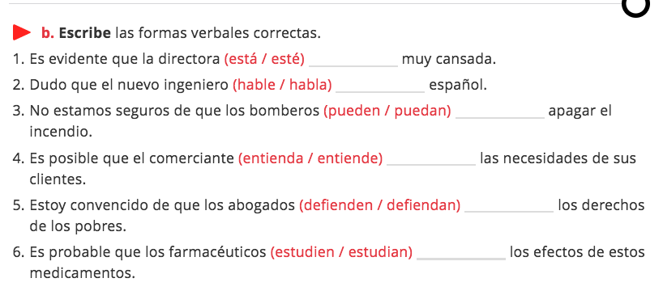
Click the circles to put them on the right words.

Slide 7
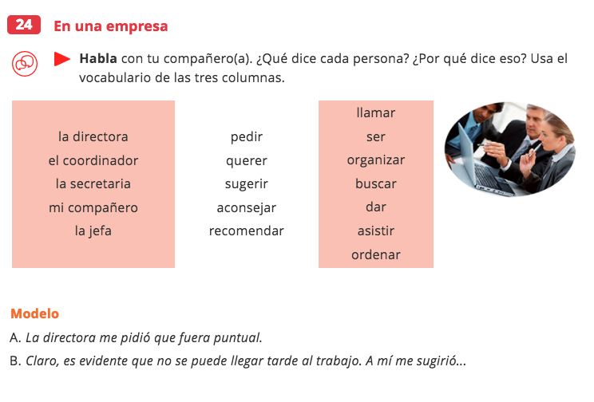
Pon su respuesta aquí….

Slide 8
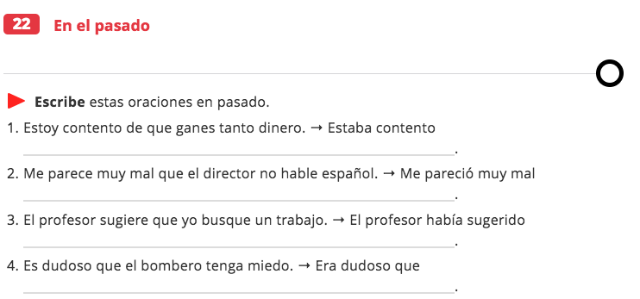
DOL
…
…
…
…

