Slide 1
Los Trabajos

Slide 2
Objetivo y DOL
OBJ: LLWBAT investigate and model concepts related to work.
DOL: Given new work-related vocabulary, 100% of LLW create a model of workplaces and jobs with a peer review of 80% or higher.

Slide 4
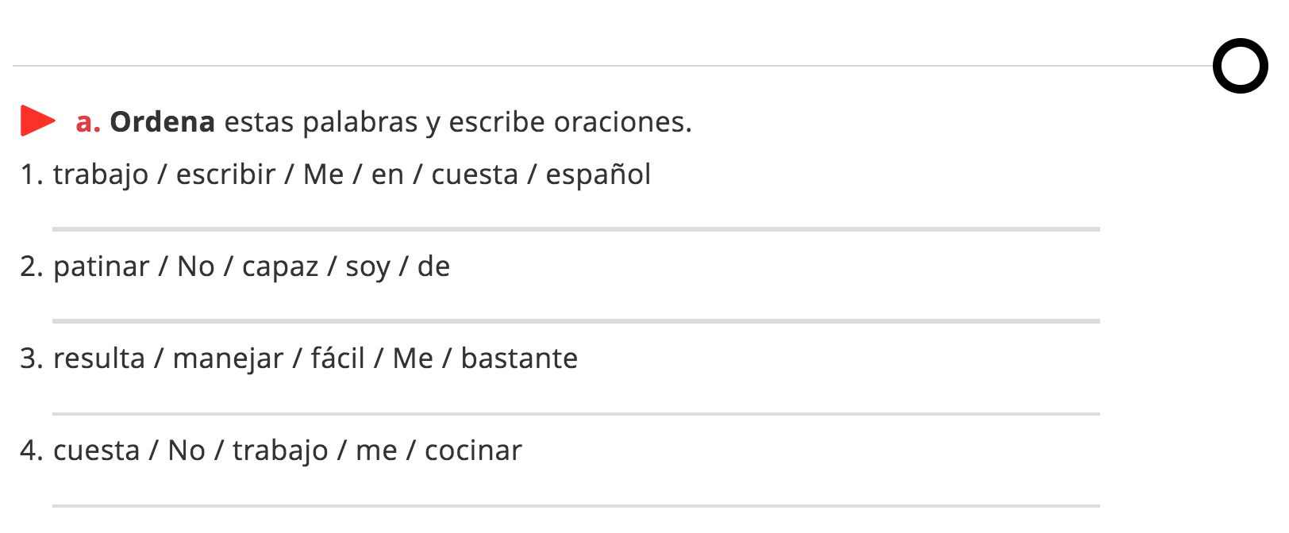
…
…
…
…

Slide 5
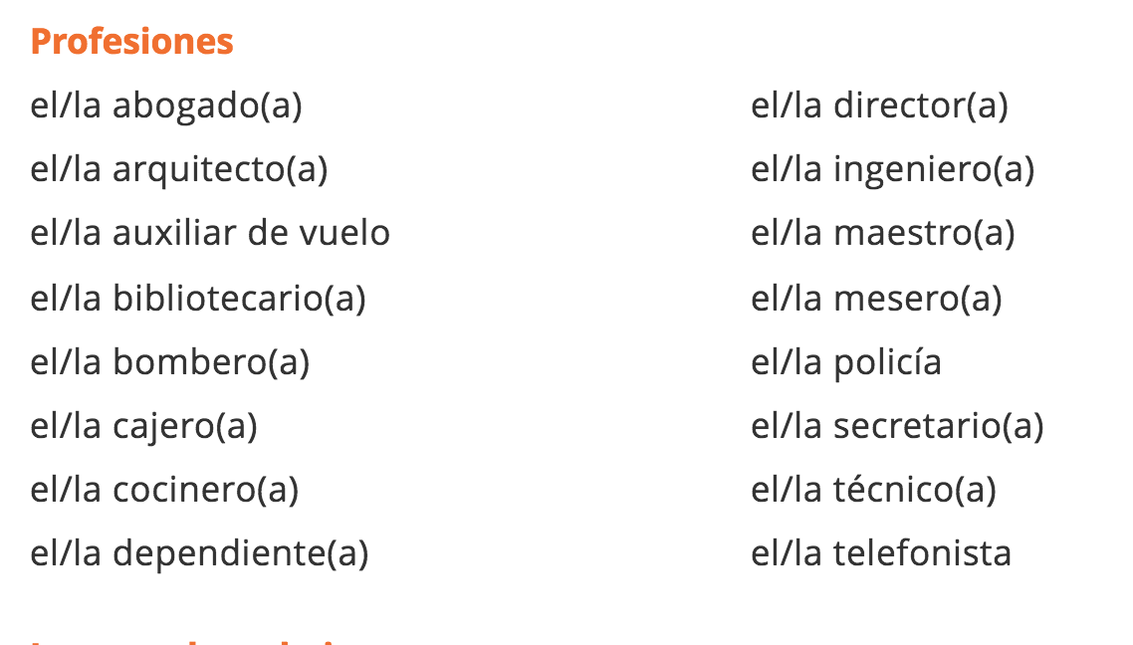

Slide 7
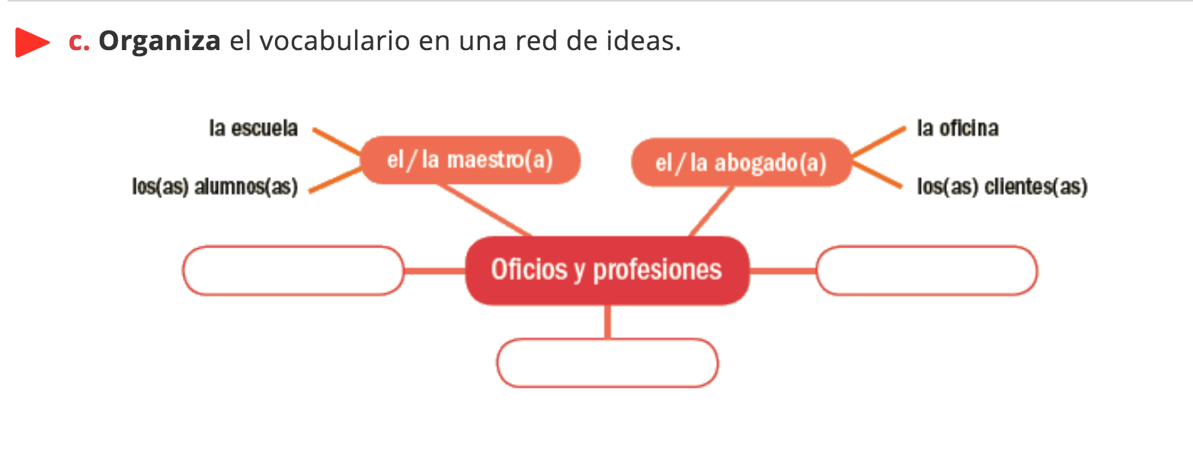
…
…
…
…
…
…
…
…
…

Slide 8
1. ..…
2. ..…
3. ..…

Slide 9
…..

Slide 10
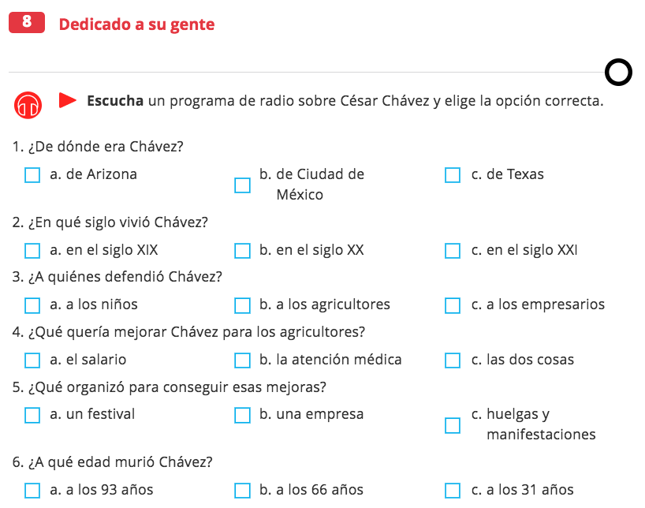
X
X
X
X
X
X

