Slide 1
La Ciencia

Slide 2
Brainstorm
Good and Bad of technology-
Con tu companero identifica los aspectos negativos y los aspectos positivos de la tecnologia.

Slide 3
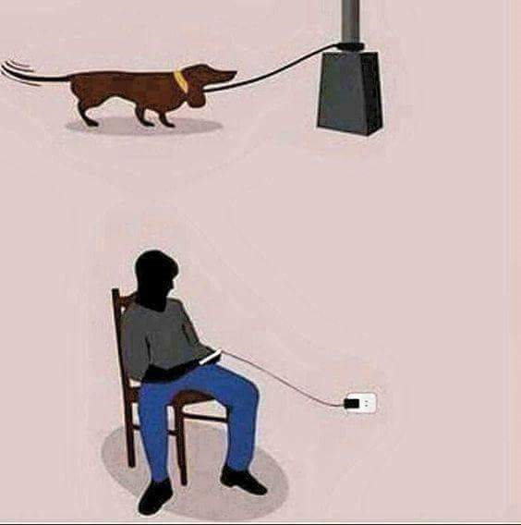

Slide 4
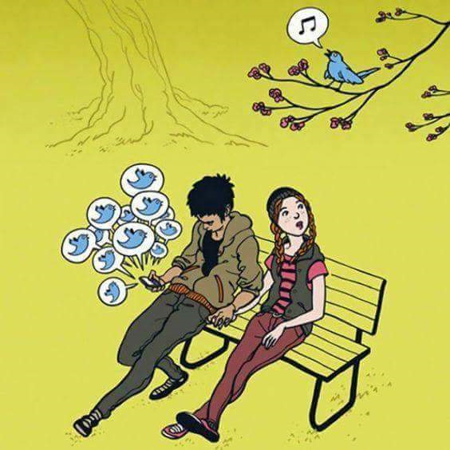

Slide 5
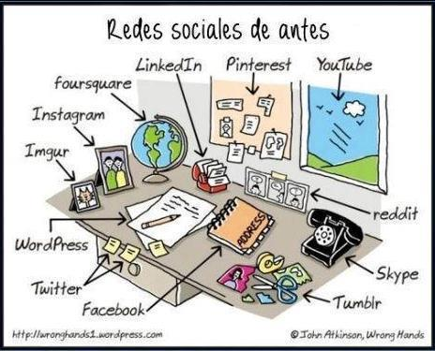

Slide 6
Prefieres un libro electrónico o un libro de papel? Cual es mejor?
1

Slide 7
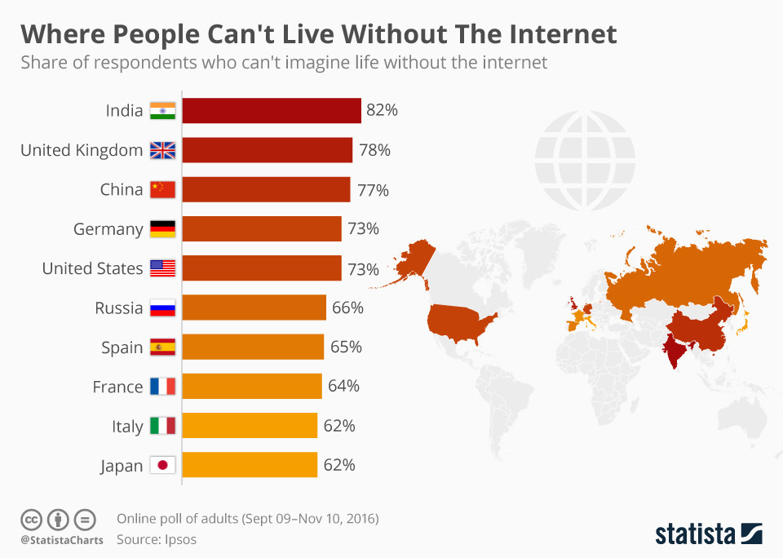

Slide 8
La Ciencia en la escuela
Leamos:
Uruguay
By now you should have read:
El Shock del future
Acceso a la tecnologia
INFOGRAPHIC- DUE MONDAY
Questions from these readings will be on your exam.

Slide 10
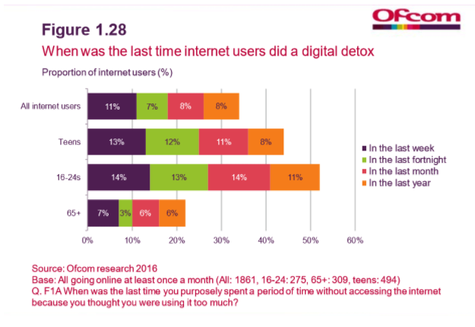

Slide 11
Muchas personas dicen que las personas que constantemente usan la computadora se convierten en adictos y que, en general, esta actividad le causa problemas al individuo.
¿Estás de acuerdo? ¿Por qué?
¿Conoces a alguien que haya cambiado su personalidad o que actué de manera diferente a causa del uso de las computadoras?
.

Slide 12
Albert Log-in

Slide 13
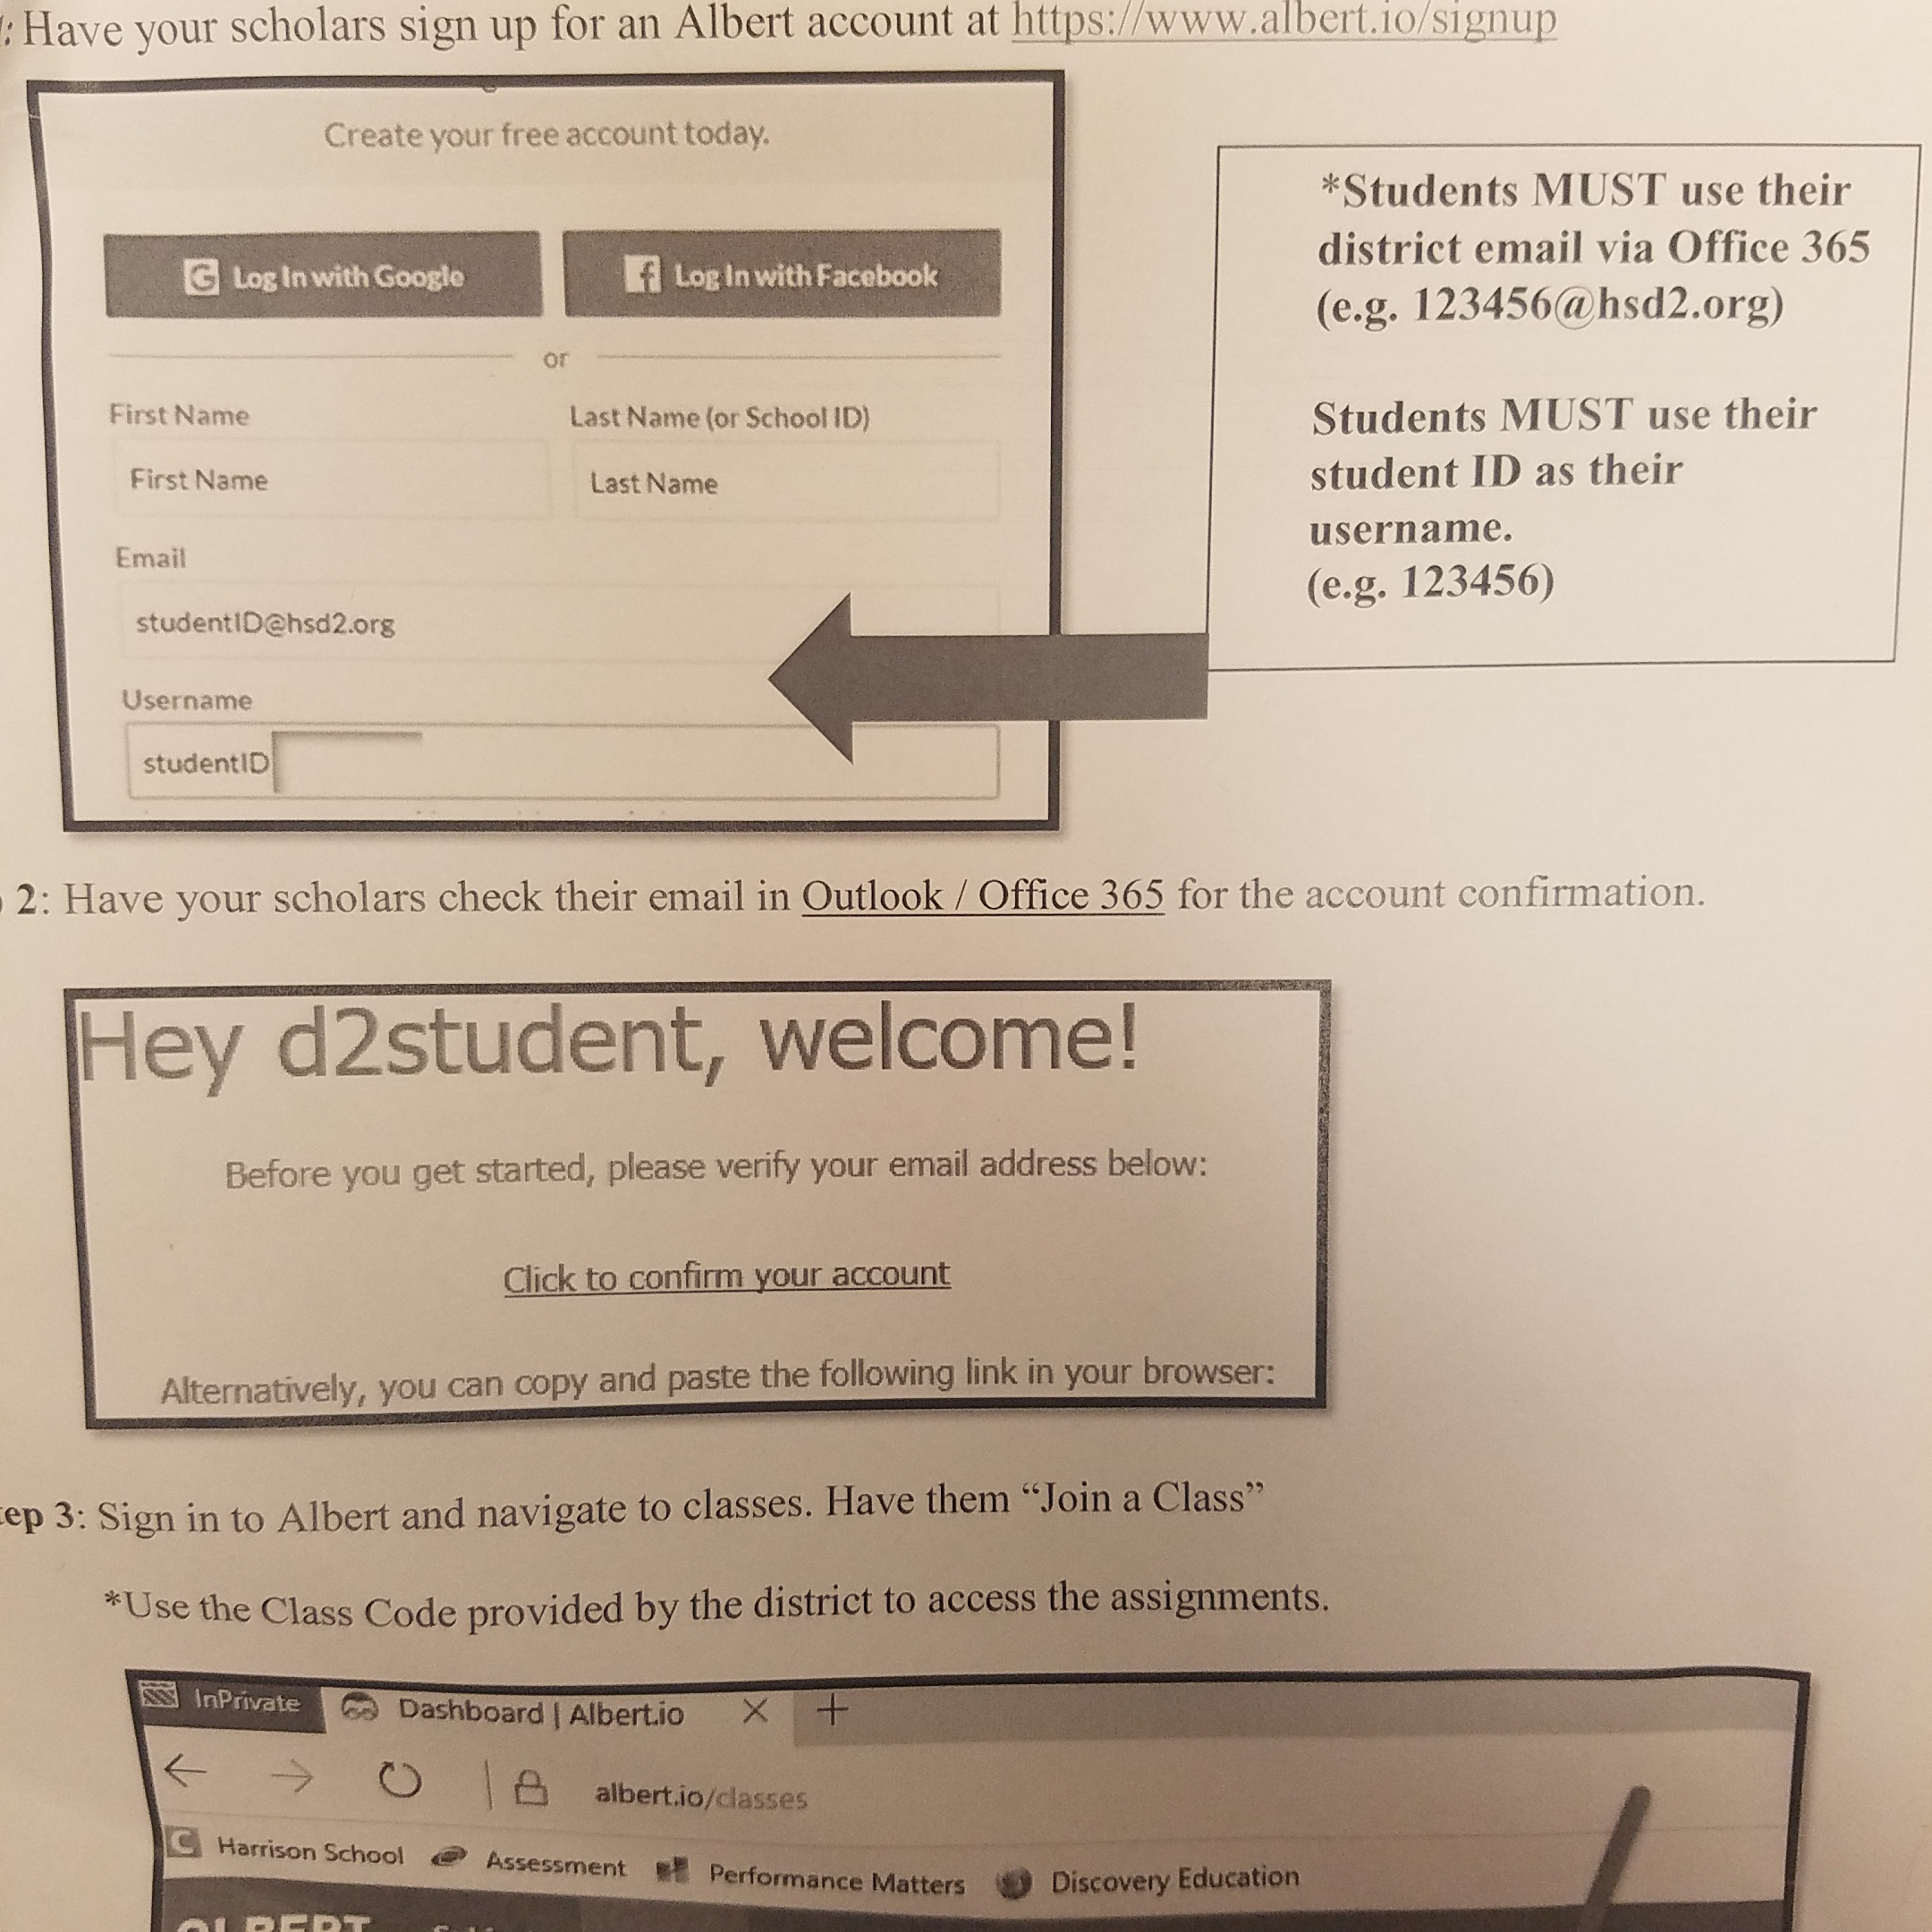

Slide 15
Pregunta Esencial:
¿Piensa que todos los inventos y tecnología de los últimos cien años han mejorado nuestro mundo? ¿Por qué? ¿Nos han perjudicado alguna vez?

Slide 16
Para pensar:
¿Ha mejorado la tecnología nuestra vida o solamente ha acelerado el ritmo de nuestras rutinas diarias? Explique su respuesta.

Slide 17
Gastronomia
Mexico un pais para comerzelo.

Slide 18
Cultural Note
https://www.youtube.com/watch?v=tovOu_YT3NY.

Slide 19
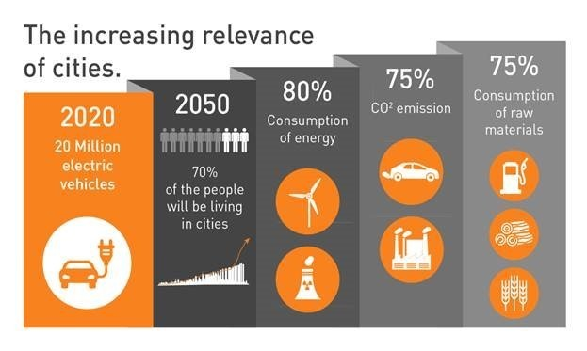
Want big impact?
Use big image.

Slide 20
https://www.bing.com/videos/search?q=careers+that+technology+will+replace+video&view=detail&mid=F66887F5BA900DAC62F0F66887F5BA900DAC62F0&FORM=VIRE

Slide 21
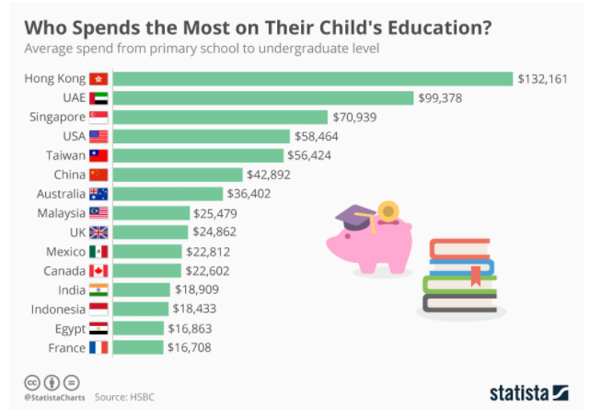
89,526,124$
185,244 users
100%
That’s a lot of money
And a lot of users
Total success!

Slide 22
Reading:
Uruguay y su avance tecnologico

Slide 23
Cuales paises---
our office

Slide 24
Our process is easy
first
second
last

Slide 25
Our sales funnel
20%
40%
60%
80%
Diagram featured by http://slidemodel.com
100%

Slide 26
Let’s review some concepts
Yellow
Is the color of gold, butter and ripe lemons. In the spectrum of visible light, yellow is found between green and orange.
Blue
Is the colour of the clear sky and the deep sea. It is located between violet and green on the optical spectrum.
Red
Is the color of blood, and because of this it has historically been associated with sacrifice, danger and courage.
Yellow
Is the color of gold, butter and ripe lemons. In the spectrum of visible light, yellow is found between green and orange.
Blue
Is the colour of the clear sky and the deep sea. It is located between violet and green on the optical spectrum.
Red
Is the color of blood, and because of this it has historically been associated with sacrifice, danger and courage.

Slide 27
Eres adicto al celular?

Slide 29
😉
Now you can use any emoji as an icon!
And of course it resizes without losing quality and you can change the color.
How? Follow Google instructions https://twitter.com/googledocs/status/730087240156643328
✋👆👉👍👤👦👧👨👩👪💃🏃💑❤😂😉😋😒😭👶😸🐟🍒🍔💣📌📖🔨🎃🎈🎨🏈🏰🌏🔌🔑 and many more...

