Slide 1
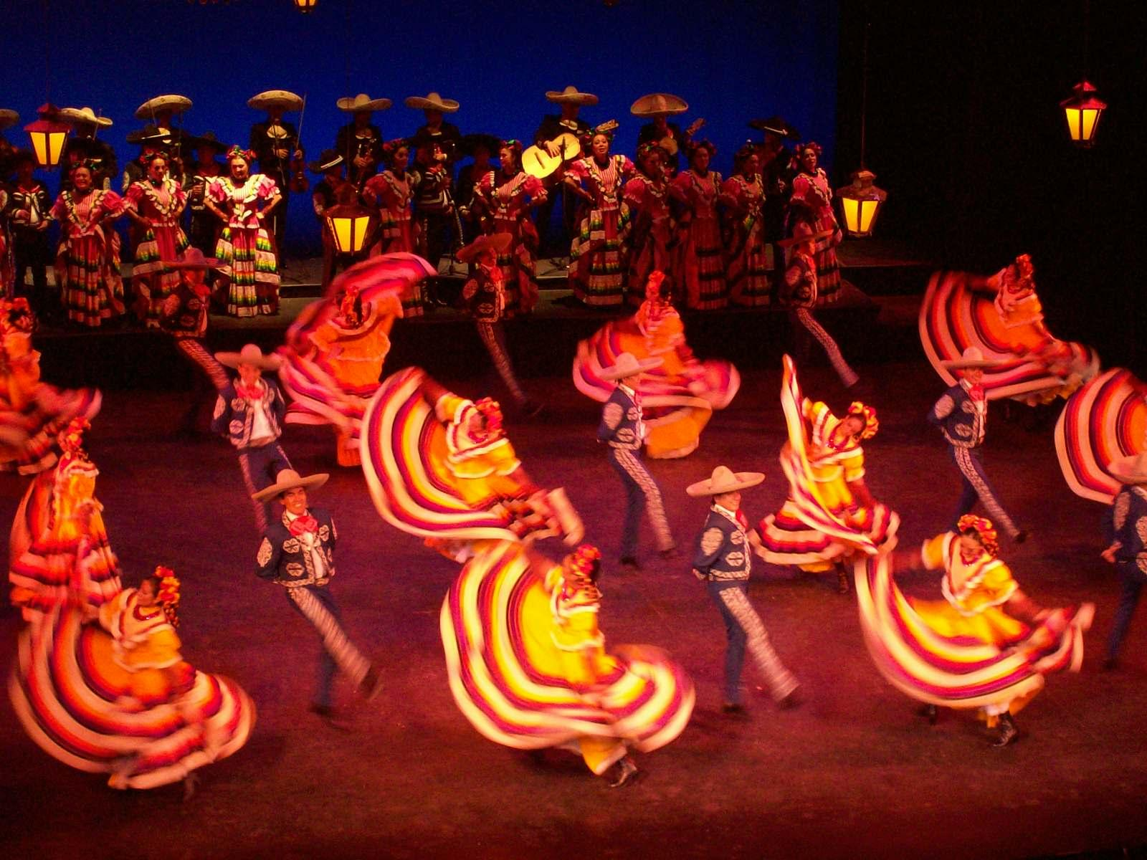
Student Exercises
Para jueves, el 25 de enero, 2018
Nombre:

Slide 2
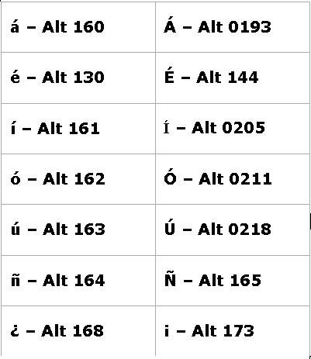
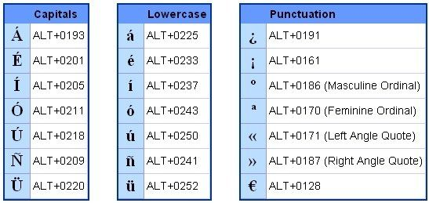
When writing answers in the note box below, use these codes for accents:

Slide 3
Re-write and translate phrases in the notes below

Slide 4
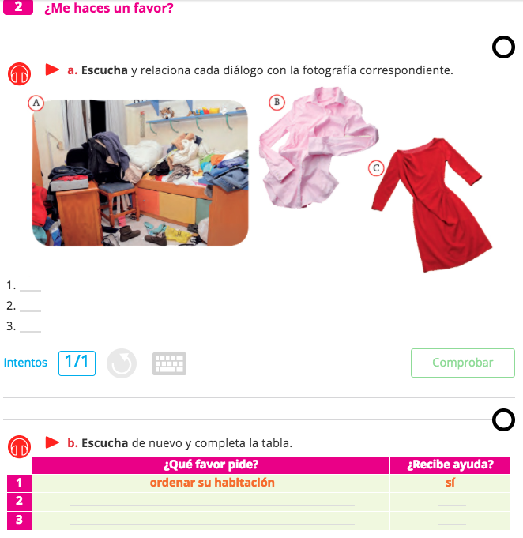

Slide 5
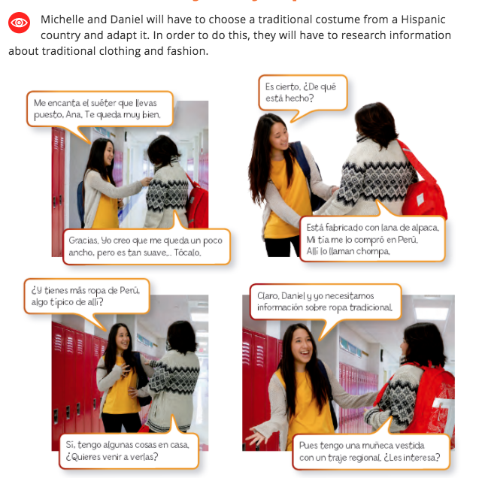

Slide 6
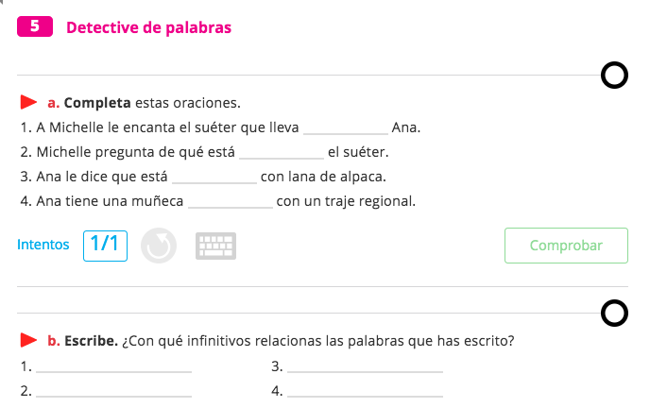
…. Fill in the text boxes with the correct response based on the previous reading. The responses for Section A are all past participles—hecho, participado, vivido, etc.
….
….
….
….
….
….
….
….

Slide 7
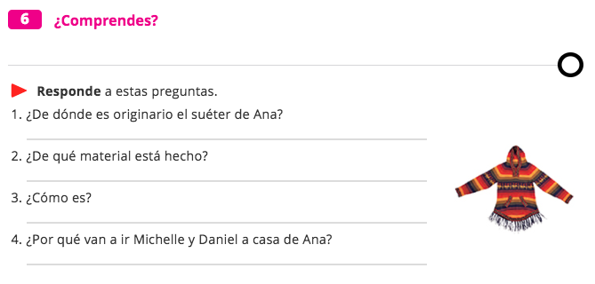
….
….
….
….

Slide 8
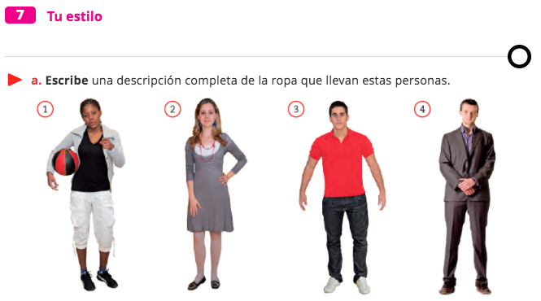
In the notes section…
Notes:
WRITE HERE….

Slide 9
Name your partner and write down their response en espanol in the notes section below….
Notes:
ESCRIBE AQUí

Slide 10
DOL
Please respond with a brief paragraph in the notes section. 4-6 sentences.
Notes:
Please respond with a brief paragraph in the notes section. 4-6 sentences.

