Slide 1
Do now!
Crear una etiqueta con su nombre
Asistencia
“Presente”
“Aquí”
“Hola”
Create a name tag
Attendance
“Presente”
“Aquí”
“Hola”

Slide 2
Name___________
Tu color favorito? – Your favorite color?
Tu deporte favorito? – You favorite sport?
Tienes mascotas? – You have pets?
Que marca de ropa prefieres? – What brand of clothes do you prefer?
Tu comida favorite? – Your favorite food?
5 mins

Slide 3
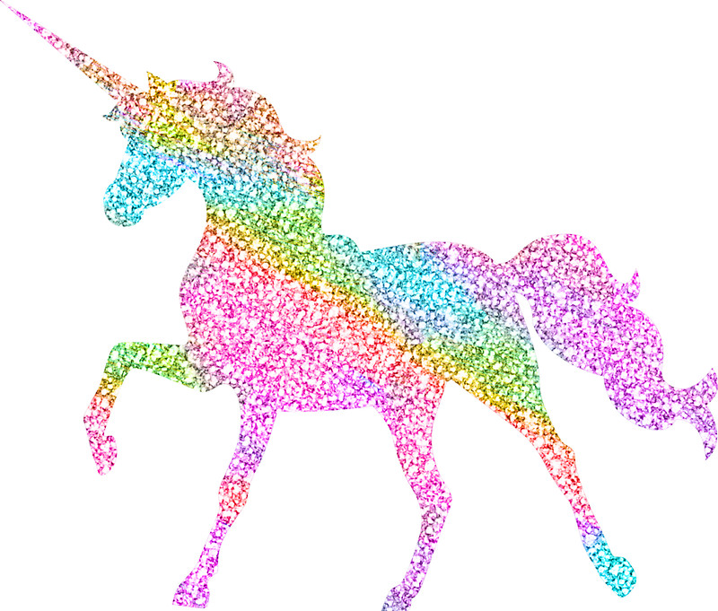
Eres lo mas Unico?
Are you the most unique?
Compare warmup sheets with 6 people sitting nearest you, cross out any similar answers and then pass them forward.

Slide 4
BIENVENIDOS A Nuestra Clase! EspaÑol 1
09 de Agosto 2018
Anuncios: Normalmente voy a poner anuncios sobre exámenes, tarea y fechas importantes AQUÍ
Announcements: Normally, I am going to put announcements about exams, homework and important dates HERE

Slide 5
BIENVENIDOS A Nuestra Clase! EspaÑol 1
09 de Agosto 2018
Syllabus to be handed out on monday

Slide 6
Time | Activity
10 minutes | Survey/ Name tags/ Attendance
5 minutes | Welcome
5 minutes | OBJ/DOL/ Expectations (supplies)
10 minutes | About the teacher
5 minutes | El Español en nuestra clase
15minutes | What you already know
10 minutes | DOL
AGENDA

Slide 7
OBJECTIVE/ dol
OBJ: LLWBAT learn about teacher, classmates and topics that will be covered throughout the year.
DOL: 100% of LLW recall one thing we will be learning this year, one thing we will be learning this unit, and one thing we will be doing this week.

Slide 8
1. Respect 3. Work hard. Always.
Expectations

Slide 9
Supplies
LOCATIONS IN THE CLASSROOM
SOMETHING TO WRITE ON- NOTEBOOK OR BINDER
SOMETHING TO WRITE WITH
COMPUTER WHEN YOU GET IT! – make sure it’s charged

Slide 10
ABOUT MAESTRA …
1. Where am I from?
2. How many siblings do I have?
3. What sports did I play in high school?
4. Where did I go to college?
6. When I was younger I wanted to be a…
7. What is my favorite color?
8. Where did I teach high school students before?

Slide 11
El espaÑol En nuestra clase
What will we do in this class?
How will we work?
What will our schedule look like?
This year?
This unit?
This week?
Que haremos en la clase?​
Como trabajaremos en la clase?
​
Como se vera nuestro itinerario?
​
Este año?​
Esta unidad?​
Esta semana?

Slide 12
El espaÑol En nuestra clase
What will we do in this class?
How will we work?
What will our schedule look like?
This year?
Unit 1 – Introductions, classroom objects, numbers, weather, time.
Unit 2 – How we describe ourselves and others (present tense verbs)
Unit 3 – School-related vocabulary, grammar and locations
Unit 4 – Home and Family
Unit 5 – Food and Restaurants (past tense verbs)

Slide 13
El espaÑol En nuestra clase
This unit?
This week?

Slide 14
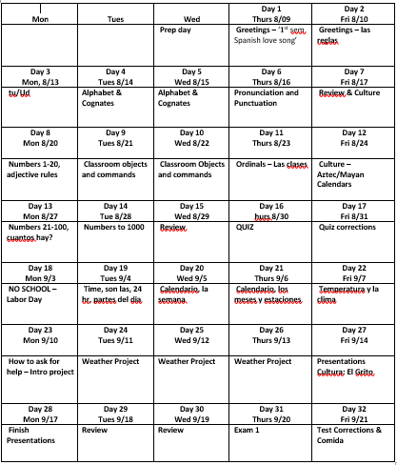

Slide 16
What you already Know…
First semester of Spanish Love Song https://www.youtube.com/watch?v=ngRq82c8Baw

Slide 17
If we have some time…
Take out your phone and look up a flag for one of the following countries. Draw the flag on a piece of paper to be hung around the room. Please label the flag.
SPAIN COLOMBIA ARGENTINA VENEZUELA
EQUITORIAL GUINEA CHILE PARAGUAY URUGUAY
BOLIVIA PERU EQUADOR HONDURAS
GUATEMALA NICARAGUA BELIZE MEXICO
EL SALVADOR COSTA RICA PANAMA PUERTO RICO CUBA DOMINICAN REBULIC

Slide 18
Dol
LLW recall and share with their partner one thing we will be doing this year in Spanish 1.

Slide 21
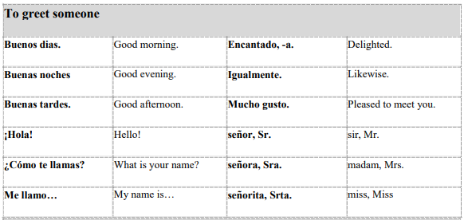
Greeting Song https://www.youtube.com/watch?v=Vld59vW3_
New vocab – greetings!
Que hago?
Volume 0
Writing.
Pencil down when done.

Slide 22
BIENVENIDOS A Nuestra Clase! EspaÑol 1
10 de Agosto 2018
Anuncios:
Que haces?
Que hago? – what do I do? Box added to each slide

Slide 23
OBJECTIVE/ dol
OBJ: LLWBAT recall and apply vocabulary related to introductions. (WL1.1.c)
DOL: Given 5 questions,100% of LLW recall and apply the correct introduction word in a conversation with 80% accuracy.

Slide 24
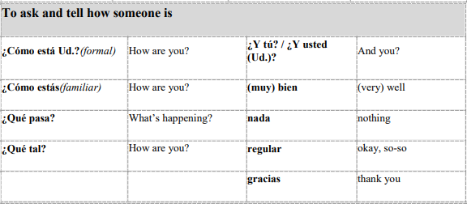
Greeting Song https://www.youtube.com/watch?v=Vld59vW3_
New vocab – greetings!
Que hago?
Volume 0
Writing.
Pencil down when done.

Slide 25
PRESENTARSE – INTRODUCE YOURSELF
WHAT PARTS OF THIS CONVERSATION DO YOU UNDERSTAND?
HOW MUCH OF THEIR COMMUNICATION IS NON-VERBAL?
https://youtu.be/GWaBQ-ZUm-c
1ST TIME NO SUBTITLES
2ND TIME WITH SUBTITLES

Slide 26
UNA CONVERSACION - READ THE FOLLOWING OUTLOUD WITH YOUR SHOULDER PARTNER
GUILLERMO
1 Buenos días!
3 Cómo estás?
5 Bien. Como te llamas?
7 Mucho gusto Brunilda. Me llamo Guillermo.
9 Pues, que tengas un buen día.
11 Adiós!
BRUNILDA
2 Buenos días!
4 Bien, gracias. Y tú?
6 Me llamo Brunilda.
8 Encantada.
10 Gracias. Igualmente.
12 Hasta luego.
Que hago?
Volume 2
Sitting.
Speaking.

Slide 27
La cancion inolvidable!
https://youtu.be/9ZKw5IldE9Y
Sing along! - canta

Slide 28
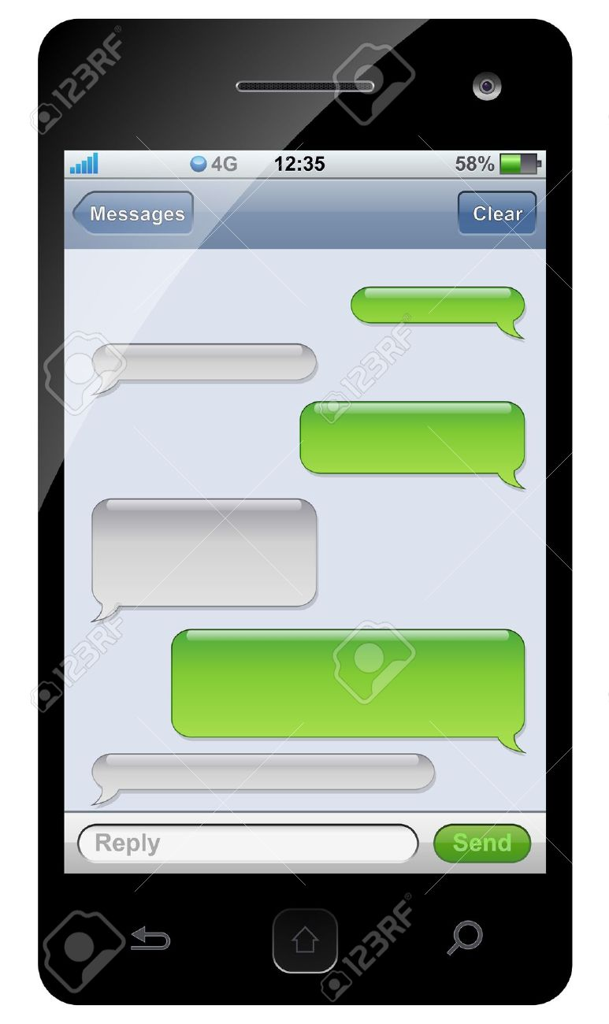
Crear tu propio conversacion
Make your own conversation
Que hago?
Volume 0
Writing.
Pencil down when done.

Slide 29
Presentarse a alguien introduce yourself to someone new!
Que hago?
Volume 2
Walking. Speaking.

Slide 30
Dol – fill in the blanks
GUILLERMO
1 Buenos _____!
3 Cómo estás?
5 Bien. Como te llamas?
7 Mucho ______ Brunilda. Me llamo Guillermo.
9 Pues, que tengas un buen día.
11 Adiós!
Word Bank [llamo, tú, gusto, Hasta, días]
BRUNILDA
2 Buenos días!
4 Bien, gracias. Y ___?
6 Me _____ Brunilda.
8 Encantada.
10 Gracias. Igualmente.
12 _______ luego.

Slide 31
Dol – fill in the blanks
GUILLERMO
1 Buenos __dias__!
3 Cómo estás?
5 Bien. Como te llamas?
7 Mucho _gusto_____ Brunilda. Me llamo Guillermo.
9 Pues, que tengas un buen día.
11 Adiós!
Word Bank [llamo, tú, gusto, Hasta, días]
BRUNILDA
2 Buenos días!
4 Bien, gracias. Y __tu_?
6 Me __llamo___ Brunilda.
8 Encantada.
10 Gracias. Igualmente.
12 ___Hasta____ luego.

