Slide 1
Warmup ordena las palabras
Re-write the conversation in order. Use every sentence.
Knock-knock. Pasale! (come in!)
Buenos dias, Pepe.
Estoy bien, gracias.
Que pasa, Pepe?
Gracias, Adios!
Nada.
Como estas?
Que tengas un buen dia.
Hola.
Que hago?
Writing
Volume 0
In seat
Notes:
This lesson needs small cut outs with questions and answers. Hats, mustaches or ties. ¼ sheet of scratch paper for DOL.

Slide 2
Warmup ordena las palabras
How did you do? ___/9
Knock-knock. Pasale! (come in!)
Hola.
Buenos dias, Pepe.
Como estas?
Estoy bien, gracias.
Que pasa, Pepe?
Nada.
Que tengas un buen dia.
Gracias, Adios!

Slide 3
BIENVENIDOS A Nuestra Clase! EspaÑol 1
Hoy es el trece(13) de Agosto 2018
Meeting in auditorium tomorrow
Hours: 2nd (freshman), 3rd (sophomores), 5th (juniors) and 6th (seniors)
Come to class first so I can take attendance
Covering Syllabus and Class Agreement on Wednesday

Slide 4
OBJETIVO/DOL
OBJ: LLWBAT correctly apply the familiar(tu) and formal(Usted) forms in a conversation. (NL 1.1B)
DOL: Given 7 people, 100% of LLW apply the familiar(tu) and formal(Usted) forms in a conversation correctly 6/7 times.
How do we communicate respectfully in Spanish?
IB Attitude: Caring

Slide 5
Repaso - Review Habla con tu companero:
Left Side
Como estas?
Como esta tu familia?
Pick [bien, mas o menos, mal]
Pick [bien, mas o menos, mal]
Example. Como estan los Broncos?
How are the Broncos?
Right
1. Pick [bien, mas o menos, mal]
2 Pick [bien, mas o menos, mal]
3. Como esta tu mascota (your pet)?
4. Como estan las clases (classes)?
Bien – good
Mas o menos – Meh.
Mal- Bad
Que hago?
Speaking: Volume 2 In seat

Slide 6
Actividad find the answer
Que hago?
Speaking: Volume 3 Walking
1. Once you have your paper, stand up
2. If you have a question paper go from person to person asking your question
3. When you find the person with an answer that makes sense, you can both go back to your seats and sit down.
Example – Q: How are you? Como estas? A: Colorado NOT A MATCH
Q: Que pasa? What’s happening? A: No mucho. Not much. MATCH!

Slide 7
Señor señora señorita
Que hago?
Listening
Volume 0
In seat

Slide 8
¿Y tú?
¿Y usted?
usted = Ud.
Que hago?
Listening
Volume 0
In seat

Slide 9
Tú - Como estas?
Ud. Como esta usted?
usted = Ud.
Que hago?
Listening
Volume 0
In seat

Slide 10
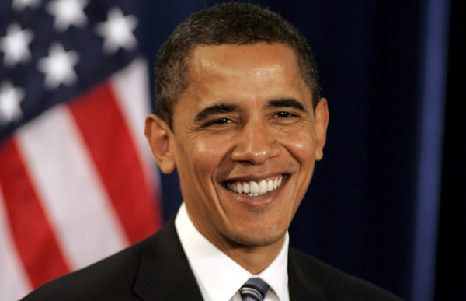
Tú o Usted

Slide 11
Tú o Usted

Slide 12
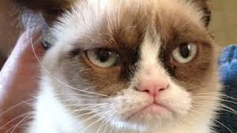
Tú o Usted

Slide 13
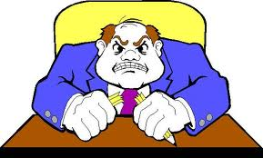
Tú o Usted

Slide 14
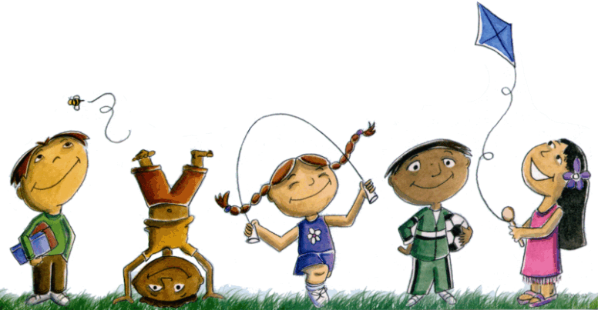
Tú o Usted

Slide 15
NECESITO 5 VOLUNTARIOS!
Notes:
Have 5 students come up and line up in front - girls and guys - and give a few hats or ties

Slide 16
Formal vs Informal Introductions
Each row will take turns introducing themselves to our volunteers. The volunteers will decide if you said it right. If you say it wrong, they’ll say “Ay, no!”
You need to say one of the following:
Hola. Como estás?
Hola, Señora. Cómo está, usted?
Hola Señor. Cómo está, usted?
Que hago?
Walking Volume 2
Waiting Volume 0

Slide 17
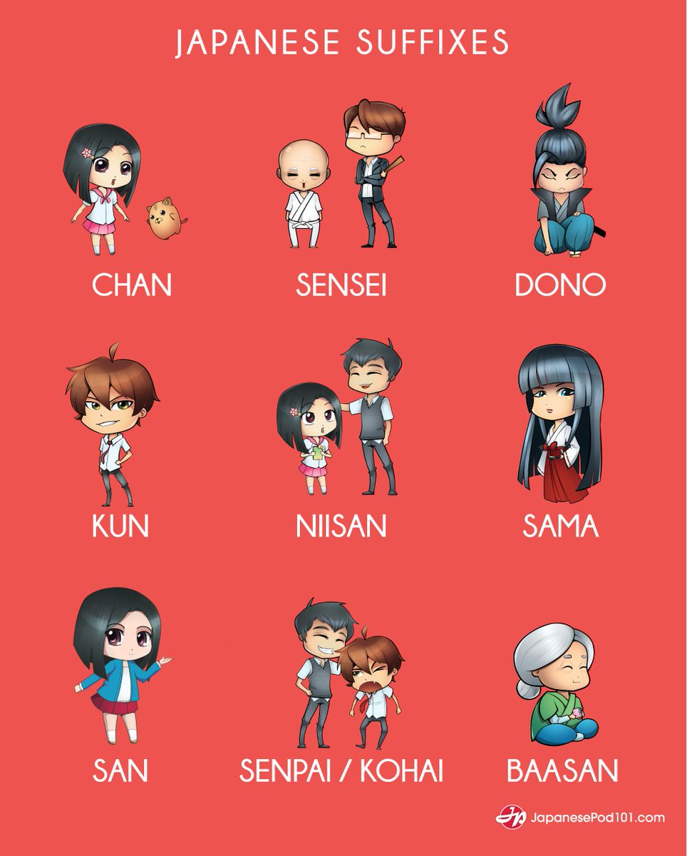
Refleccion
Spanish uses Usted, Tu and Vos as different levels of politeness
Japanese is famous for having more ‘honorifics’ than any other language, making it one of the most difficult to learn.
http://japanese.wikia.com/wiki/Honorifics
Which IB Global Context categories do you think fit this multi-cultural tradition of honoring our elders in language?
If you invented a language, would it include honorific language? Why or why not?
Que hago?
Group Discussion.
Raise hand to participate. Vol. 4
Notes:
Class discussion

Slide 18
¿tú o Ud.?
D.O.L.
Your brother
Your teacher
Your best friend
Your friend’s mother
Your cat
Your principal
A new acquaintance who is your age

Slide 19
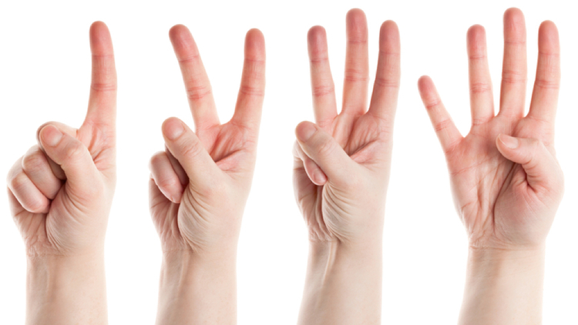
¿tú o Ud.?
Your brother - tú
Your teacher - Ud.
Your best friend - tú
Your friend’s mother - Ud.
Your cat - tú
Your principal - Ud.
A new acquaintance who is your age – tú/Ud.

Slide 22
Warm Up LEER! READ!
Please pick a magazine or book and read OUTLOUD for 4 mins.
Que hago?
Sitting.
READING volume 3

Slide 23
BIENVENIDOS A Nuestra Clase! EspaÑol 1
Hoy es el catorce(14) de Agosto 2018
Meeting in auditorium TODAY
Hours: 2nd (freshman), 3rd (sophomores), 5th (juniors) and 6th (seniors)
Que hago?
Group Discussion.
Raise hand to participate. Vol. 4
Notes:
You’ll need reading materials for a warmup, a copy of the ABCs handout Whiteboards and markers if possible

Slide 24
ABC’s, Vowels & pronunciation
Just add an –o to the end and it’s Spanish right?

Slide 25
OBJETIVO/DOL
OBJ: LLWBAT imitate modeled words and phrases using the Spanish alphabet. (NL 1.1B)
DOL: Given 5 modeled words, 100% of LLW correctly spell them using Spanish alphabet 4/5 correctly.
How do we spell in Spanish?
IB Attitude: Risk-takers
Que hago?
Group Discussion.
Raise hand to participate. Vol. 4

Slide 26
Pay attention to the chorus & Sing along to learn your vowels https://www.youtube.com/watch?v=wu54D15-21Q
Que hago?
Repeat! Choral response.
Vol. 5

Slide 27
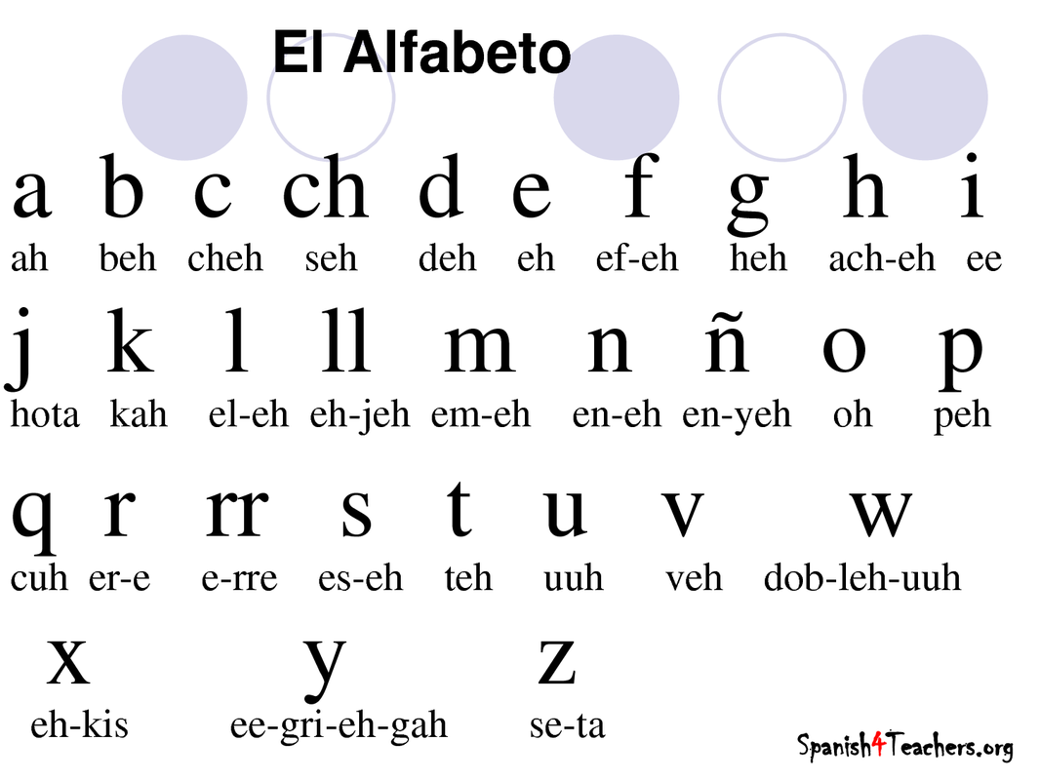
seh che
Que hago?
Repeat! Choral response.
Vol. 5

Slide 28
Vamos a Cantar!
https://www.youtube.com/watch?v=JUcu9PUh9_A

Slide 30
En tus pizarras – On Your Whiteboards
Write out the following words that will be spelled aloud in Spanish.
Que hago?
Writing
Volume 0
In seat

Slide 31
Ahora tu!
Take turns spelling 3 short words outloud for your shoulder partner
Write what your partner spells.
Que hago?
Speaking: Volume 2 In seat

Slide 32
How to Sound Less Like a Gringo
VOWELS
A –AH
E – A
I –EE
O – O
U – OO
Que hago?
Repeat! Choral response.
Vol. 5
Notes:
Repiten!

Slide 33
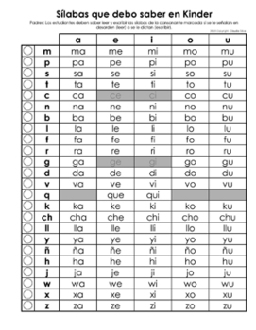
P
R
O
N
U
N
C
I
A
T
I
O
N
Que hago?
Repeat! Choral response.
Vol. 5
Notes:
Repiten

Slide 34
Say with your very best espaneesh accent…
Harrison
Chihuahua
Gordita
Vocales
Ciega
(how many syllables?)
Chicharon
Murciélago
Que hago?
Repeat! Choral response.
Vol. 5

Slide 35
Humuhumunukunukuapua
Que hago?
Group Discussion.
Raise hand to participate. Vol. 4
NL.1.1d Use words and phrases without awareness of grammatical structures
Notes:
Use the Spanish vowels

Slide 36
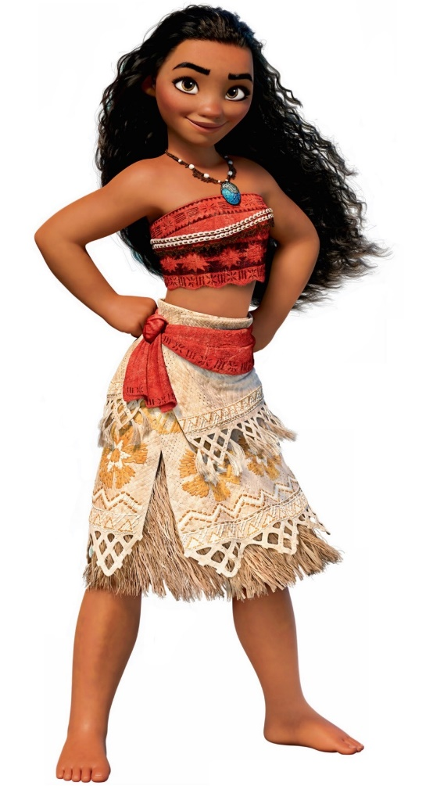
[ Chorus, Opetaia Foa'i] | [Translation from Tokelauan]
Aue, aue | Oh! Oh!
Nuku i mua | There is land up ahead
Te manulele e tataki e | A bird in flight to take us there
Aue, aue | Oh! Oh!
Te fenua te mālie | This beautiful land
Nae ko hakilia mo kaiga e | The place I was looking for, we will make our home
Que hago?
Group Discussion.
Raise hand to participate. Vol. 4
NL.1.1b Imitate modeled words and phrases using intonation and pronunciation

Slide 37
How to Sound Less Like a Gringo
G is hard unless followed by an E, then it sounds like an H.
The G goes?
Gorda, Angel, Grosería, Fuego, Gema, Agarrar, Gemir
NL.4.1c Recognize different pronunciation and intonation of individual words and basic phrases

Slide 38
How to Sound Less Like a Gringo
Emphasize the vowels, not the consonants
J sounds like H (Joven)
Y sounds like E (Yvonne)
Emphasize words on the accents: Dondé?
D sounds like Th
R sounds like D (Debora)
RR makes the rolling noise (Arriba!)
LL = Y or Sh (Quesadilla)
C sounds like S at the word’s beginning (el cine vs taco)
V=B
H is Always Silent (Hola!)
NL.4.1c Recognize different pronunciation and intonation of individual words and basic phrases

Slide 39
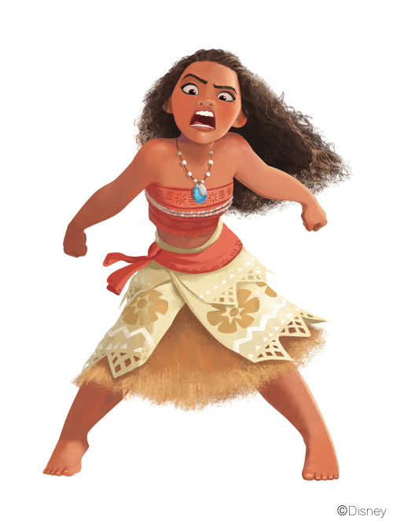
Don’t get frustrated just yet.

Slide 40
Show off that tongue and talk fast!

Slide 41
TRABALENGUA Practice saying the following tongue twisters correctly to your partner
Compadre, coco no compro porque el que poco coco come, poco coco compra. Como poco cococomo, poco coco compro.
Pepe Pecas pica papas con un pico, con un pico pica papas Pepe Pecas.
El bebé bebe bebidas con burbujas.
https://www.spanishdict.com/guide/tongue-twisters-in-spanish
Que hago?
Speaking: Volume 2 In seat

Slide 42
DOL: ESCRIBE Write the 5 words that I spell on your paper.
1.
2.
3.
4.
5.

Slide 43
DOL: ESCRIBE Write the 5 SPANISH words that I spell on your paper.
1. TACO
2. CUBA
3. QUE
4. DEALBA
5. PANTERA

Slide 46
HAZLO AHORA
Match the time of the day with the appropriate greeting used at that time.
1) Buenos dias a)anytime
2) Buenas noches b) 2pm
3) Hola c)8am
4) Buenas tardes d)11pm
Fill in the blank telling the teacher's name in Spanish. Then write out a COMPLETE SENTENCE in SPANISH telling me your name.
1) La profesora ____ _________ Maestra DeAlba. Y tú, como te llamas?
2) _____________________________________________________
Que hago?
Writing
Vol. 0

Slide 47
BIENVENIDOS A Nuestra Clase! EspaÑol 1
Hoy es el quince (15) de Agosto 2018
Que hago?
Group Discussion.
Raise hand to participate. Vol. 4
Notes:
You’ll need reading materials for a warmup, a copy of the ABCs handout Whiteboards and markers if possible

Slide 48
OBJETIVO/DOL
OBJ: LLWBAT recognize cognate pairs and the rules they follow (NL 4.1B)
DOL: 100% of LLW record 4 Spanish/ English cognate pairs, the rule they follow, and one false cognate with 80% proficiency.
How much Spanish do we already know?
IB Attitude: Thinkers
Que hago?
Group Discussion.
Raise hand to participate. Vol. 4

Slide 49
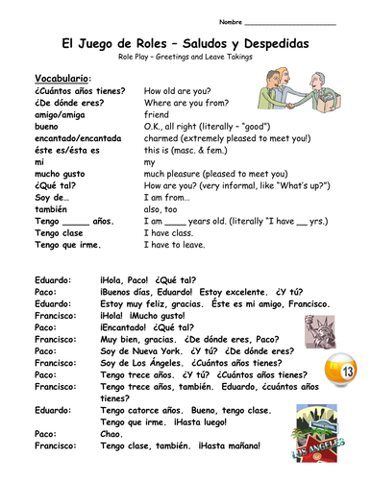
Que hago?
Partner Discussion. Vol. 2

Slide 50
Cognates? ¿Cognados?
A cognate is a word that shares a root, making it sound or look like the word in English.
It often (but NOT ALWAYS!) has a similar meaning.
Que hago?
Note-taking
Vol. 0

Slide 51
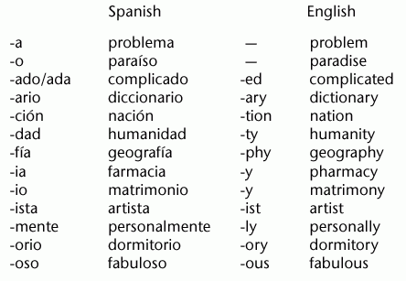
Cognates
Que hago?
Note-taking
Vol. 0

Slide 52
How much Spanish do you already know? ¿Cuánto Español ya sabe?!
Exact times
to watch:
0- 0:36
1:00-1:25
Stop! create the
sentence (repeat!)
1:25-1:50
:36- 1:00

Slide 54
Similarities Similaridades
crear, dedicar, indicar, demostrar, iniciar
general, social, final, natural, animal, nacional
plástico, elástico, alcohólico, tóxico, metálico
superior, color, favor, autor, profesor, doctor
espacio, especial, estricto, estudiar
#11 definitivo, positivo, colectivo, relativo, primitivo
#12 mínimo, máximo, equilibrio, museo, petróleo
-ate → -a
-al → -al
-ic → -ico
-or → -or
s- → es-
-ive → -ivo
–um → -imo

Slide 55
Cognates
Grupo 1 – Words that end in –tion (ie nation)
>>>cion
Grupo 2 – Words that end in –ous (ie suspicious)
>>>oso
Grupo 3 – Words that end in –ity (ie anonymity)
>>>idad
Grupo 4 – Words that end in –ly (ie really)
>>>realmente
NL.4.1b Recognize some simple structures in the target language that differ from their own language
Que hago?
Group Discussion.
Vol. 3

Slide 56
asistir, carta, pan, ropa, largo, mayor, once, éxito, embarazada http://www.brycehedstrom.com/wp-content/uploads/2011/09/THE-POWER-OF-COGNATES-Sample.pdf
FALSOS AMIGOS

Slide 57
DOL
DOL: LLW record 4 Spanish/ English cognate pairs, the rule they follow, and one false cognate with 80% proficiency.

Slide 58
El silabo
The Syllabus

Slide 60
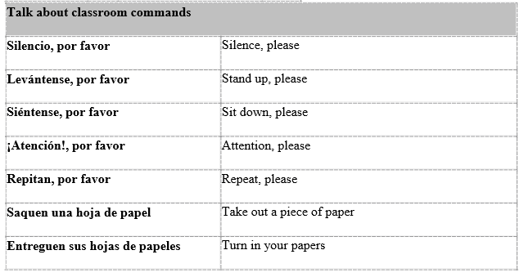

Slide 61
BIENVENIDOS A Nuestra Clase! EspaÑol 1
Hoy es el diecisiete(17) de Agosto 2018
Que hago?
Group Discussion.
Raise hand to participate. Vol. 4
Notes:
You’ll need reading materials for a warmup, a copy of the ABCs handout Whiteboards and markers if possible

Slide 62
OBJETIVO/DOL
OBJ: LLWBAT recall vocabulary related to the classroom (NL 1.1B)
DOL: Given 10 vocabulary words, 100% of LLW recall and match 8/10 definitions.
What vocab do we need for the classroom this year?
IB Attitude: Communicators
Que hago?
Group Discussion.
Raise hand to participate. Vol. 4

Slide 63
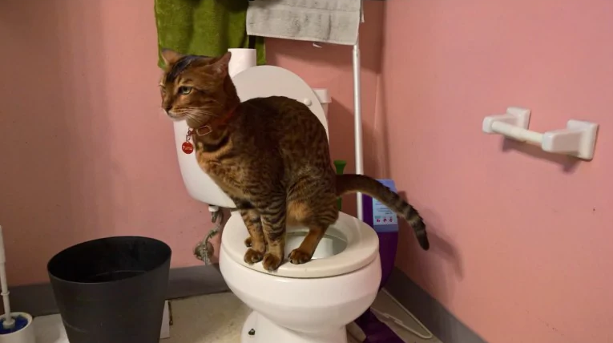
Necesito usar el baño! / Puedo ir al baño?

Slide 64
Necesito agua!

Slide 66
Vocabulario- las materiales
El lápiz - pencil
El Bolígrafo – ballpoint pen
El Libro - book
El Cuaderno - notebook
La Carpeta - binder
El Pupitre (OR…) El escritorio - desk
La Hoja de Papel – piece of paper
La regla – ruler
Las tijeras - scissors
El reloj - clock
El pegamento - glue
El mapa - map
La mochila - backpack
La cinta -tape
El sacapuntas - sharpener
La computadora - computer

Slide 67
Vocabulario- las materiales
La calculadora - calculator
El diccionario - dictionary
El calendario -calendar
Engrapadora -stapler
Borrador - eraser
Pizarra - whiteboard
La pantalla - screen
El teclado - keyboard
La basura - trash
La bandera - flag
El cartel - poster
El ratón - mouse
Que hago?
Note-taking
Vol. 0

Slide 68
Nouns!/¡Sustantivos!
In Spanish, nouns can either be masculine or feminine
Nouns ending in “-o” generally are masculine
Nouns ending in “-a” generally are feminine
Nouns ending in consonants can be either…and have to be memorized!
Nouns need articles!
Masculine: El, Los
Feminine: La, Las
Que hago?
Note-taking
Vol. 0

Slide 69
¿Cómo se dice…?
On your whiteboard

Slide 70
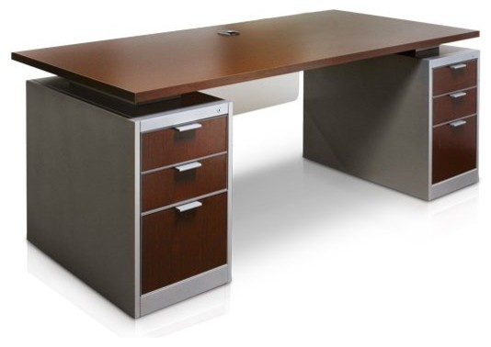
Que hago?
writing
Vol. 0

Slide 81
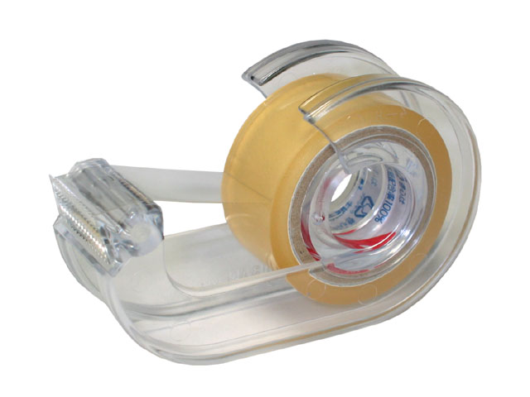

Slide 85
¿Que está a dentro de tu mochilla?
DRAW A BACKPACK
List 6 classroom things you might find in your backpack.

Slide 86
Simon dice simon says

Slide 87
DOL - Matching
Reloj
Lapiz
Mochila
Papel
Pizarra
Computadora
Boligrafo
Maestro
Pupitre
Cuaderno
Desk
Paper
Notebook
Pen
Computer
Whiteboard
Pencil
Teacher
Clock
Backpack

Slide 88
DOL - Matching
Reloj - clock
Lapiz - pencil
Mochila –backpack
Papel - paper
Pizarra -whiteboard
Computadora - computer
Boligrafo -pen
Maestro -teacher
Pupitre -desk
Cuaderno -notebook
Desk
Paper
Notebook
Pen
Computer
Whiteboard
Pencil
Teacher
Clock
Backpack

Slide 92
Warm-Up
On a piece of paper, list at least 3 reasons why, in general, learning a second language is important.

Slide 93
Objective and DOL
Objective: SWBAT to explain the importance of second language acquisition in this day and age, and how it impacts their lives.
DOL: Given multiple choice and short-answer questions, SW demonstrate the importance of SLA in this day and age, and how it impacts their lives

Slide 94
Brainstorming!
Why is learning a second language important???

Slide 95
Why is learning a second language important?
According to Kaushanskaya, et al: “…in English-Spanish bilinguals, higher self-reported reading skills in Spanish were associated with higher English reading-fluency scores…” (But not for English-Mandarin bilinguals!)
Strength in an increasingly global economy (according to the ACTFL): “it is a growing reality that American students are losing a competitive edge in the business world because they lack skills in other cultures.”
A second language opens up an entirely new world!

Slide 96
Mi Viaje a Costa Rica!
https://www.facebook.com/KellenDeAlba/media_set?set=a.10156430098185070&type=3

Slide 97
Popularity of Languages
Top 3 languages spoken world wide?
Chinese (Mandarin) – 1.8 Billion
Spanish – 414 Million
English – 335 Million
Top 3 languages spoken in the U.S.A.?
English – 231 Million
Spanish – 37 Million
Chinese (Cantonese) – 2.8 Million

Slide 98
Write, Group, and Share!
Individually, write 1 or 2 ideas about how improving Spanish will impact your life or personal goals.
In groups of 4, share your ideas with your group. Synthesize your ideas down into one main idea for your group. Each group must have one!
Be prepared to share with, and explain to the class!

Slide 99
Si Se Puede! - You can do it!
Man learns Spanish online in 6 months - https://youtu.be/6xelYTrDESI

Slide 100
How long does it take to learn a new skill?

Slide 101
DOL
What does learning a second language allow one to do?
Have better reading fluency
Get better grades in school
Go on more dates
How is second language acquisition affecting American students?
Taking time away from studies in more important áreas, such as science and math
Forcing them to think in a more global context.
The lack of SLA results in less competitiveness in the business world.
What are the most popular languages spoken in the United States, in order?
How can second language acquisition help you reach your own goal(s) for this year?

