Slide 1
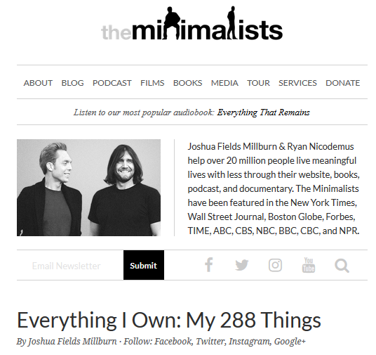
Warmup - Traduce! Translate the following numbers into written Spanish
33 -
Life Tools & Accessories. items, including my car, guitar, books, hairbrush, toothbrush, etc.
18 -
Furniture items, including my bed, couch, coffee table, desk, chairs, etc.
50 -
Dress Clothes. items, including suits, ties, dress shirts, etc.
79 -
Casual clothes. Items, including jeans, hoodies, T-shirts, button-down shirts, etc.
288 -
https://www.theminimalists.com/288/

Slide 2
Warmup - Traduce! Translate the following numbers into written Spanish
Treinta y tres
Dieciocho or diez y ocho
Cincuenta
Setenta y nueve
Dos cientos ochenta y ocho
33 -
Life Tools & Accessories. items, including my car, guitar, books, hairbrush, toothbrush, etc.
18 -
Furniture items, including my bed, couch, coffee table, desk, chairs, etc.
50 -
Dress Clothes. items, including suits, ties, dress shirts, etc.
79 -
Casual clothes. Items, including jeans, hoodies, T-shirts, button-down shirts, etc.
288 -
https://www.theminimalists.com/288/

Slide 3
Bienvenidos a nuestra clase de español 1
Hoy es el veinte y siete de Agosto
Anuncios:
Tuesday is Seminar! (also Anime Club)
Wed 6-8pm Aug 29th – open house
29th is also picture day
TAREA – Quiz review worksheet
Check to see if you are missing work on Infinite Campus – Find it in CANVAS

Slide 4
Objetivo:
LLWBAT synthesize numbers and phrases into complete sentences. (WL1.2.b)
LLWBAT find the materials they need online for class.
DOL:
Given 5 sentence stems, 100% of Language Learners will synthesize numbers and phrases into complete sentences 4/5 times correctly.
LLW login to and explore all 4/4 programs.
IB Profile: Reflective
What are some easy ways to say how many of something there are?
How can I make up assignments in this class?

Slide 5
Bienvenidos a nuestra clase de español 1
Hoy es el veinte y siete de Agosto
Anuncios:
Tuesday is Seminar! (also Anime Club)
Wed 6-8pm Aug 29th – open house
29th is also picture day
TAREA – Quiz review worksheet

Slide 6
Objetivo:
LLWBAT synthesize numbers and phrases into complete sentences. (WL1.2.b)
LLWBAT find the materials they need online for class.
DOL:
Given 5 sentence stems, 100% of Language Learners will synthesize numbers and phrases into complete sentences 4/5 times correctly.
LLW login to and explore all 4/4 programs.
IB Profile: Reflective
What are some easy ways to say how many of something there are?
How can I make up assignments in this class?

Slide 7
Saquen sus pizarras por favor ☺

Slide 8
No hay nadie como tu!
Cuantas veces escuchas “HAY”
https://www.youtube.com/watch?v=tUGcWXYfCsY
Que hago?
Listening/Writing
Volume 0
In seat
Notes:
I THINK it’s 78

Slide 9
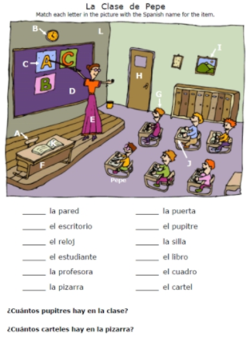
Cuántos -
Hay -
¿Cuántos
estudiantes hay?
Que hago?
Choral response
Volume 2
In seat

Slide 10
Write 2 Questions
¿Cuántos
_________hay?
Que hago?
Writing
Volume 0
In seat

Slide 11
Exchange boards
Write 2 answers
Hay # ________.
Que hago?
Writing
Volume 1
In seat

Slide 12
Quiz-Quiz-Trade
LOS NUMEROS
How to:
https://www.youtube.com/watch?v=o4n60DpwYOg
Middle 2 rows make a rectangle around the desks. Outside rows, surround and face them.
Every one gets a flashcard.
Quiz your partner, then teach if they get it wrong.
30 seconds – treinta segundos, then outer ring switches clockwise.
Use sentences stem… “Cuantos hay?” Respond with Hay….#.
Que hago?
Standing,
speaking Spanish
Volume 2
Notes:
Every one gets a paper, write a number on one side and the translation on the back. Middle 2 rows make a rectangle around the desks. Outside rows, face them.

Slide 15
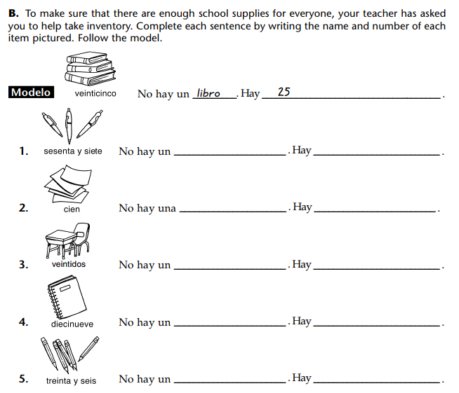
DOL 1
Makeup if you did not complete yesterday
Que hago?
Writing
Volume 0
In seat

Slide 16
Ordering Dialogue Warm Up
Lorenzo
Graciela
Igualmente.
¡Buenas noches! ¿Cómo te llamas?
Me llamo Lorenzo.
¡Hola! Me llamo Graciela. ¿Y tú?
Encantada

Slide 17
Ordering Dialogue Warm Up
Lorenzo -¡Buenas noches! ¿Cómo te llamas?
Graciela - ¡Hola! Me llamo Graciela. ¿Y tú?
Lorenzo -Me llamo Lorenzo.
Graciela-Encantada
Lorenzo-Igualmente. (likewise)

Slide 18
Bienvenidos a nuestra clase de español 1
Hoy es el veinte y ocho de Agosto
Anuncios:
Today is Seminar! (also Anime Club)
Tomorrow, 6-8pm – open house and is also picture day
Hiciste tu tarea? – due mañana

Slide 19
Objetivo:
LLWBAT find the materials they need online for class.
DOL:
LLW login to and explore all 4/4 programs.
IB Profile: Reflective
How can I make up assignments in this class?

Slide 20
Saquen las computadoras por favor ☺

Slide 21
Numbers Review
Kahoot
Small
https://create.kahoot.it/details/spanish-numbers/db3dad07-8829-49fa-ad65-6096761dae13
https://play.kahoot.it/#/k/db3dad07-8829-49fa-ad65-6096761dae13
Large
https://create.kahoot.it/details/numbers-in-spanish/73bf1fe8-057e-4f06-aae7-1288d6f868d0
https://play.kahoot.it/#/k/73bf1fe8-057e-4f06-aae7-1288d6f868d0

Slide 22

Login to Infinite Campus
Login: Lunch#
  Password: Dd051386
    Click Grades
      Click Spanish I
        What are you missing?
          Jot down the name and date of the missing assignment.

Slide 23
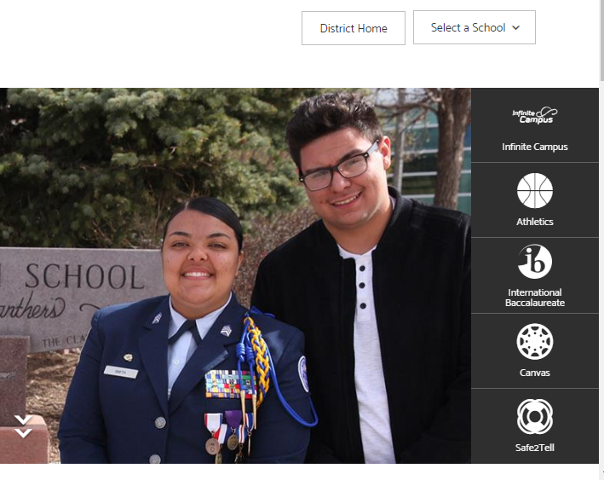
Login to CANVAS
Hsd2.org
Select a school
Click CANVAS icon
Login using same info
Click Spa 1
Click assignments
Online DOL2

Slide 24
Connect to school printer
Lower left corner, next to window symbol is the FIND box
Click there and type \\hhsnts1
Then search for printer LIB-4100 and click
LIB 4100 is a black and white printer in the back of the library by magazine rack.

Slide 25
Duolingo – create an account
Go to Duolingo.com
Create an account: P5Alex Santiago
Click your name, settings, then type in our class code. WZJGDZ
4 pts for a skill (1-12 lessons)
You may work on this at home or when we have a substitute. NOT DURING REGULAR CLASSTIME.
Notes:
If extra time.

Slide 26
DOL 2 - online
Where do you check your grade, attendance and missed assignments?
What’s the difference between kahoot.it and kahoot.com?
Where are my slides and DOLs?
Where is your printer?
How much extra credit can you get for a Duolingo Skill?

Slide 27
Saquen un papel por favor ☺

Slide 28
Objetivo:
NL 1.1 A, D. LLWBAT express time in Spanish.
DOL:
Given 5 numerical times, 100% of Language Learners will express those times in a Spanish sentence with 80% accuracy.
IB Profile: Thinkers
How do I express the time in Spanish?

Slide 29
¿Qué hora es?

Slide 30
Es la una.
  It’s one o’clock
Son las dos
  It’s two o’clock
Notes:
The verb ser is used when telling time. Use es when referring to one o’clock and son when referring to all other hours. The feminine article la/las is used before the hour because it is referring to la hora.

Slide 31
How! The verb ser.
  SER- TO BE
  We use ES for 1:00
  Es is the singular form of ser.
  We use SON for all other hours.
  Son is the plural form of ser.
  We use la/ las to express hours.
    La for 1:00
    La is the singular form
  We use las for all other hours
    Las is the plural form.

Slide 32

What’s la mean?

Slide 33
¿Que hora es?
  9:00 AM
  10:00 AM
  11:00 AM
  12:00 PM
  1:00 PM
  2:00 PM
  3:00 PM
  4:00 PM
  5:00 PM
Es la…. Son las…
  Son las nueve “ah-eme”
  Es la una “peh-eme”

Slide 34
Completar la frase...
________ la una. A. Es
Son ________ ocho. B. Son
______ las cuatro. C. La
Es ______ una. D. Las
_______ las seis.
_______ ______ una.
_____ ______ nueve.

Slide 35



Tiempo de día

Slide 36
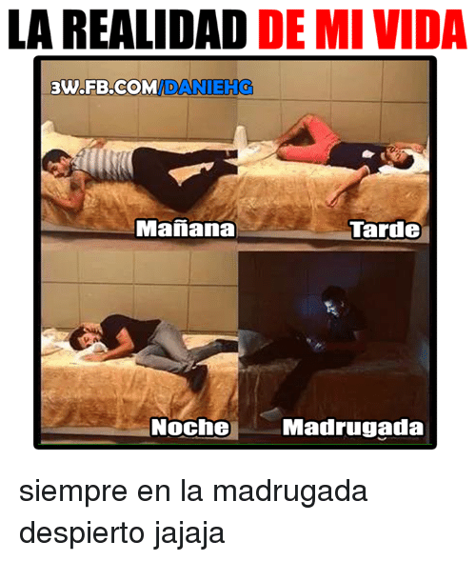

Slide 37
Escribe la hora y el tiempo de día
It is 11:00pm Son las ______ de la ________. (mañana, tarde, noche, madrugada)
It is 3:00am ________________________.
It is 12:00 pm ________________________.
It is 10:00 am _______________________.
It is 1:00 am Es la________ de la __________.
It is 4:00 pm ________________________.

Slide 38
Trade with your partner – check their work
It is 11:00pm Son las once de la noche. (mañana, tarde, noche, madrugada)
It is 3:00am Son las tres de la madrugada.
It is 12:00 pm Son las doce de la tarde.
It is 10:00 am Son las diez de la mañana.
It is 1:00 am Es la una de la madrugada.
It is 4:00 pm Son las cuatro de la tarde.

Slide 39
Saquen sus relojes por favor ☺

Slide 40
MILITARY TIME
Many Spanish-speaking countries use MILITARY TIME or a 24 HOUR clock
13:00
14:00
15:00
16:00
17:00
18:00
19:00
20:00
21:00
22:00
23:00
24:00/ 00:00

Slide 41
SWBAT interpret the time when given.
Es la ______ y ______
Son las ________ y ______
  It’s ____(Time)____
Example: Es la una y cinco
  It’s one o’five (1:05)
Notes:
¿

Slide 42

SWBAT interpret the time when given.
Es la ______y________
Notes:
¿

Slide 43
SWBAT interpret the time when given.
Es la una y cinco
Notes:
¿

Slide 44
Convert the times from a 24 hour clock to a 12 hour clock .
Son las veintitrés.
14:00
Son las trece.
16:00
18:00
Son las vientiuno
22:00
Son las once en la noche
Son las dos de la tarde
Es la______ de la______.

Slide 45
DOL: Convert the times from a 24 hour clock to a 12 hour clock .
Son las veintitrés.
14:00
Son las trece.
16:00
18:00
Son las vientiuno
22:00
Son las once de la noche
Son las dos de la tarde
Es la una de la tarde.
Son las cuatro de la tarde.
Son las seis de la tarde.
9:00pm – Son las nueve de la noche
Son las diez de la noche.

Slide 48
Warmup:
Son las ______ y_____ de la_______.
4:13pm
7:10pm
9:23am
10:04pm
1:09 am

Slide 49
Warmup:
Son las ______ y_____ de la_______.
4:13pm
7:10pm
9:23am
10:04pm
1:09 am
Son las cuatro y trece de la tarde
Son las siete y diez de la noche
Son las nueve y veintitrés de la mañana
Son las diez y cuatro de la noche
Es la una y nueve de la mañana

Slide 50
Bienvenidos a nuestra clase de español 1
Hoy es el veinte y nueve de Agosto
Anuncios:
Quiz mañana – open note

Slide 51
Objetivo:
NL 1.1 A, D. LLWBAT express time in Spanish.
DOL:
Given 5 numerical times, 100% of Language Learners will express those times in a Spanish sentence with 80% accuracy.
IB Profile: Thinkers
How do I express the time in Spanish?

Slide 52
Saquen un papel por favor ☺

Slide 53
¿Qué hora es?

Slide 54
Para expresar la hora y minutos
  At 30 minutes = “y media”
Notes:
Minutes can be added to the hour by saying “y” meaning “and”

Slide 55

SWBAT interpret the time when given.
Notes:
¿

Slide 56
SWBAT interpret the time when given.
Es la una y media
Notes:
¿

Slide 57


SWBAT interpret the time when given.
  Y cuarto= quarter past
  Cuarto para las= a quarter until

Slide 58

Son ____ para la _____.
Notes:
¿

Slide 59
  Example: Son cinco para la una.
Notes:
¿

Slide 60
¡En voz alta!
Son las cuatro y media
Son cuarto para las tres.
Son las siete y cuarto
Son las seis y media
Es la una y quince
Son las doce y media
Son cuarto para las diez.
4:30
2: 45
7:15
6:30
1:15
12:30
9:45

Slide 61
2:56
4:40
9:47
10:51
12:55
Son cuatro para las tres.
Son ______ para las ____.

Slide 62
2:56
4:40
9:47
10:51
12:55
Son cuatro para las tres.
Son veinte para las cinco.
Son trece para las diez.
Son nueve para las diez.
Son cinco para la una.

Slide 63
SWBAT interpret the time when given.
  To say something occurs at a specific time, use the formula es
  a+ la(s) + Time
    La clase es a las 2:05

Slide 64
Completar la frase
The game is at 4:30pm
El partido es a las cuatro y media de la tarde.
The party is at 11:00pm
La fiesta ______________________.
The movie is at 9:05pm
La película _____________________.

Slide 65
Telenovelas
    Create a TV guide for the week’s top shows
      Make up your own Novelas/Spanish TV shows or use your favorite shows
      Schedule 3 shows for the morning, 3 for the afternoon, and 3 for the evening
      Create a chart with the name of the show and the time written in complete sentences in Spanish
      Add military times in Spanish
Notes:
- Diferentiation: schedule for the week top three shows in morning, midday, afternoon

Slide 66
DOL – Turn in paper TODAY
Write the following times out in Spanish (complete sentences):
1) 2:20 2)10:15 3) 6:40 4) 10:30
Write the numerical representations of this time:
  5) Es la una y media
6) Unscramble the following to write out how you ask what time it is:
  Euq raoh se?

Slide 67
Tarea Due Today – Hand it in & then we will peer grade

Slide 70
Bienvenidos a nuestra clase de español 1
Hoy es el treinta de Agosto
Anuncios:
Saquen sus carpetas y computadoras
Please quietly get out your notes and laptops. You have 5 minutes to prep and review.
We’re taking a quiz online.

Slide 71
Quiz on Nearpod
https://share.nearpod.com/ZY2bYroLGP

Slide 72
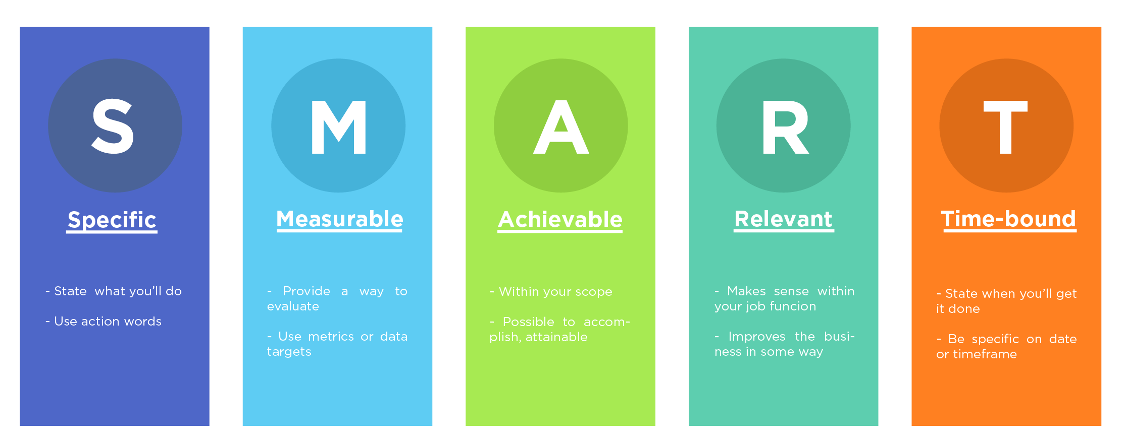
Metas - Goals

Slide 73
Numbers Review eStop! Game
“Declaro la guerra en contra de mi peor enemigo que es…” https://www.youtube.com/watch?v=jjpbsgu3Daw

Slide 74
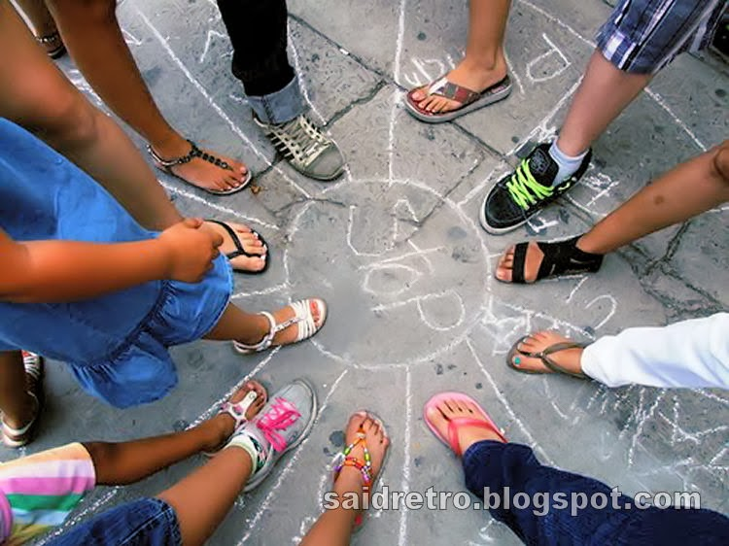
Stop! Game
“Declaro la guerra en contra de mi peor enemigo que es…”
Find your color group
Make a 2 circles on the paper and divide the outer one into countries. One in the middle. Puro español!

Slide 77
Mi Viaje a Mexico
Saquen sus computadoras y vayan a Nearpod por favor

Slide 78
Mi Viaje a Mexico
https://share.nearpod.com/QRMYnwgMGP

