Slide 1
HAZLO AHORA
1)¿Cuál es la fecha hoy?
2)¿Cuántos días hay en una semana?
Write the corresponding season for the following.
3) Colorado Springs, Julio
4) Japon, Diciembre
5) Argentina, Junio
6) Australia, Enero

Slide 2
Bienvenidos a Nuestra Clase
Español 1
Hoy es lunes, el diez de septiembre

Slide 3
OBJETIVO Y DOL
OBJ: LLWBAT use weather patterns in combination with season vocabulary.
DOL: Given 5 images, 100% of LLW write the weather that is occuring in that location based on the season listed with 80% accuracy.

Slide 4
Repaso de calendario: Line Ups!
Be the first team to order yourself in the correct way for the months, days of the weeks and days of the months!

Slide 5
Saquen un papel por favor!
https://youtu.be/8E0XIF2uJCQ (begin 3:20)

Slide 6
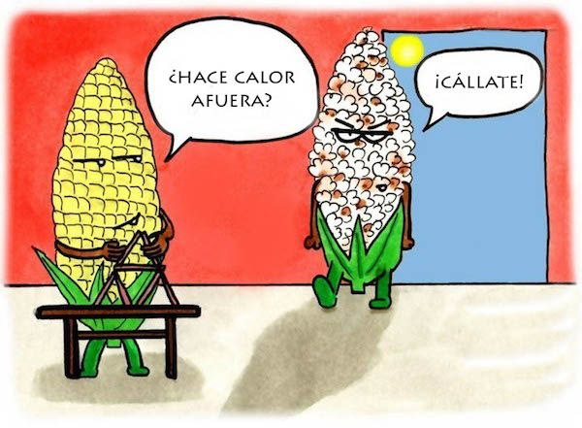

Slide 7
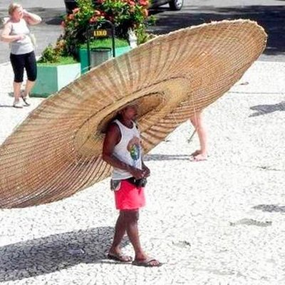
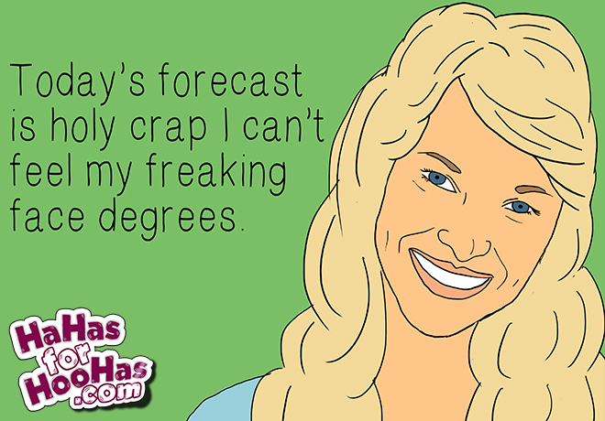
Como esta el clima hoy?
Esta bonito afuera. – It’s beautiful outside.
Esta feo afuera. – It’s nasty outside.
Hace (mucho) calor. – It’s (really) hot.
Esta templado/agradable. – It’s warm/nice.
Esta fresco. – It’s cool/fresh.
Hace frio. - It’s cold.
Esta helando – It’s freezing.

Slide 8
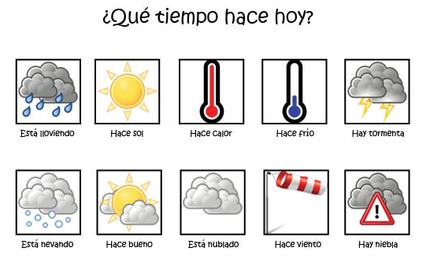
Hace buen tiempo. Hace mal tiempo
Esta soleado
Esta agradable

Slide 9
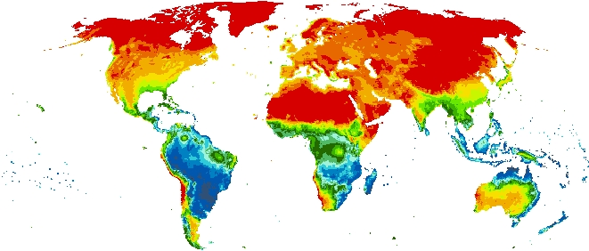
Esta lloviendo o puedes decir…
Tromba – the rain dumps then stops suddenly Lluvia en el mundo:
Aguacero – river of rain
Lloviendo a cantaros – buckets of rain
Llovizando – regular rain
Granizando – hailing or sleeting
Pringando – light rain
Chispiando - sprinkling
Salpicando – light sprinkling
El chipi chipi – just a few drops of rain here an there

Slide 10
El prognostico del tiempo
https://youtu.be/gOw8Yr3-qA0
Saquen sus pizarras por favor

Slide 11
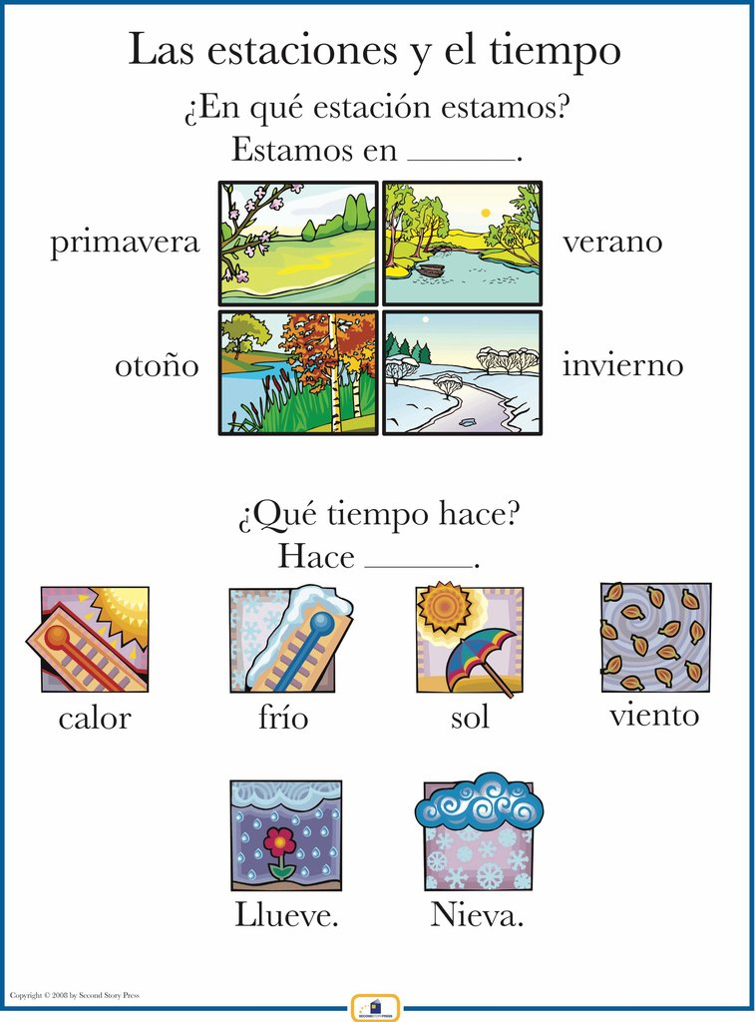

Slide 12
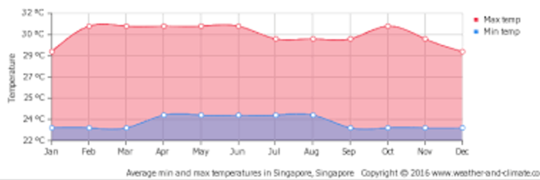
Máximo , mínimo
Hay un máximo de _______ y un mínimo de ____

Slide 13

En Singapore en _________ hay un máximo de _______ y un mínimo de ____.

Slide 14
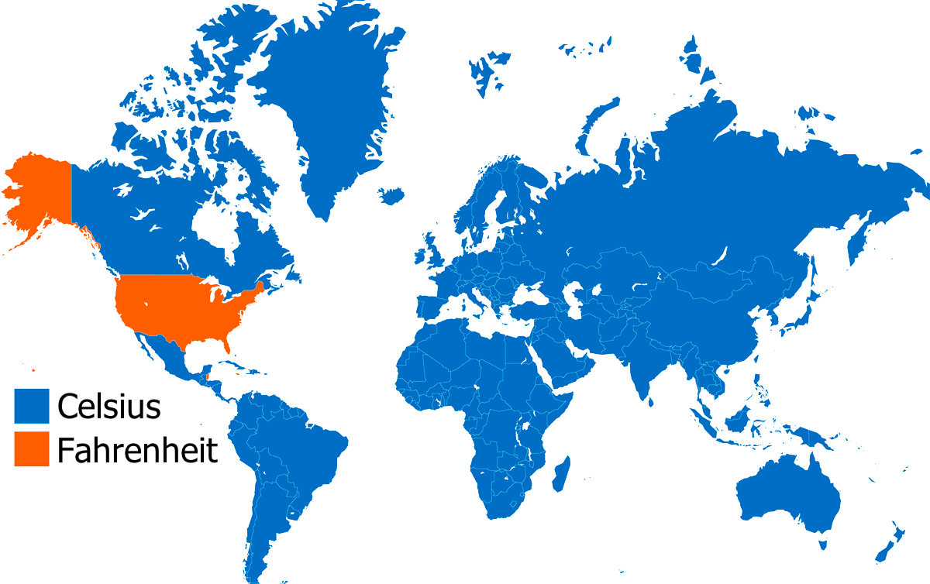
CELSIUS VS FAHRENHIET

Slide 15
Check for Understanding (Pg. 19, activity 1)
Listen to the following descriptions
On whiteboards, write numbers 1-6
Write the letter of the picture that best matches the descriptions listed.
Notes:
Script for the listening portion

Slide 16
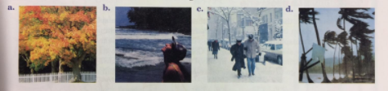
http://media.pearsonschool.com/realidades/mp3s/level1/ch00/L1_pe_act_8.mp3

Slide 17
¿Que tiempo hace en…?
What is the weather in…
Look at the locations and the seasons to determine what they weather most likely is on the following slides.
Write your response in a complete sentence on your whiteboard

Slide 18
¿Qué tiempo hace…
En _lugar___ + en __estacion____?
Hace _tiempo_ en _lugar__ + en __estación__.

Slide 19
¿Qué tiempo hace…
En Chicago en el invierno?
Hace frío en Chicago en el invierno.

Slide 20
¿Qué tiempo hace…
En Colorado en septiembre?
Hace viento en Colorado en septiembre.

Slide 21
¿Qué tiempo hace…
en el North pole en invierno?
Nieva en el North Pole en invierno.

Slide 22
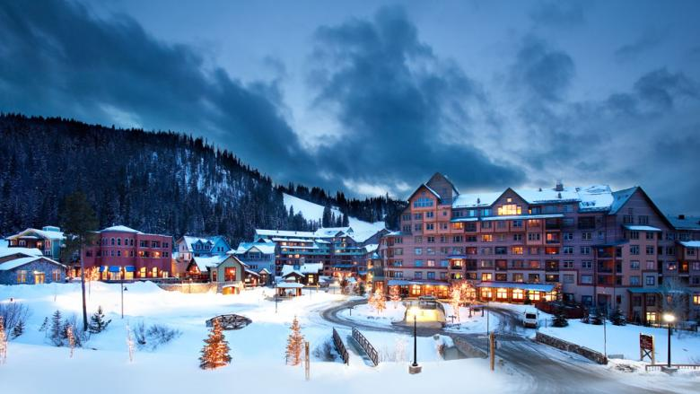
DOL: using sentence stems, write out complete sentences for the following pictures
Winter Park, febrero

Slide 23
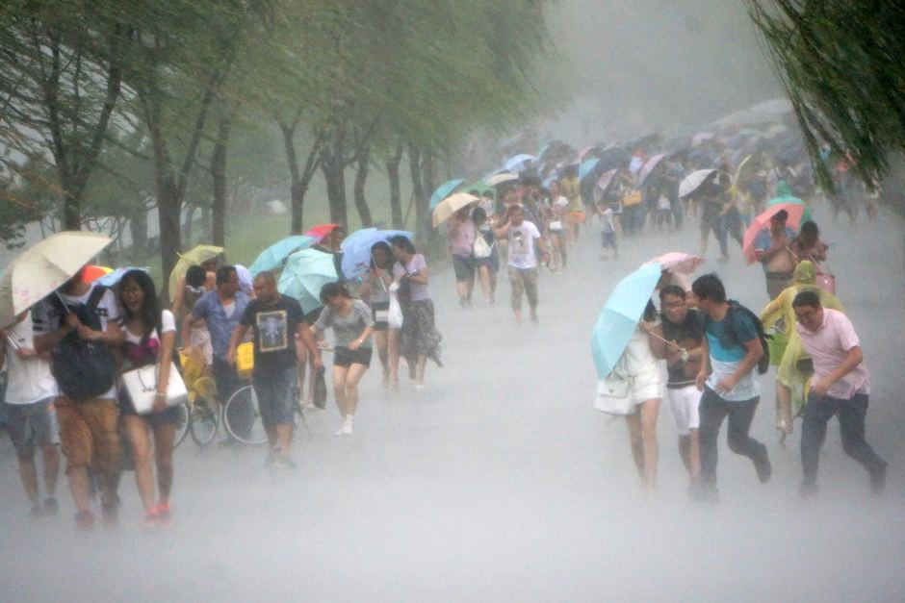
DOL: using sentence stems, write out complete sentences for the following pictures
Tokyo, verano

Slide 24
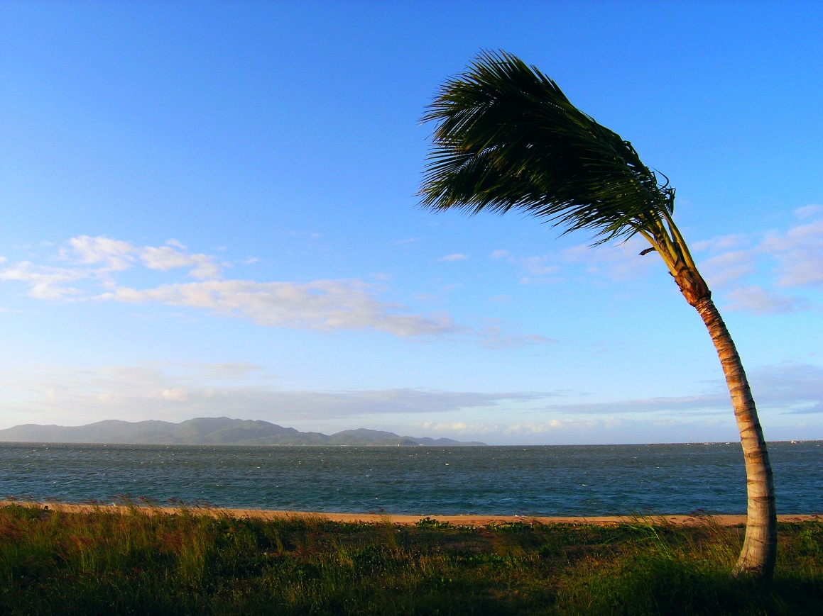
DOL: using sentence stems, write out complete sentences for the following pictures
Hawaii, Agosto

Slide 25

DOL: using sentence stems, write out complete sentences for the following pictures
Pennsylvania, primavera

Slide 26

DOL: using sentence stems, write out complete sentences for the following pictures
Paris, diciembre

Slide 27
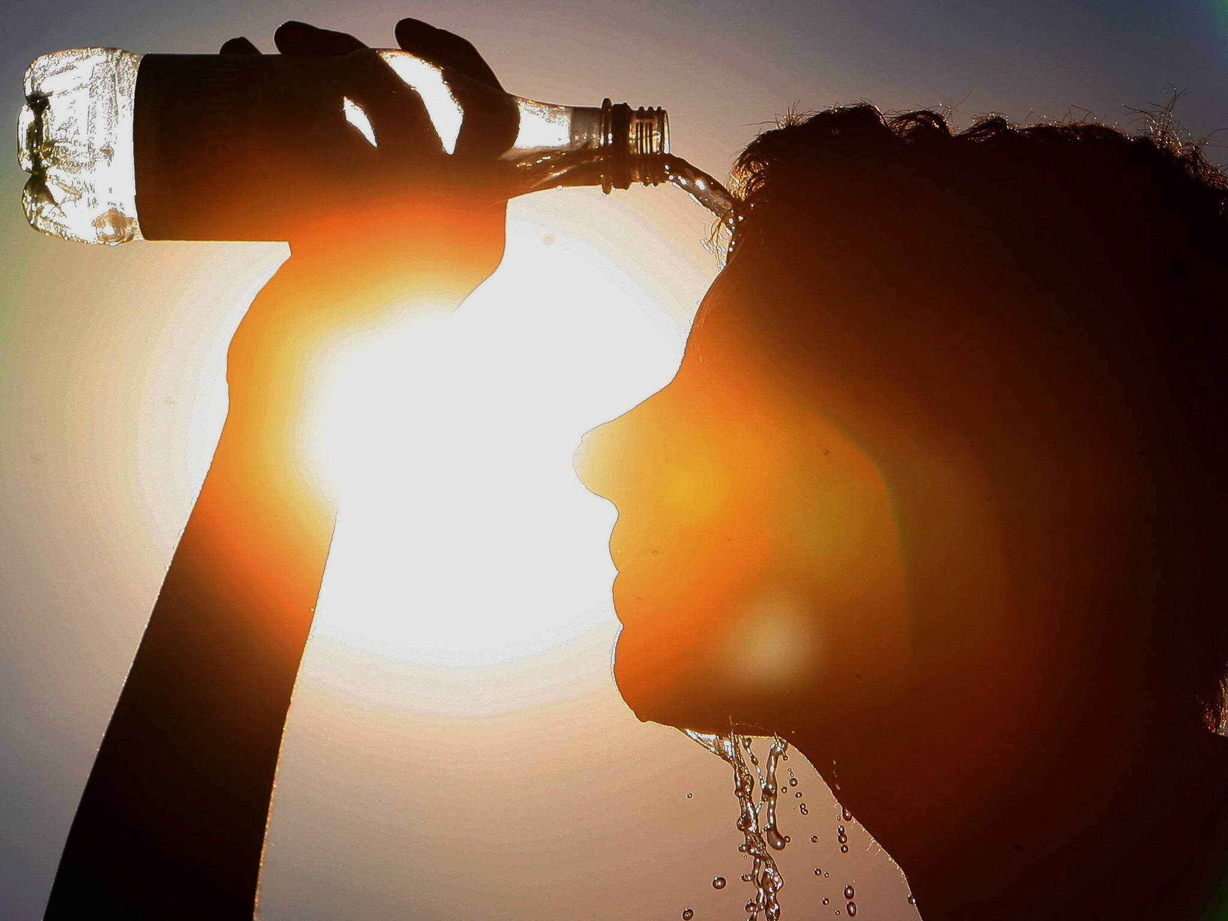
DOL: using sentence stems, write out complete sentences for the following pictures
Los Ángeles, junio

Slide 29
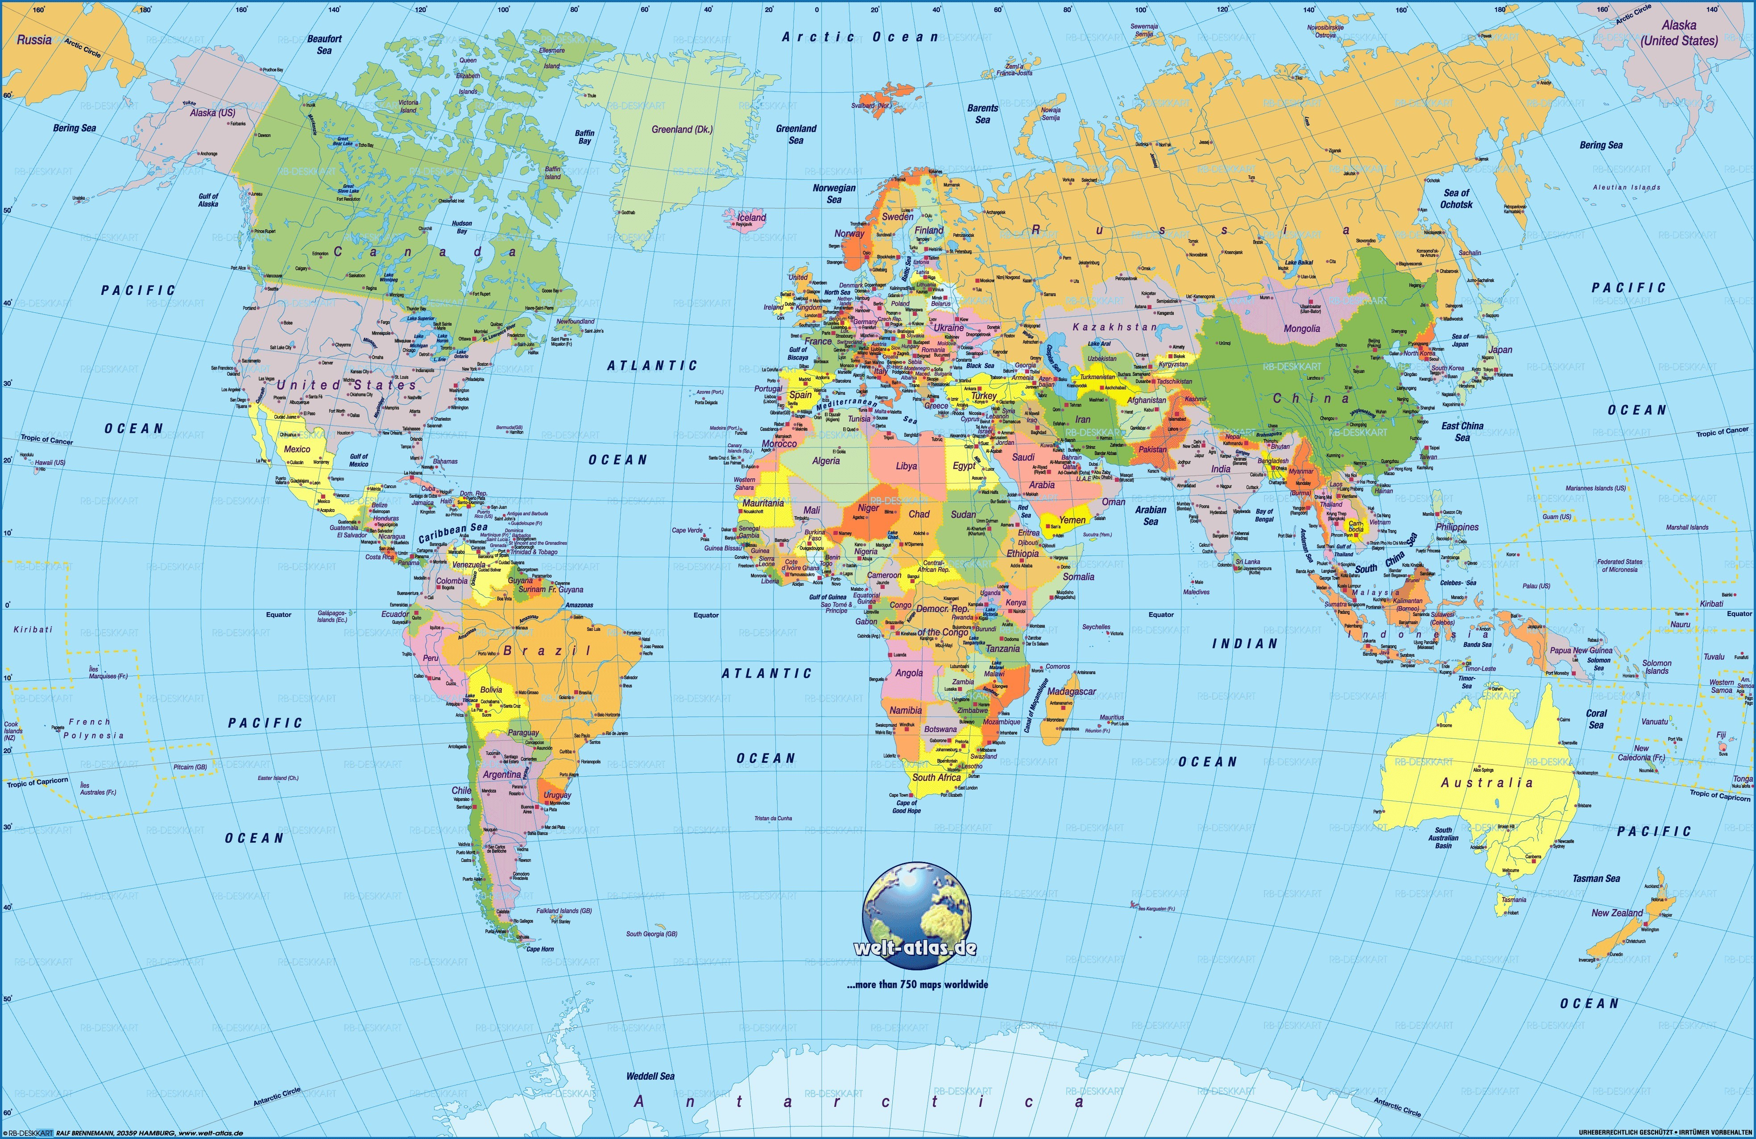
Find your assigned group and
choose a city for your weather project.

Slide 30
Bienvenidos a Nuestra Clase
Español 1
Hoy es martes, el once de septiembre

Slide 31
OBJETIVO Y DOL
OBJ: LLWBAT use dates, seasons and weather in a presentation.
DOL: Given a rubric, 100% LLW choose a location around the world and research their weather as well as other topics for specific dates to give a presentation to the class with 90% accuracy.

Slide 32
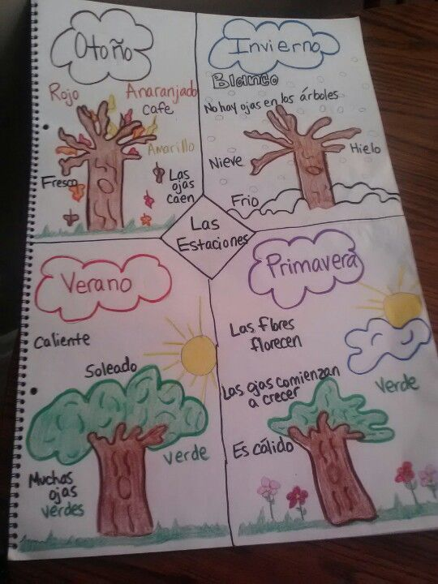
Graphic Organizer:
Create a season graphic organizer
In your notes,
depicting what each season
looks like to you
Label the weather patterns that
represent each season

Slide 33
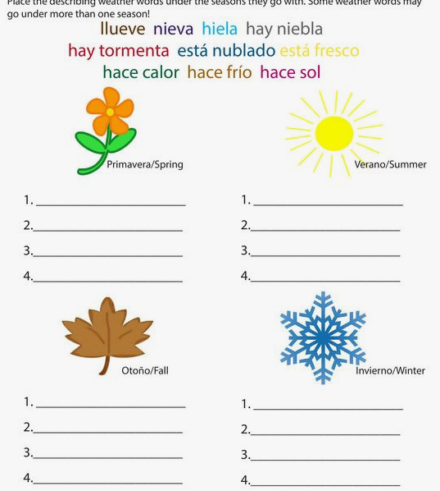

Cancion:
https://youtu.be/CDCWOGMwabs

Slide 34
¿Qué temperatura hace?
La temperatura es de
[número]
grados”
Es de 95 grados
Farenheit.
(Es de 35 grados
Centígrado.)
Es de 32 grados
Farenheit.
(Es 0 grados
Centígrado.)

Slide 35
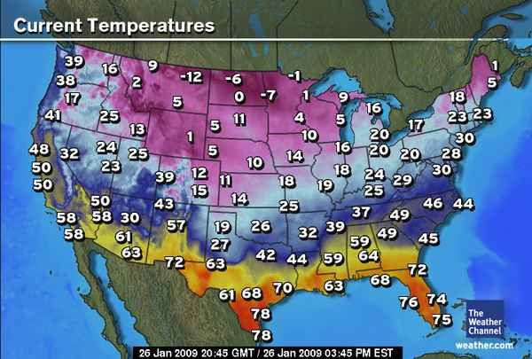
SWBAT identify and describe the weather and seasons.
1NL.1.e Answer simple questions about very familiar topics.
1NL.1.d Use words and phrases without awareness of grammatical structures.
In your notes, write sentences describing the weather based on the map you see. Then, share with partner.
“En Colorado Springs,
…”
Notes:
(see p 19 act 2)

Slide 36
.
SWBAT identify and describe the weather and seasons.
1NL.1.e Answer simple questions about very familiar topics.
1NL.1.d Use words and phrases without awareness of grammatical structures.
In your notes, write sentences describing the weather based on the map you see. Then, share with partner.
En Miami,
…..
Notes:
(see p 19 act 2)

Slide 37
In your notes, write sentences describing the weather based on the map you see. Then, share with partner.
En Tulsa…
Notes:
(see p 19 act 2)

Slide 38
CONVERSIONS
Fahrenheit = Celsius × 1.8 + 32
What is our conversion from Fahrenheit to Celsius.
Celsius = (Farhenhiet- 32) / 1.8
Convert the following
Presentation temperatures MUST be in degrees centigrade

Slide 39
Weekly Weather Forecast
Viernes (Hoy) | Sábado | Domingo | Lunes | Martes | Miércoles | Jueves

Slide 40
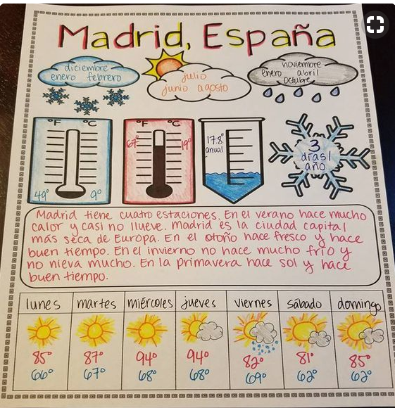
POSTER
REQUIREMENTS
Name of location
Seasonal information
/weather patterns
Highs and lows of seasons
Annual rainfall/ snowfall
Weekly weather
forecast
-highs/lows for each day
-Weather image
-days of the week
Cultural fact

Slide 41
ORAL PORTION- In Spanish!
Present your poster in Spanish .
Present two days of weather in Spanish and include the date.
Additional Requirements:
Each person must speak.
Visually appealing and neat.

