Slide 1
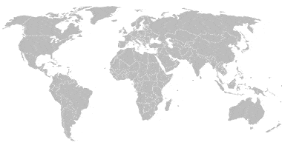

Slide 2
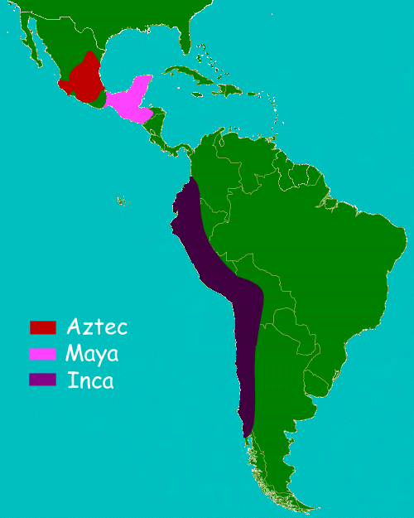

Slide 3
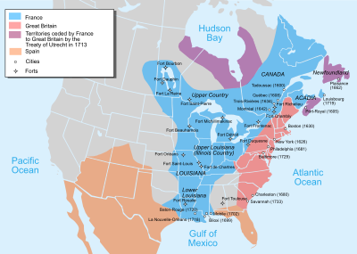

Slide 4
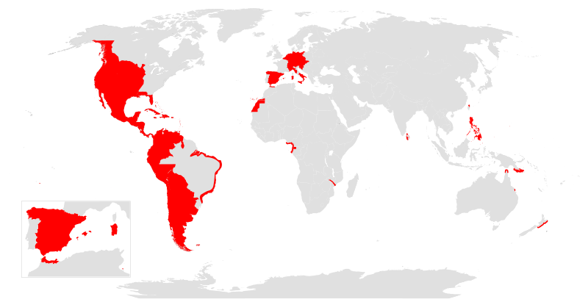
The Spanish Empire

Slide 5
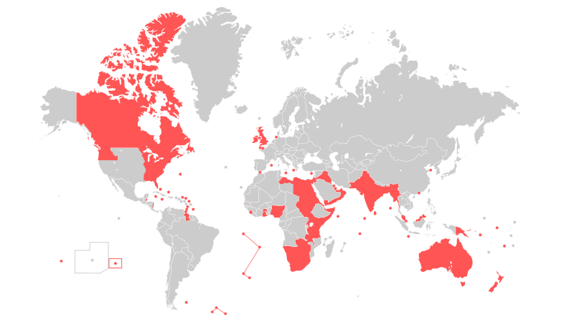
The British Empire

Slide 6
“Somos mas americanos”
https://www.youtube.com/watch?v=qsOPbN8ViEg
Knowing this history, does this effect your opinon of immigration?
ESTADOUNIDENSES - UNITED STATESERS.

Slide 7
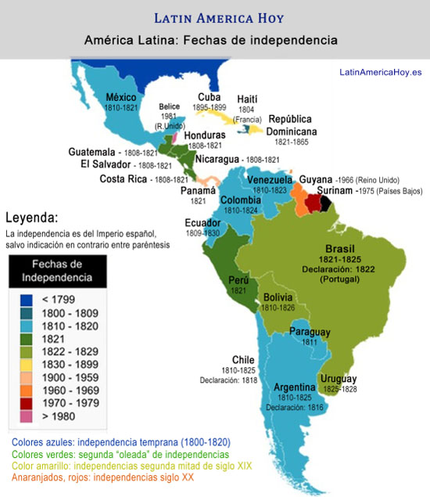

Slide 8
Video - EL GRITO DE INDEPENDENCIA
https://www.youtube.com/watch?v=C-0aiEhaHtM&disable_polymer=true
Versión mejor:
https://www.youtube.com/watch?v=fdMx5a5LxQA

