Slide 1
ORGANIZAR: PLEASE TAKE THIS TIME TO ORGANIZE YOUR BINDERS AND STORE THE ASSIGNMENTS BEING HANDED BACK. I HAVE EXTRA DIVIDERS. THERE ARE 5 UNITS TOTAL. WE HAVE JUST FINISHED UNIT 1.

Slide 2
BIENVENIDOS A NUESTRA CLASE
ESPANOL 1
Hoy es martes, el veinticinco de septiembre

Slide 3
ANUNCIOS
GRADES ARE IN – PLEASE CHECK YOUR GRADE. MAKEUP WORK IS ACCEPTED AT A 10% DISCOUNT.
SEMINAR IS TODAY AFTER SCHOOL
WE WILL BE DOING TEST CORRECTIONS AND PROGRESS MONITORING TODAY
DON’T FORGET TO FIND AND WRITE ABOUT A SPANISH-SPEAKING EXPERIENCE THIS WEEK – MI SELFIE CULTURAL IS DUE VIERNES.
There’s only 2 weeks left in this quarter!

Slide 4
LA ESTRELLA DEL DIA

Slide 5
DICHO DE LA SEMANA

Slide 6
Notaste algo diferente en tu pupitre?

Slide 7
TEST CORRECTIONS
You will earn half the value of each question (so half a point for MC and one point for open response) if you:
Write the correct answer
Explain why it was correct
Turn in your corrections this week

Slide 8
Progress Monitoring & Grade Checks
Keep your progress monitoring papers in the very front of your binder, so you can review your goals daily.
If you STILL can’t access Infinite Campus or CANVAS, ask for help and I will try once myself, then add your name to a list for the technician/district IT.
SELF- ADVOCATE! El interés tiene pies.
If you’re totally done and sooo bored, login to my italki.com account. ddealba@hsd2.org Harrison1

Slide 10
HAZLO AHORA
¿Cuales son las cuatro estaciones en español? Write down the four seasons in Spanish:
The Spring-
The winter-
The summer-
The fall-
¿Que te gusta hacer?
Talk about two activities in English that you like to do in each season.

Slide 11
BIENVENIDOSA NUESTRA CLASE ESPAÑOL 1
Hoy es miércoles el veintiséis de septiembre

Slide 12
Objective:
LLWBAT recognize vocabulary expressing activities and categorize the type of verb they are. (1NL.1.e, 1NL.2.a,1NL.1.d)
DOL
Given 10 matching , 100% of LLW recognize vocabulary about activities and correctly categorize its ending with (10/10 proficiency)

Slide 13
ANUNCIOS
DON’T FORGET TO FIND AND WRITE ABOUT A SPANISH-SPEAKING EXPERIENCE THIS WEEK – MI SELFIE CULTURAL IS DUE VIERNES.
There’s only 1 week left in this quarter! – I’m sending an email on Sunday to the parents of students with D’s and F’s. Get that makeup in.

Slide 14
LA ESTRELLA DEL DIA

Slide 15
TIME | ACTIVITY
5 MINUTES | WARM UP
10 MINUTES | INTRODUCTION TO NEW VOCABULARY
5 MINUTES | ACT IT OUT! CFU
5 MINUTES | INM Infinitive verbs
5 MINUTES | Chart- POST IT??
5 MINUTES | CFU: WHITEBOARDS
5 MINUTES | Practicar en línea
10 Minutes | Que hacen los españoles? Que haces tu?
5 MINUTES | DOL

Slide 16
LLWBAT recognize vocabulary expressing likes/dislikes leisure activities. (1NL.1.e, 1NL.2.a,1NL.1.d)
¡Vocabulario!
Highlight words/definitions
Do a motion
Notes:
1. The whole class will fold the paper together
2. Pass out scissors- one per row. Give students 3 minutes to make the cuts.

Slide 17
bailar
to dance

Slide 18
ver la tele/ peliculas
to watch television/ movies

Slide 19
cantar
to sing

Slide 20
usar la computadora
to use the computer

Slide 21
correr
to run

Slide 22
trabajar
to work

Slide 23
dibujar
to draw

Slide 24
tocar la guitarra (un instrumento)
to play the guitar (an instrument)

Slide 25
escribir cuentos
to write stories

Slide 26
practicar deportes
to practice sports

Slide 27
escuchar música
to listen to music

Slide 28
patinar
to skate

Slide 29
esquiar
to ski

Slide 30
pasar tiempo con amigos/ salir con amigos
to spend time with friends/ go out with friends

Slide 31
hablar por teléfono
to talk on the phone

Slide 32
nadar
to swim

Slide 33
ir a …
to go to …
La escuela- school
el cine- the movie theater
De compras- shopping

Slide 34
jugar videojuegos
to play video games

Slide 35
montar en pantineta/ bicicleta
to skateboard/ bike ride

Slide 36
leer revistas
to read magazines

Slide 37
LLWBAT recognize vocabulary expressing likes/dislikes leisure activities. (1NL.1.e, 1NL.2.a,1NL.1.d)
Práctica:
Charades!
Row 1 vs Row 2
Row 3 vs Row 4
Designate a score keeper. You must say it in Spanish for your team to get the point.

Slide 38
Saquen una hoja de papel por favor ☺

Slide 39
What do all of these words have in common???

Slide 40
¡Infinitivos! (infinitives)
Most basic form of the verb
Infinitives in English infinitives have “to” in front of them: To skate, to write, to eat
In Spanish, infinitives are only one word and ALWAYS end in -ar, -er, or -ir.
patinAR, escribIR, comer
When you remove the ending you are left with the stem of the verb

Slide 41
Create this chart in your notes.
Categorize our new vocabulary
into the correct category
-AR | -ER | -IR
Dibujar
Ver
Escribir
Notes:
At this point, draw out this chart on the whiteboard, and ask about the ones that they came up with in their warm-up, and put those in the correct category

Slide 42
Create this chart in your notes.
Categorize our new vocabulary
into the correct category
-AR | -ER | -IR
Dibujar
Bailar
Escuchar música
Practicar deportes
Nadar
Esquiar
Ver la televisión
Correr
Escribir
Salir
Ir
Notes:
At this point, draw out this chart on the whiteboard, and ask about the ones that they came up with in their warm-up, and put those in the correct category

Slide 43
¡Practicar! Identify the stem of the verbs by eliminating the ar, er, ir ending.
http://www.spanishdict.com/topics/practice/29

Slide 44
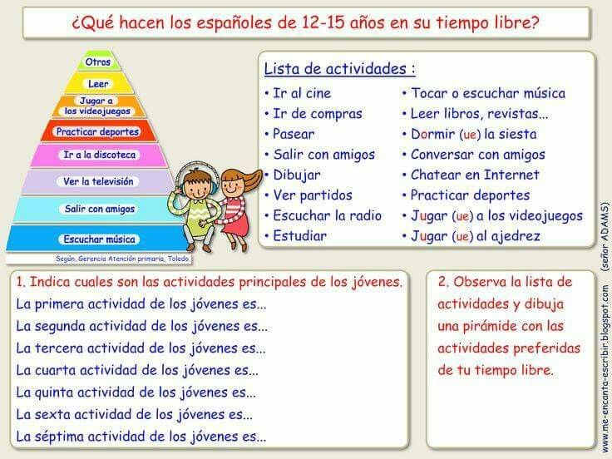

Slide 45
DOL: Write the following verb in spanish and underline its infinitive form ending
To dance
To practice sports
To draw
To watch televisión
To swim
To write
To run
To ski
To play
To listen

Slide 48
Hazlo ahora
LEER
Take turns reading outloud with your shoulder partner for 4 mins.

Slide 49
BIENVENIDOS A NUESTRA CLASE
Espanol 1
Hoy es jueves, el veintisiete de septiembre

Slide 50
Objective:
LLWBAT recognize vocabulary expressing activities and categorize the type of verb they are. (1NL.1.e, 1NL.2.a,1NL.1.d)
DOL
Given 10 matching , 100% of LLW recognize vocabulary about activities and correctly categorize its ending with (10/10 proficiency)

Slide 51
ANUNCIOS
DON’T FORGET TO FIND AND WRITE ABOUT A SPANISH-SPEAKING EXPERIENCE THIS WEEK – MI SELFIE CULTURAL IS DUE VIERNES.
There’s only 2 weeks left in this quarter! – I’m sending an email on Sunday to the parents of students with D’s and F’s. Get that makeup in.

Slide 52
LA ESTRELLA DEL DIA

Slide 53
Saquen sus pizarras y sus paquetes por favor

Slide 54
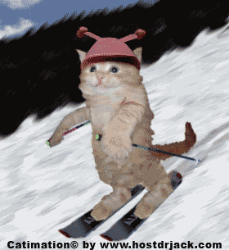
Esquiar
Notes:
CFU: Students write out the verb on their whiteboards

Slide 55
Escuchar la música
Notes:
CFU: Students write out the verb on their whiteboards

Slide 56
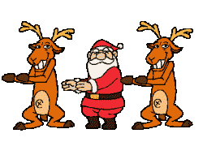
Bailar
Notes:
CFU: Students write out the verb on their whiteboards

Slide 57
Correr
Notes:
CFU: Students write out the verb on their whiteboards

Slide 58
usar
Notes:
CFU: Students write out the verb on their whiteboards

Slide 59
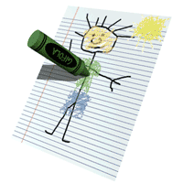
Dibujar
Notes:
CFU: Students write out the verb on their whiteboards

Slide 60
Hablar! Con tu pareja, hablen sobre lo que haces bien o mal…
Talk! (volumen 2)
With your partner discuss what you’re talented at or don’t do well.
Ex. Jugar basquetbol – BIEN!
Tocar la guitarra – Más o menos.
Esquiar – MAL.

Slide 61
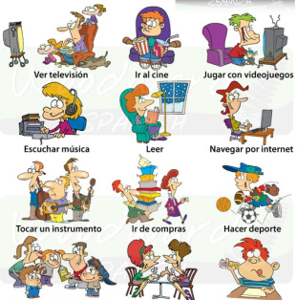

Slide 62
“GUSTAR”
HIGHLIGHT SUBRAYAR
TO LIKE

Slide 63
(A mí) no me gusta __ nada.
I don’t like ___ at all.

Slide 64
A mí tampoco.
Me neither.
(I don’t like to either.)

Slide 65
¿Qué te gusta hacer?
What do you like to do?

Slide 66
¿Qué te gusta más?
What do you like more?

Slide 67
¿Te gusta __?
Do you like ___?

Slide 68
¿Y a ti?
And do you?

Slide 69
ni…ni
neither…nor
not…or

Slide 70
o
or

Slide 71
y
and

Slide 72
pues...
well...

Slide 73
sí
yes

Slide 74
también
also, too

Slide 75
QUIZ QUIZ TRADE

Slide 76
¿Te gusta o no te gusta? Show a thumbs up or thumbs down.
Turn to your partner
and share a complete sentence.
A mi me gusta _____ A mi no me gusta _______. Be prepared to share
the sentence outloud

Slide 77
Vocal response! Volumen 3. Si me gusta! No me gusta!

Slide 87
Making Comparisons Saquen tu hoja de papel ☺
More than 5 mins left?

Slide 88
Me gusta futbol mas que el futbol americano.

Slide 89
No me gusta ni futbol ni el futbol americano.

Slide 90
¿Qué te gusta mas? Turn to your partner
and share a complete sentence.
A mi me gusta _____ mas.
OR
No me gusta ni _____ ni _______. Be prepared to share
the sentence outloud

Slide 95
DOL
1. jugar videojuegos
2. tocar la guitarra
3. (A mí) no me gusta __ nada.
4. ir a la escuela
5. hablar por teléfono
6. escuchar música
7. usar la computadora
8. ¿Te gusta __?
A. Go to school
B. use the computer
C. talk on the phone
D.Listen to music
E. Do you like…?
F. Play videogames
G. Play the guitar
H. I don’t like _____at all.
If this is too easy, escribe un párrafo!

Slide 98
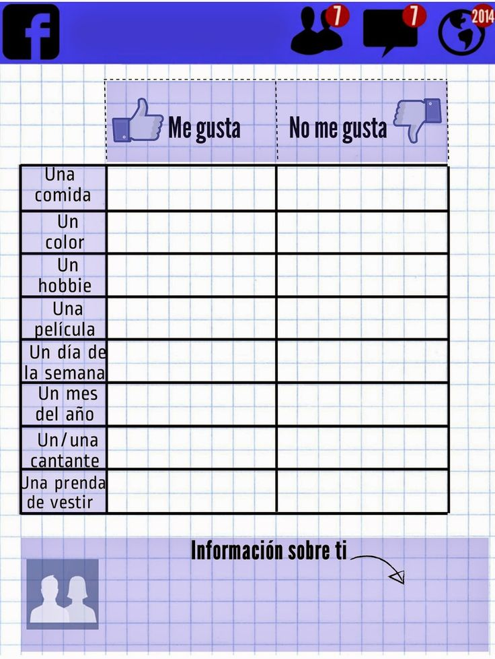
In a complete sentence,
fill in the
following chart
based on your
own likes/dislikes

Slide 99
BIENVENIDOS A NUESTRA CLASE
Espanol 1
Hoy es viernes, el veintiocho de septiembre

Slide 100
OBJETIVO Y DOL
LLWBAT use actions vocabulary in conjunction with seasons in Reading, writing and listening.
Given 5 prompts, 100% of LLW read, listen and write a response if they like to do that activity in that season with 90% accuracy.

Slide 101
ANUNCIOS
MI SELFIE CULTURAL IS DUE HOY! WARMUPS/DOLS DUE HOY.
There’s only 1 week left in this quarter! – I’m sending an email on Sunday to the parents of students with D’s and F’s. Get that makeup in.

Slide 102
LA ESTRELLA DEL DIA

Slide 103
Saquen tu papel de miercoles por favor

Slide 104
Me gusta futbol mas que el futbol americano.

Slide 105
No me gusta ni futbol ni el futbol americano.

Slide 106
In your notes, write 3 questions asking what someone likes more..
Que te gusta mas: _____ o ______?
Ex. Que te gusta mas: hamburguesas o pizza?
Once done, Exchange papers with the person next to you and answer the three questions.
Ex. Me gusta hamburguesas mas.
OR No me gusta ni Pizza ni hamburguesas.

Slide 107
LLWBAT recognize vocabulary expressing likes/dislikes leisure activities. (1NL.1.e, 1NL.2.a,1NL.1.d)
Práctica:
Write the 4 phrases on sticky notes
Me gusta
No me gusta
Me gusta mucho
No me gusta nada
Using the posters around the room, write a complete sentence to describe your like/dislike for the activity
Notes:
(Actividad 5) p. 30, Actividad 5---have 5 posters in room. Students write 5 sticky notes, one for each activity shown, and stick them on each category (1) me gusta, no me gusta nada, me gusta mucho, Me gusta , No me gusta ni ___ ni ____. They fill out complete sentence PLUS their name. Students will then share which they put their sticky notes on.

Slide 108
LLWBAT recognize vocabulary expressing likes/dislikes leisure activities. (1NL.1.e, 1NL.2.a,1NL.1.d)
Práctica:
Levantense!
Place the sticky notes on the posters your sentences describe
Notes:
(Actividad 5) p. 30, Actividad 5---have 5 posters in room. Students write 5 sticky notes, one for each activity shown, and stick them on each category (1) me gusta, no me gusta nada, me gusta mucho, Me gusta , No me gusta ni ___ ni ____. They fill out complete sentence PLUS their name. Students will then share which they put their sticky notes on.

Slide 109
Saquen una hoja de papel por favor

Slide 111
ESRCRIBIR Y HABLAR Create 4 questions about activities you like to do and the seasons you like to do them in. Ex: ¿Te gusta nadar en el invierno? Walk around the room and ask people questions when the music stops. Record their responses.

Slide 112
DOL LEER Y CONTESTAR LAS PREGUNTAS
1. Chet le gusta equiar y jugar en la nieve. Vive (he lives) en Alaska.
2. Miguel le gusta los meses junio, julio y agosto. Miguel le gusta cuando hace calor.
3. Sarah y Susana les gusta pasar tiempo con amigos. Ellos le gusta ir de compras y hablar por teléfono.
4. Mis amigos les gusta practicar deportes como futbol y béisbol. No pueden jugar (they cannot play) cuando esta lloviendo o nevando.
1. ¿Que estaciones no les gustan mis amigos?
2. ¿Que estación le gusta Chet?
3. ¿Qué actividades le gustan Miguel?
4. Does it matter what season it is for Susana and Sarah? Why or why not?

Slide 113
Unit 2 review
https://create.kahoot.it/details/01f7f1ad-4a7a-4829-8140-040331d18a6c

Slide 116
EXTRA SLIDES

Slide 117
HAZLO AHORA

