Slide 1
¡Hazlo ahora!
¿Como fue tu vacación? How was your vacation?
Piensa en dos personas que viste. Think of two people you saw.
¿Como son? Write a complete sentence (for each) describing them.

Slide 2
BIENVENIDOS A NUESTRA CLASE
ESPAÑOL 1
HOY ES LUNES, EL VEINTiseis de noviembre

Slide 3
OBJETIVO Y DOL
OBJETIVO: LLWBAT reorganize unit 2 sentences into a logical order [NL.1.1c, NL.1.e]
DOL: given 8 scrambled sentences from unit 2, 100% of llw reorganize them into a logical order 6/8 times correctly.

Slide 4

LA ESTRELLA DEL DIA

Slide 5
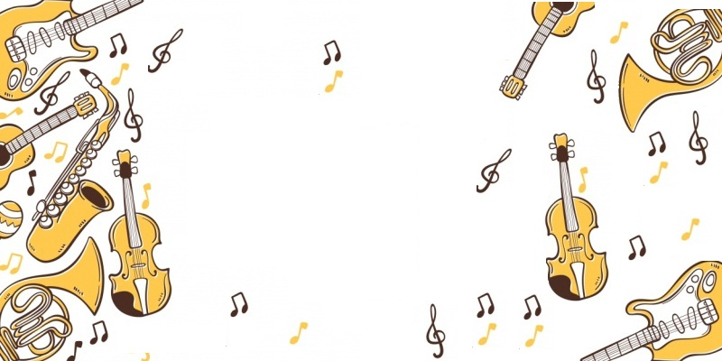
La canción del dia
Como se llama el artista?
Como se llama la canción?
Que tipo de música es?
reggaetón norteña/banda bachata
salsa pop latino cumbia samba
ska merengue bolero/mariachi
Rock/rap en español

Slide 6
¿Como eres tú?
What are you like?
Correct
form of ser
Subject pronoun
adjective
Yo
soy
inteligente

Slide 7
¿Como es ella?
What is she like?
Correct
form of ser
Subject pronoun
adjective
Ella
es
perezosa

Slide 8
Saquen sus pizarras y paquetes de unidad 2 por favor ☺

Slide 9

¿Como eres tú?

Slide 10
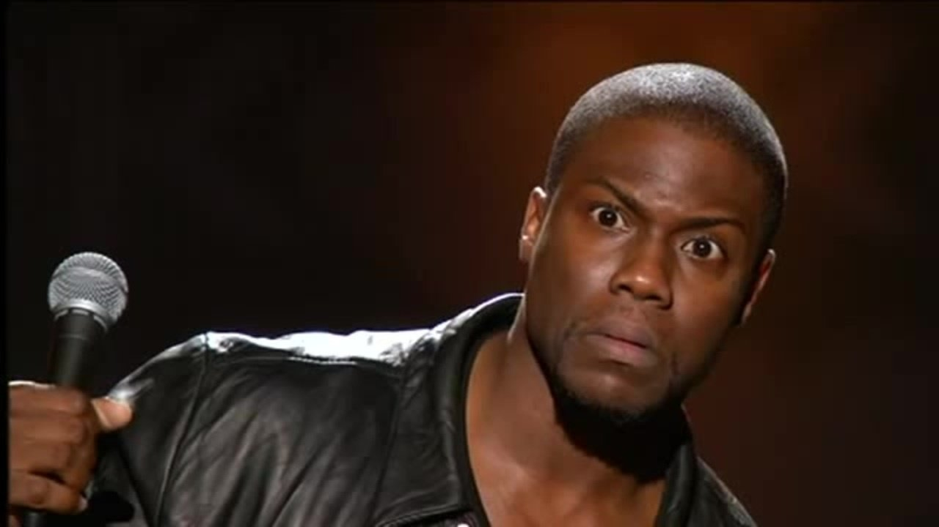
¿Como es?

Slide 11
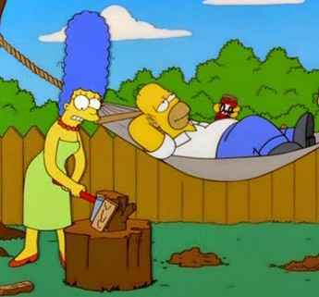
¿Como es El? ¿Como es ella?

Slide 12
¿Como son ellos?
What are they like?
Correct
form of ser
Subject pronoun
adjective
Ellos
son
graciosos

Slide 13
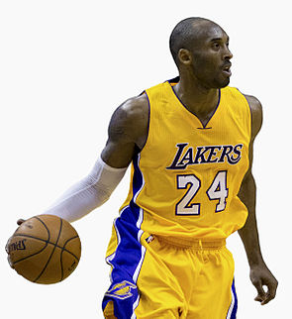
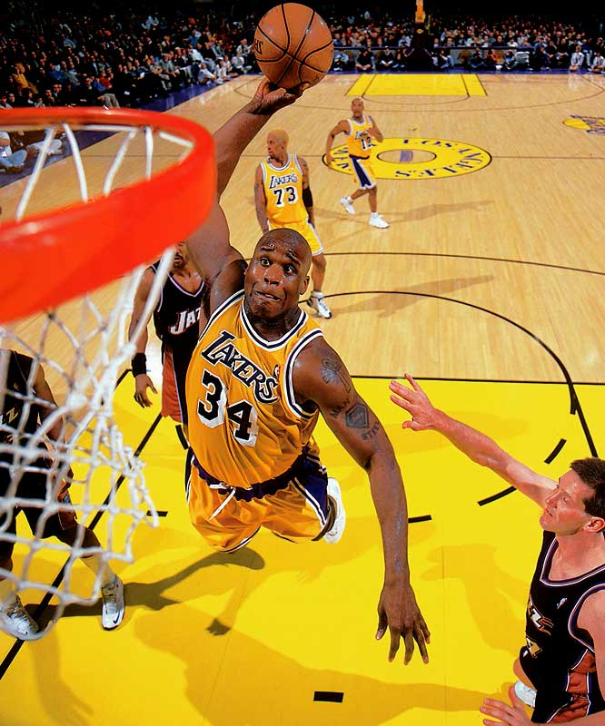
¿Como son?
Use the subject pronoun

Slide 14
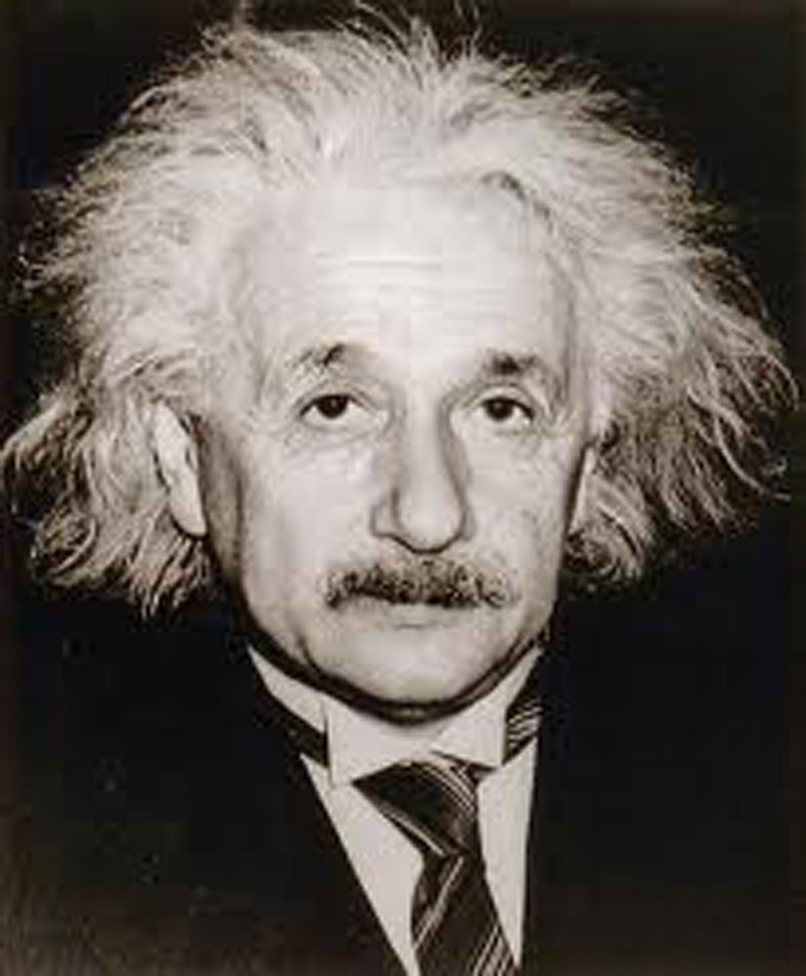
¿Como son?
+

Slide 15
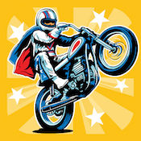
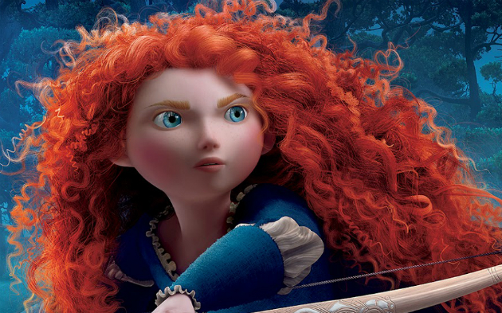
¿Como son?

Slide 16
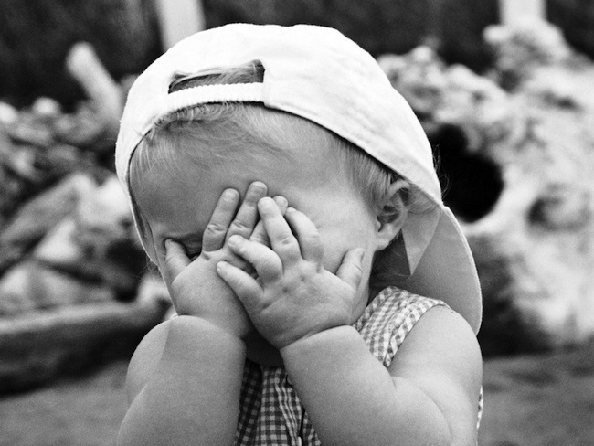
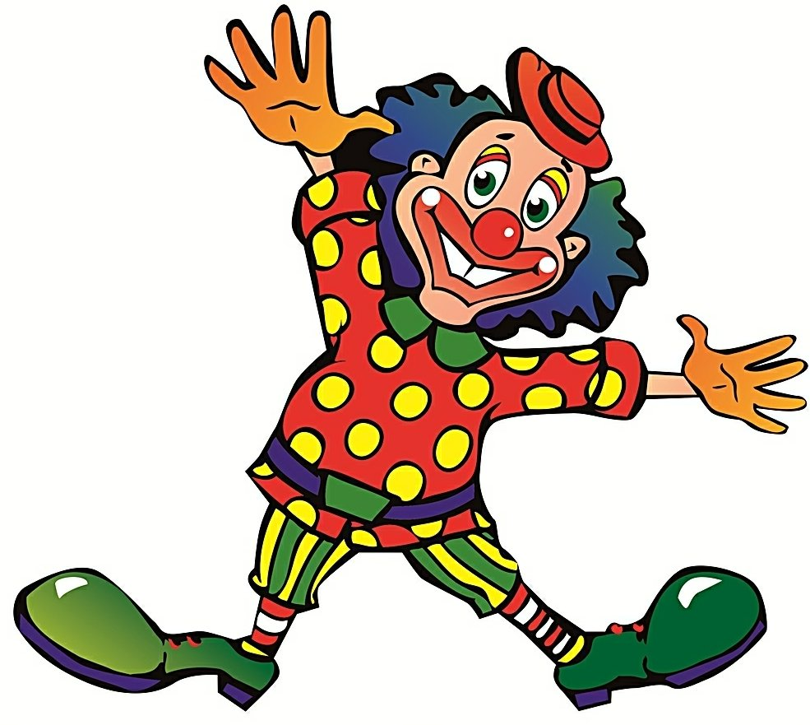
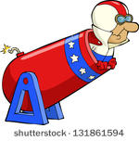
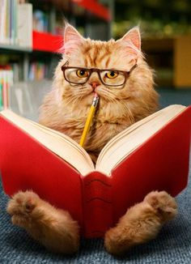

Slide 17
Unscramabling sentences
1. un estudiante Roberto serio es
2. deportistas chicos Carla y Román son unos
3. una es María alta chica.
4. bonitas chicas somos unas nosotras.
5. eres tú amigo un bueno muy .
6. atrevida muy chica una es no Kelly.
7. muy familia simpática es mi.
8. SOY YO chico FEO NO un.

Slide 18
Crea tu propio…
Create your own sentence scramble…
…Pass it to a partner to unscramble!

Slide 19
WORKSHEET
Let’s get as much as we can done today!
Tarea – Due Miercoles
Examen el Jueves – closed note
Traigan sus computadoras mañana

Slide 22
Abren las computadoras y vayan a nearpod.com por favor.
https://share.nearpod.com/JOuwq3KW8R

Slide 23
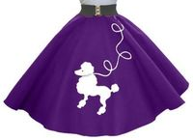
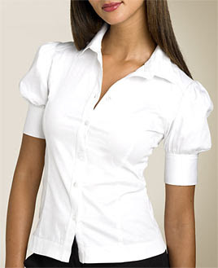

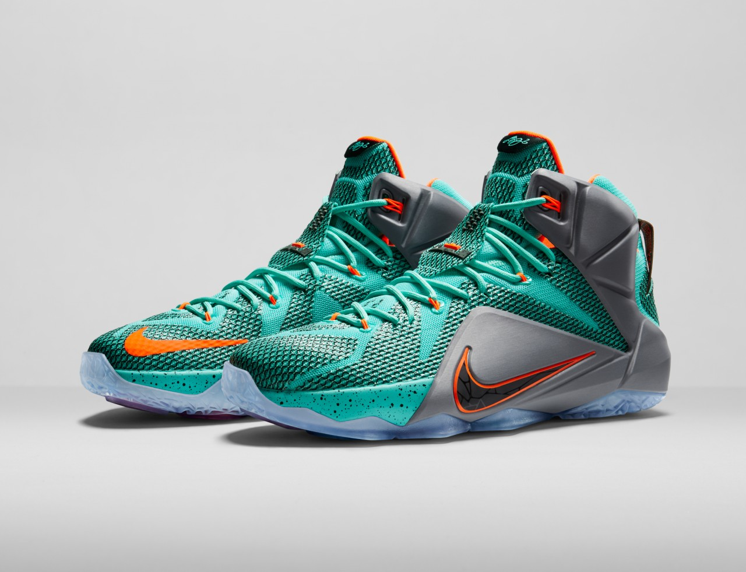
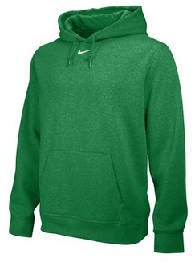
Repaso: Create a complete sentence stating if you like or dislike the following clothing

Slide 24
BIENVENIDOS A NUESTRA CLASE
ESPAÑOL 1
HOY ES LUNES, EL Veintisiete de noviembre

Slide 25
OBJETIVO Y DOL
OBJETIVO: LLWBAT identify vocabulary related to physical traits, personality traits, indefinite articles and clothing. [NL.1.1c, NL.4.1b]
DOL : Given 12 sentence fragments, 100% of LLW construct 6 basic sentences related to physical traits, personality traits, indefinite articles and clothing. with 100% accuracy.

Slide 26
What is a subject pronoun?

Slide 27
What is a subject pronoun?
Yo, tú, él, ella, usted, nosotros, nosotras, vosotros, ellos, ellas, ustedes

Slide 28
Name that subject pronoun…
1. Alex _______
2. Ezequiel y yo ___________
3. Jadan y Taylieh __________
4. Curtis, Jesse y Abby ________
5. Señor Lawrence __________
6. Tú y Daniel ____________
Practice quiz – you have 2 mins to put this in your notes. Show me on your fingers how many you got right.

Slide 29
Name that subject pronoun…
1. Alex ___él____
2. Ezequiel y yo ______nosotros_____
3. Jadan y Taylieh ____ellas______
4. Curtis, Jesse y Abby ____ellos____
5. Señor Lawrence (you formal) __usted/ud._____
6. Tú y Daniel ______ustedes______
Practice quiz – you have 2 mins to put this in your notes. Show me on your fingers how many you got right.

Slide 30
Repaso ser/ tener traduce/translate
Ser – to be
Tener – to have
I am | We are
You are | Thou art
He/she/it/sir is | They, you all are
I have | We have
You have | Thou hast
He/she/it/sir has | They, you all have

Slide 31
Repaso ser/ tener traduce/translate
Ser – to be
Tener – to have

Slide 32
SER VS. TENER:
Which would you use in each of these sentences.
Conjugate it correctly
Ella ________ alta.
Nosotros ____________ pelo liso y largo.
El chico _____________ una barba.
Yo __________ ojos marrones.
Los ojos ___________ verdes.
Yo _______ feo.
Tú ____ loco o qué?

Slide 33
Me gusta mucho ir a la escuela y leer libros.
1. Yo soy muy deportista
2. Ella es muy inteligente
3. Yo soy estudiosa
Ella le gusta practicar deportes.
1. Son muy atléticos
2. Es muy atlética
3. Soy muy fuerte

Slide 34
Es morena, alta y fuerte.
1. él es muy atrevido.
2. son muy deportistas.
3. ella es deportista y atrevida.
Nosotros nos gusta dibujar.
1. Nosotros somos inteligentes.
2. Nosotros somos artísticos.
3. Ustedes son estudiosos.

Slide 35
When a Word ends in an “o” it is –
When a Word ends in an “a” it is –
When a Word ends in an “s/es” it is talking about -
Repaso de gramatica

Slide 36
When a Word ends in an “o” it is – masculine
When a Word ends in an “a” it is – feminine
When a Word ends in an “s/es” it is talking about –plural/plural ending in a consonant

Slide 37
What is a definite article?

Slide 38
What is a definite article?
El, la, las, los

Slide 39
What is an indefinite article?

Slide 40
What is an indefinite article?
Un, una, unos, unas

Slide 41
Name that object…
El → un
La → una
Las → unas
Los → unos
https://www.youtube.com/watch?v=FD4MJmTEkeQ

Slide 42
Name the indefinIte/definite article
1. THE camisa _______
2. THE pantalones ___________
3. THE traje __________
4. A vestido________
5. A chaqueta __________
6. SOME sudaderas ____________
7. SOME pantalones cortos __________
Practice quiz – you have 2 mins to put this in your notes. Show me on your fingers how many you got right.

Slide 43
Name the indefinte/definte article
1. THE camisa ____la___
2. THE pantalones _____los______
3. THE traje ____el______
4. A vestido____un____
5. A chaqueta _____una_____
6. SOME sudaderas _______unas_____
7. SOME pantalones cortos _____unos_____
Practice quiz – you have 2 mins to put this in your notes. Show me on your fingers how many you got right.

Slide 44
MATCH THE SENTENCE
A. rizado
B. Zapatos azules
C. azules
D. un chico simpático
E. una chica atrevida
F. Camisa negra
H. rubia
i. son chicas inteligentes
J. Morados
K. ir a la escuela ni estudiar.
1. a MI ME Gustan LOS
2. El pelo de juan es
3. A mi no me gusta ni
4. El es
5. los ojos son
6. clara y maría

Slide 47
Warmup – contesta (answer)
Que te gusta hacer? What do you like to do?
Como eres? What are you like?
Que ropa llevas? What clothes are you wearing?

Slide 48
BIENVENIDOS A NUESTRA CLASE
ESPAÑOL 1
HOY ES miercoles, EL VEINTiocho de noviembre

Slide 49
OBJETIVO Y DOL
OBJETIVO: LLWBAT use personality trait vocabulary, conjugated forms of ser and subject pronouns in Spanish to describe people.
[NL.1.1c, NL.1.e
DOL: LLW write 5 complete sentences using personality trait vocabulary, conjugated forms of ser and the correct subject pronouns to describe people in a skit with 100% accuracy.

Slide 50
LA ESTRELLA DEL DIA

Slide 51
La canción del dia
Como se llama el artista?
Como se llama la canción?
Que tipo de música es?
reggaetón norteña/banda bachata
salsa pop latino cumbia samba
ska merengue bolero/mariachi
Rock/rap en español

Slide 52
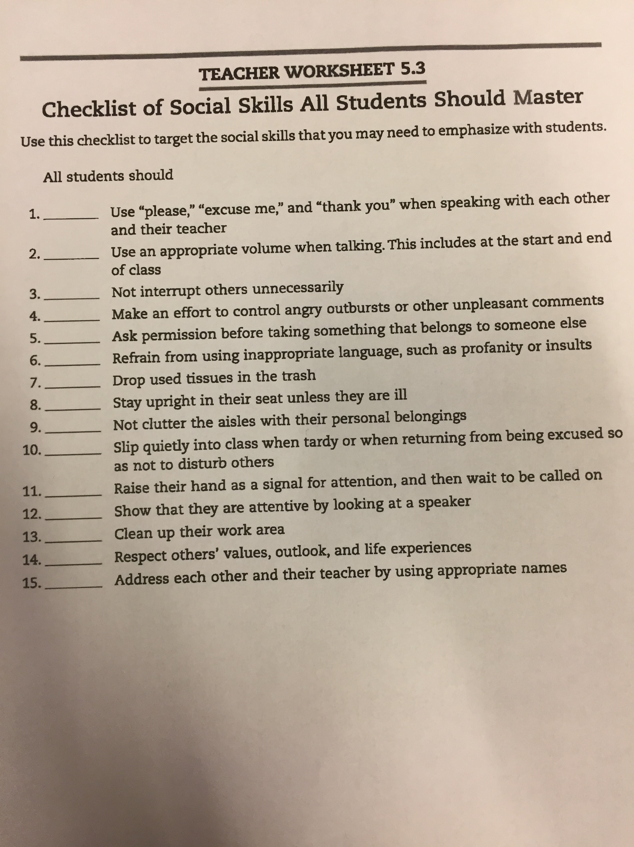

Slide 53
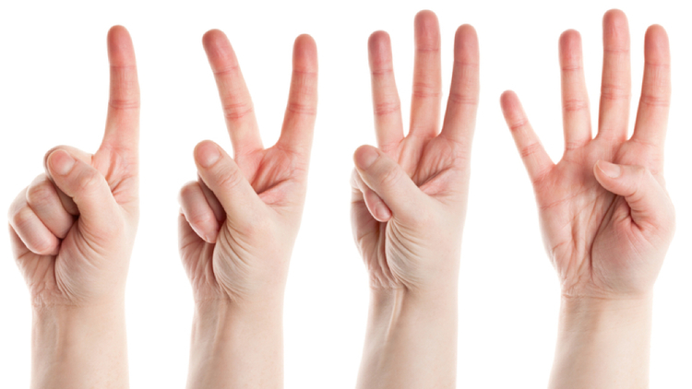
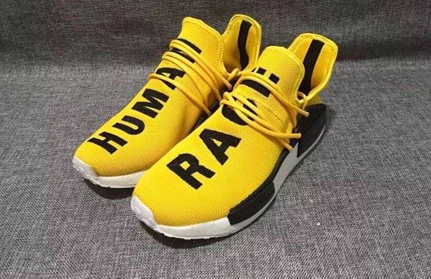
A mi me gustaN …
A. los zapatos amarillas
B. los zapatos amarillos
C. Los zapatos verdes
D. La camisa amarilla

Slide 54
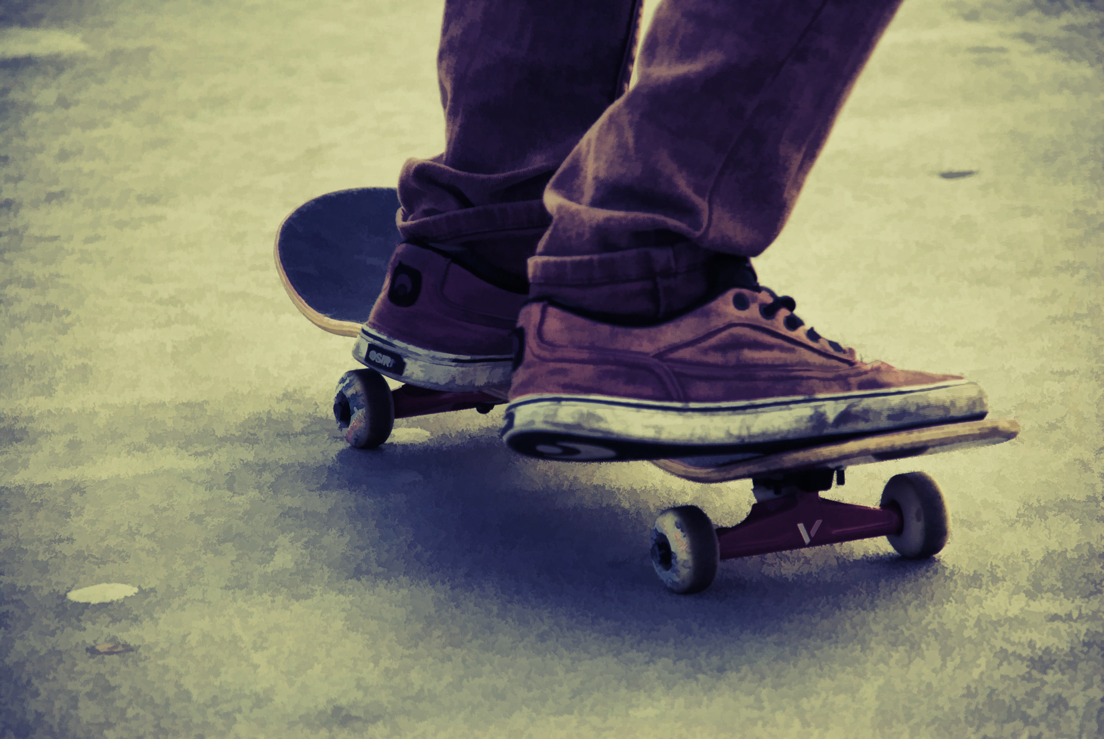
a mi me gusta …
A. trabajar
B. montar en bicicleta
C. Andar en patineta
D. patinar

Slide 55
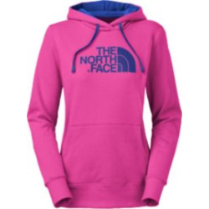
A MI NO ME GUSTA
A. la chaqueta rosado
B. el suéter rosado
C. la sudadera rosada
D. la sudadera roja

Slide 56
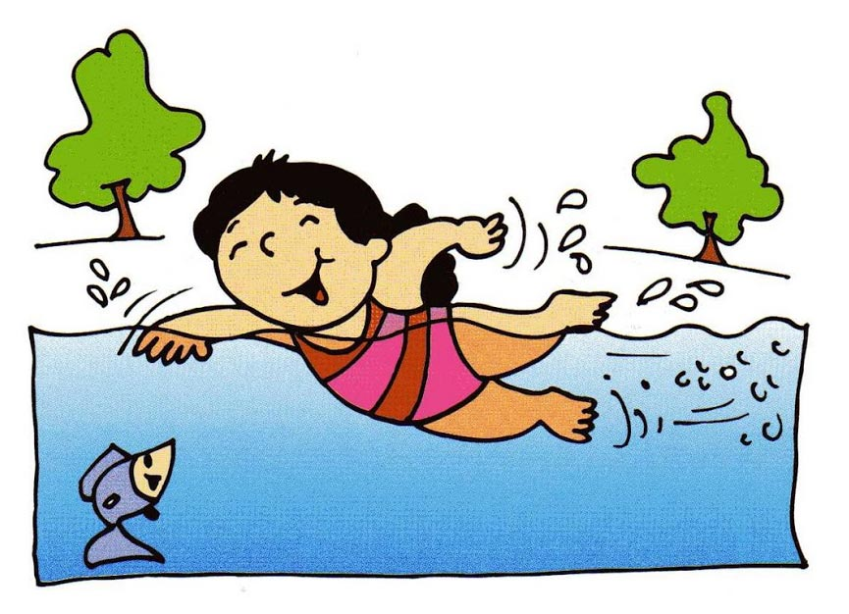
A MI NO ME GUSTA…
A. correr
B. Jugar videojuegos
C. comer los peces
D. Nadar

Slide 57
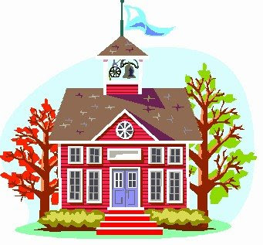

A mi no me gusta
A. IR A LA ESCUELA O TRABAJAR
B. NI IR A LA ESCUELA O TRABAJAR
C. NI IR A LA ESCUELA NI TRABAJAR
D. CORRER O IR A LA ESCUELA

Slide 58
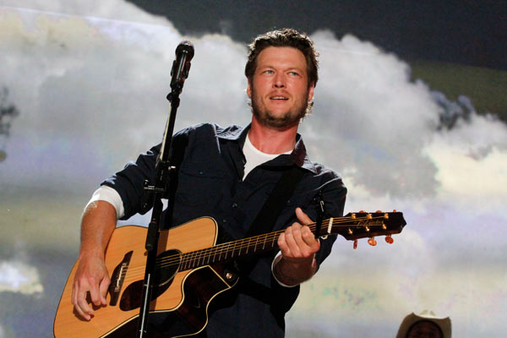
BLAKE SHELTON LE GUSTA…
A. correr
B. tocar la guitarra
C. cantar
D. ir a la escuela

Slide 59
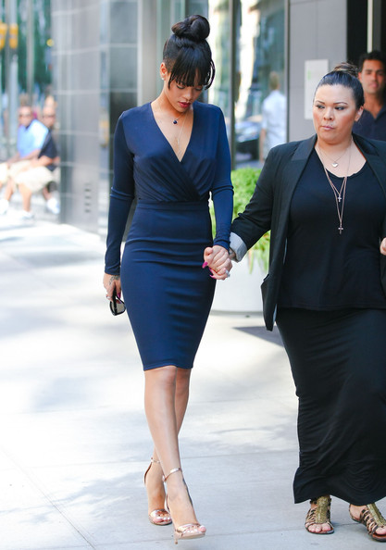
RIHANNA ES …
a. alta y delgada
B. LARGO Y DELGADA
C. ALTO Y GORDO
D. BAJA Y DELGADA

Slide 60
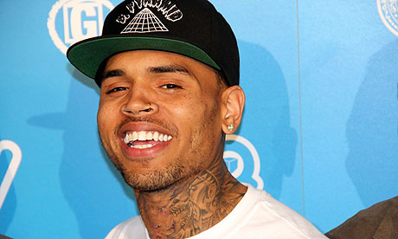
CHRIS BROWN LE GUSTA ______. A mi ________.
A. correr, tampoco
B. Bailar, también.
C. correr, también
D. bailar, tampoco

Slide 61
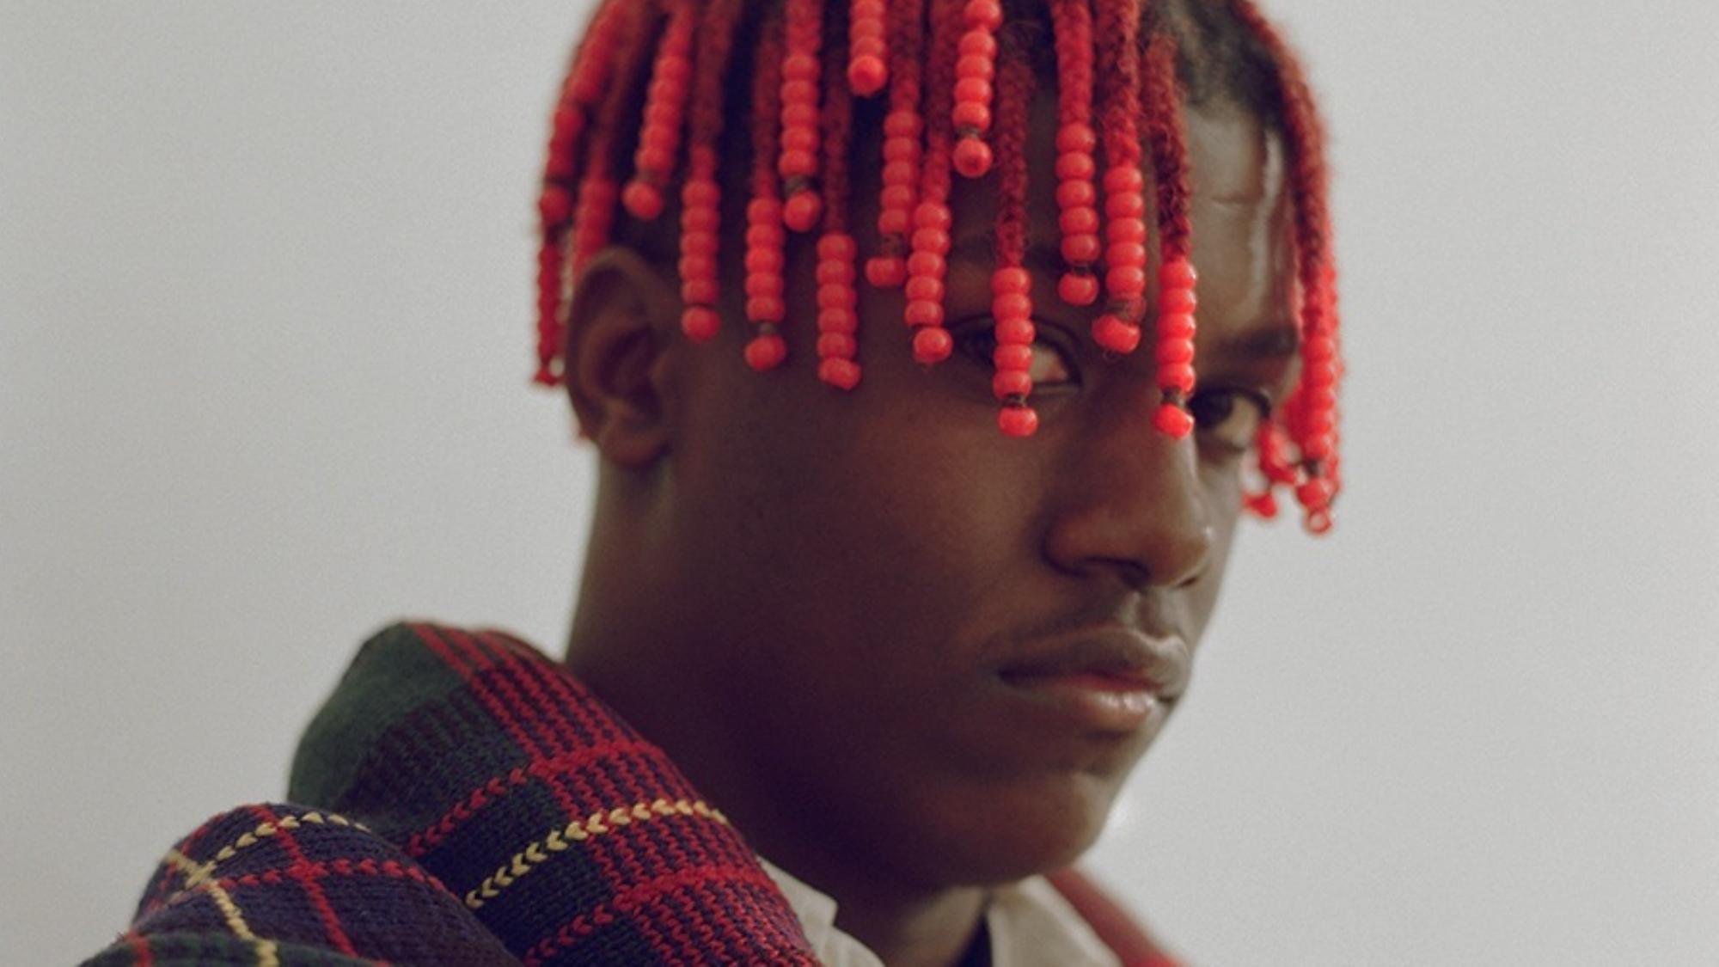
El pelo de LIL YACHTY ES …
A. rizado y negro
B. liso y rizado
C. largo y rojo
D. liso y azul

Slide 62
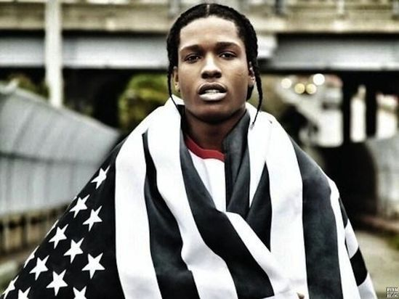
La piel de A$AP ROCKY ES…
A. no piel
B. Piel anaranjada
C. piel morena
D. piel clara

Slide 63
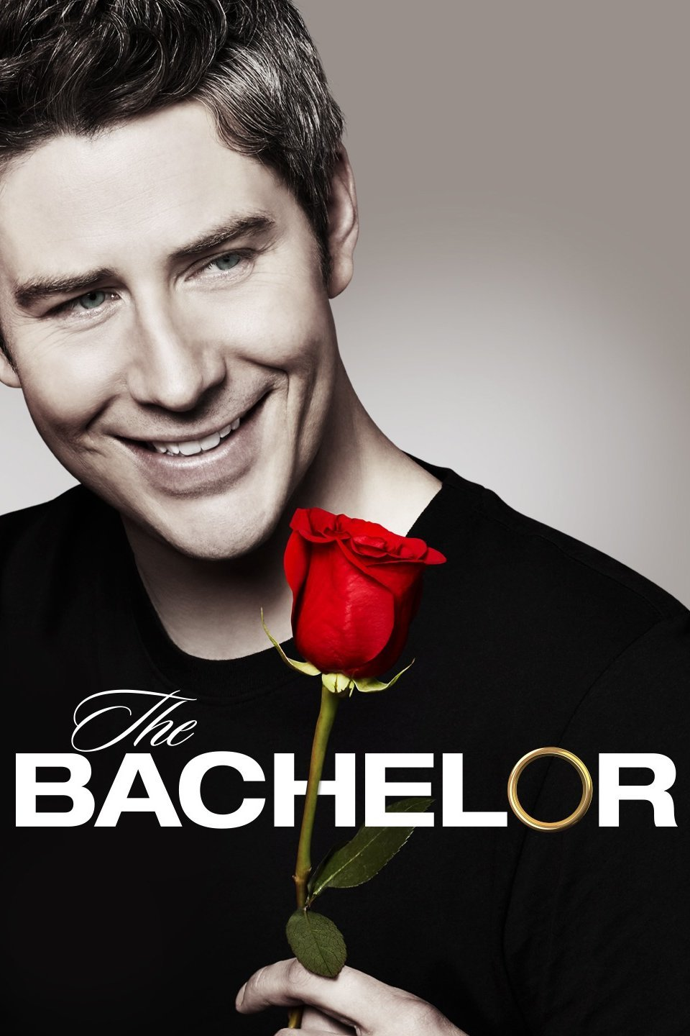
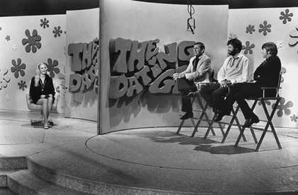

Slide 64
Ask our solteros 3 questions and pick your favorito! Questions you could ask…
Que te gusta hacer? What do you like to do?
Como eres? What are you like?
Que ropa llevas? What clothes are you wearing?
Que comida te gusta? What food do you like?
Que música te gusta? What music do you like?
Que color es tu favorito? What’s you favorite color?
Que clase es tu favorita? What’s your favorite class?
Cuantos anos tienes? How old are you?

Slide 65
Prepare responses to each question:
Qué te gusta hacer? What do you like to do? A: Me gusta….
Como eres? What are you like? B. Soy…. Tengo…
Qué ropa llevas? What clothes are you wearing? C. Llevo…
Qué comida te gusta? What food do you like? D. Me gusta comer…
Qué música te gusta? What music do you like? E. Me gusta música de…
Qué color es tu favorito? What’s you favorite color? F. Mi color favorito es…
Qué clase es tu favorita? What’s your favorite class? G. Mi clase favorita es…
Cuantos años tienes? How old are you? H. Tengo …. Años.

Slide 67
Hablar
Discuss the following questions with your shoulder partner…
What do you know about latin american culture?
What do you find interesting about it?
Which countries do you want to learn more about?

Slide 68
BIENVENIDOS A NUESTRA CLASE
ESPAÑOL 1
HOY ES viernes, EL treinta de noviembre

Slide 69
OBJETIVO Y DOL
OBJETIVO: LLWBAT summarize cultural topics from latin america.
[NL.1.1c, NL.1.e]
DOL: 100% LLW write 8 complete sentences summarizing a cultural topic with 6/8 correct.

Slide 70
1.*Who were the Aztecs? Where were they located? A nomadic tribe located in the valley of central Mexico- present day Mexico City. | 2. What artistic style did Frida Khalo Paint in? Self- portraits | 3. What is the symbolism of the Mexican flag? Color White- hope Green- unity Red- blood of heroes Coat of arms- eagle eating a rattlesnake perched on the nopal (prickly pear) cactus. green oak- strength. laurel branch –victory | 4. How are friendships in Spanish speaking countries different from those in the US? They have fewer friends and closer friendships. It takes longer to build friendships | 5. *What occurs during the los sanfermines festival? The running of the bulls- Festival celebrating ‘San Fermin’ with daily bull fights and the running of the bulls festival

Slide 71
6. What culture has had an influence on Spanish architecture in Spain? Moors – Northern African Arabs | 7. What is a difference between greetings between strangers and friends in Spanish speaking countries? New acquaintances greet each other with a handshake while friends greet with a hug or a kiss on the cheek. Less personal space is a norm in Spanish speaking countries | 8. *How many days were included in the Aztec calendar? The Aztec calendar represents a 260- day year. | 9. Who were two famous artists famous for the artistic style known as muralism? Joan Miro y Diego Rivera | 10. What were the principal differences between the Aztec and Mayan calendars?

Slide 72
11.*When, for how long and where is los sanfermines celebrated? July 7th, 2 weeks in Pamplona, Spain | 12. *What was one famous painting by Pablo Picasso? What artistic style did he represent? Three musicians- cubism | 13. Spanish is the official language of how many countries in the world? 21 countries spanning North America, South America, Europe and Africa | 14. What role does location (hemisphere) play on the weather during each season? The seasons are opposite- Summer in the Northern Hemisphere is winter in the Southern Hemisphere and vice versa | 15. What are the three ways to address adults in Spanish? Señora Señor Señorita

Slide 73
16. List three differences in the high school experience in Spanish speaking countries. 10 to 12 classes that do not meet everyday No lockers or amenities Lecture style classes Uniforms Number Grading scale | 17. What are two aspects of Spanish architecture that can be seen in the U.S? Patios and balconies Using stone, brick, or adobe | 18. What systems do Spanish speaking countries use for measurements and the temperature? Spanish speaking countries use the metric system and | 19.*How can you address a friend and someone formally in Spanish? You can address a friend in the tú form and someone formally in the usted form | 20. What is a difference in how we write the date in english vs. writing the date in Spanish? In English the date is the month and then the day and in Spanish it is the day and then the month Ex: December 27 English: 12/27 Spanish: 27/12

Slide 74
Dol: choose 4 cultural topics and write a mínimum of 2 sentences for each.
ARCHITERCTURE AND ITS INFLUENCE
The high school experience in latin america
Los sanfermines
Friendships in latin american countries
Artists and artistic styles
The mexican flag
The mayans and aztecs

Slide 75
Cultural kahoot
https://create.kahoot.it/details/spanish-1-cbm-culture/e810e731-659c-4249-ac8b-0e0e2d76c401

Slide 78
Extras:

Slide 79
TRABAJAR
CORRER
DIBUJAR
MONTAR EN BICICLETA
CANTAR
PATINAR
PRACTICAR DEPORTES
USAR LA COMPUTADORA
BAILAR
ESCRIBIR
JUGAR VIDEOJUEGOS
LEER REVISTAS
IR A LA ESCUELA
IR DE COMPRAS
VER PELICULAS
MONTAR EN MONOPATIN
ESTUDIAR
ESQUIAR
TOCAR LA GUITARRA

Slide 80
ORDENADO
INTELIGENTE
ME GUSTA
SERIO
ÉL
SIMPATICO
TALENTOSO
NOSOTROS
RESERVADO
USTEDES
GRACIOSO
ELLAS
DESORDENADO
QUE TE GUSTA HACER
PACIENTE
TÚ
BUENO
IMPACIENTE
ATREVIDO
ATLETICO
ESTUDIOSO
PEREZOSO
DEPORTISTA
TRABAJADOR
USTED
YO
ELLOS
SOCIABLE
NOSOTRAS

Slide 81
SOMOS
PELO RIZADO
DELGADO
ALTO
JOVEN
UN
BIGOTE
ES
FEO
LAS
PELO LARGO
OJOS AZULES
GAFAS
OJOS MARRONES
CHICO
CALVO
CHICA
VIEJO
UNAS
MORENO
GUAPO
PELIRROJO
OJOS VERDES
PELO CORTO
SOY
RUBIO
BONITO
LA
UNOS
BARBA
LOS
UNA
ERES
EL
SON
GORDO
PELO LISO
BAJO

Slide 82
Fakebook writing assignment
Need to Include:
A description of yourself
  Physical and personality
  Things you do and do not like to do
  Description of outfit in profile picture
  Complete sentences and correct grammar

Slide 83
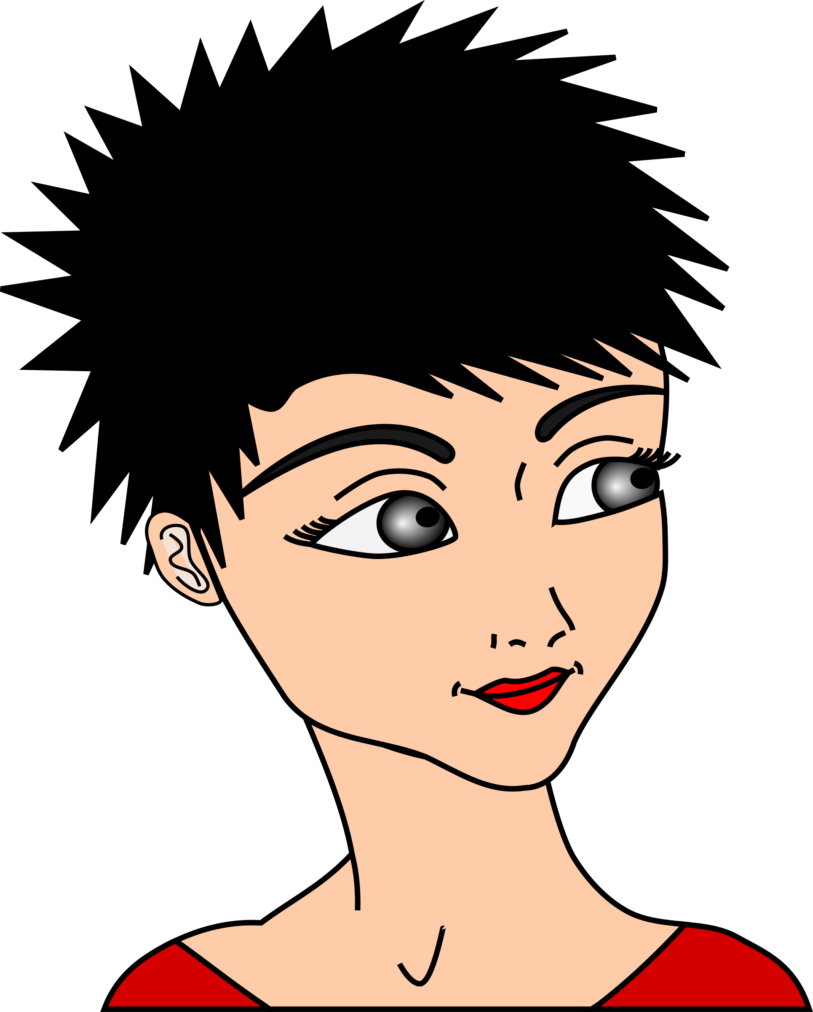
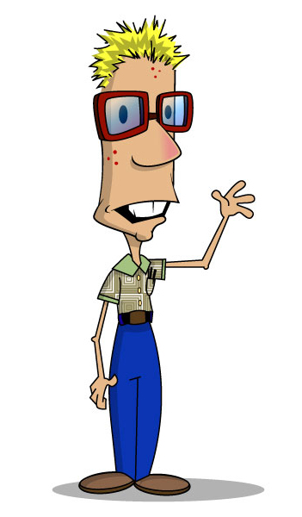
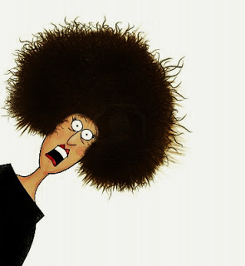
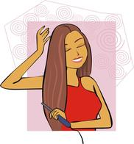
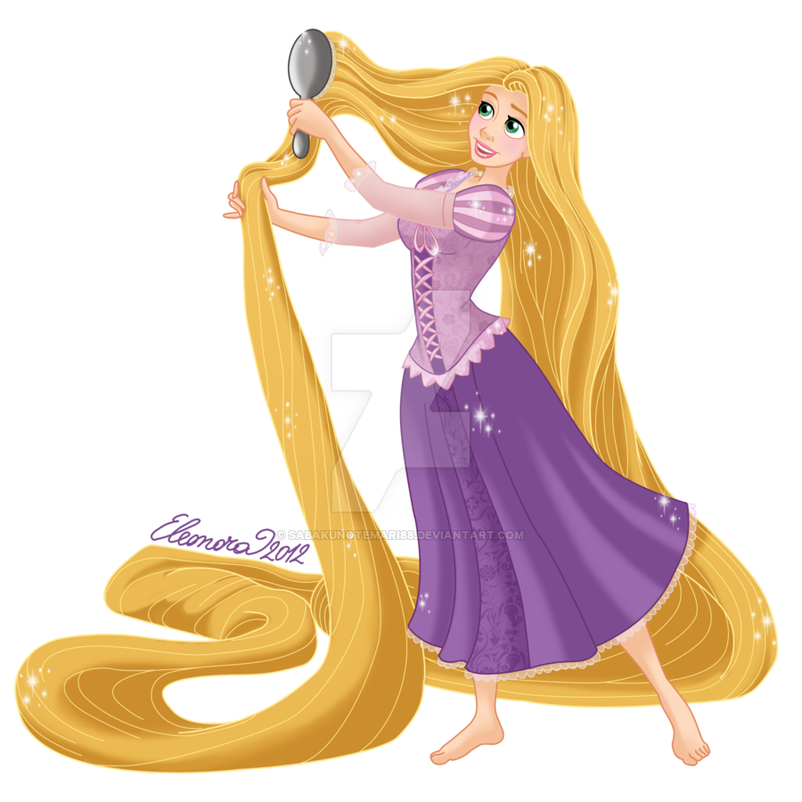

Slide 84
Complete the sentences with the correct indefinite article
1. La Sra. Santiago es _____ profesora simpática.
2. Alicia es _____ estudiante trabajadora.
3. Juan y Carlos son _____ chicos perezosos.
4. German es ______ amigo sociable.
5. Sr. Guzmán es _____ profesor gracioso.
6. Adriana y Carla son ______ chicas muy serias.
7. La Srta. Cifuentes es _____ profesora paciente.
8. Arturo es _______ estudiante talentoso.

