Slide 1
Cosas que hiciste durante sus vacaciones
HAZLO AHORA Welcome back!
Personas con quien pasaste tiempo.
Meta para este semestre en la clase de español.

Slide 2
Bienvenidos a nuestra clase Español 1
Hoy es martes, el ocho de enero

Slide 3
OBJETIVO Y DOL
OBJ: LLWBAT inquire about Latin American traditions in Spanish.
DOL: Given media about New Year’s traditions in Latin America, 100% of LLW write a letter inquiring about their new year’s traditions and sharing theirs with100% accuracy.

Slide 4
El Dia de los reyes
https://www.youtube.com/watch?v=DJdM1CnWIpo
Group discussion:
Que es el dia de los reyes? What is the day of the Kings?
Como se celebra? How is it celebrated?

Slide 5
El año nuevo
https://www.youtube.com/watch?v=_4mO_YTXOfk
Cual tradicion harias tu?
Which tradition would you do?

Slide 6
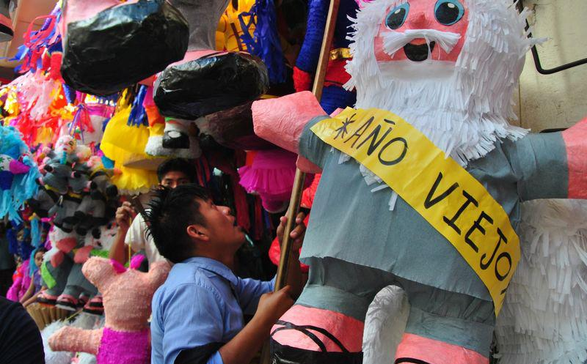
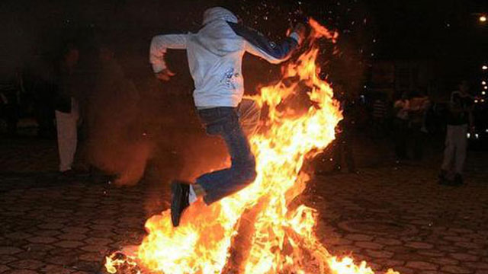
El año viejo
https://www.youtube.com/watch?v=iGwBLHGRPME
Que te dejo el Año Viejo?
What did the Old Year leave you?
Another Latin tradition is to burn Mr. Old Year and then jump over to the new year. [and then you get to spend your holiday in the ER!]

Slide 7
DOL: Escribe una carta write a letter
Share what you did over winter break and ask about the traditions of others.
Fui a - I went to
Hicimos – we did, we made
Una tradicion – a tradition
Con mi familia – with my family
Como celebras _______? How do you celebrate?
El año nuevo
La navidad
El dia de los reyes
Pase ______ con - I spent_______ with

Slide 9
¡PROGRESS MONITORING!
Semester 1 progress monitoring
1.Was your final grade the grade you aimed for?
2.What was your strongest aspect in Spanish class?
3.What area needs the most work?
4.¿Como puedes ser mas exitoso?
List two things you can do to be more succesful in Spanish class next semester.

Slide 10
Bienvenidos a nuestra clase Español 1
Hoy es miercoles, el nueve de enero

Slide 11
OBJETIVO Y DOL
OBJ: LLWBAT summarize about classroom rules, why they are relevant in achieving a SMART goal for this semester in Spanish.
DOL: Given their own SMART goal, 100% of LLW summarize about classroom rules, relevancy and how they will contribute to a personal SMART goal for Spanish class in the second semester with 100% accuracy.

Slide 12
Caring
care for students well- being inside and outside of the classroom
Care about students inputs and opinions in their learning
Principled:
Be organized in ways around grading, extra credit and seminar to benefit students
Be principled with school policy and classroom policy

Slide 13
Syllabus Grading Rubric: Semester 2 see canvas

Slide 14
SMART GOALS

Slide 15
Las reglas
Encuentra alguien con la misma regla que tú tienes pero en ingles o español.
Hablen sobre la importancia de la regla en nuestra clase.

Slide 16
LAS REGLAS
Hay que llegar a tiempo
1.
2.
3.
It is necesary to arrive on time.
1.
2.
3.

Slide 17
LAS REGLAS
Hay que tomar apuntes
1.
2.
3.
It is necessary to take notes
1.
2.
3.

Slide 18
LAS REGLAS
Se prohíbe tirar cosas.
1.
2.
3.
It is prohibited to throw things.
1.
2.
3.

Slide 19
LAS REGLAS
Hay que respetar la profesora y los otros estudiantes.
1.
2.
3.
It is necessary to respect the teacher and the other students.
1.
2.
3.

Slide 20
LAS REGLAS
Se prohíbe usar su computadora para cosas fuera de la tarea.
1.
2.
3.
It is prohibited to use your computer for off task things.
1.
2.
3.

Slide 21
LAS REGLAS
Se prohíbe usar su teléfono o audiofonos sin permiso.
1.
2.
3.
It is prohibited to use your phone or headphones without permission.
1.
2.
3.

Slide 22
LAS REGLAS
Hay que sentarse en su silla asignada
1.
2.
3.
It is necesary to sit in your assigned seat.
1.
2.
3.

Slide 23
LAS REGLAS
Se prohíbe usar lenguaje ofensivo hacia ti mismo u otros.
1.
2.
3.
It is prohibited to use offensive language towards yourself or others.
1.
2.
3.

Slide 24
LAS REGLAS
Hay que venir con una buena actitud, pedir ayuda, y disfrútense.
1.
2.
3.
It is necessary to come with a good attitude, ask for help and enjoy yourself.
1.
2.
3.

Slide 25
dulces - sweets
Ways to earn a letter
Everyone on time to class, ready with materials
Everyone on task during a class activity
100% completion of homework
Once you’ve earned dulces, you can work to earn refresco

Slide 26
DOL:
Summarize your SMART goal and an IB Focus for your success in Spanish this semester.
How will the rules established for this class help you achieve this goal?
¿Cual es tu meta para español este semestre? ¿Como vas a lograrla?
¿Las reglas para la clase pueden ayudarte en que manera?

Slide 29
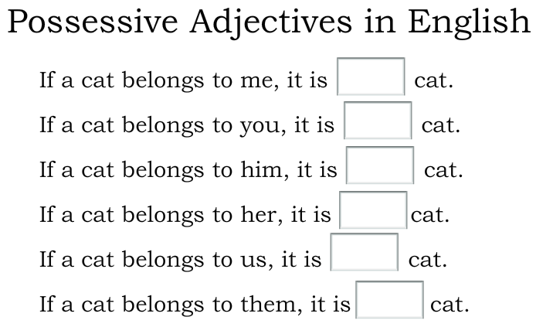
Notes:
Picture with reflected caption
(Basic)
To reproduce the picture effects on this slide, do the following:
On the Home tab, in the Slides group, click Layout and then click Blank.
On the Insert tab, in the Images group, click Picture. In the Insert Picture dialog box, select a picture, and then click Insert.
Under Picture Tools, on the Format tab, in the Size group, click the Size and Position dialog box launcher. In the Format Picture dialog box, resize or crop the image so that the height is set to 3.17” and the width is set to 10”. To crop the picture, click Crop in the left pane, and in the right pane, under Crop position, enter values into the Height, Width, Left, and Top boxes. To resize the picture, click Size in the left pane, and in the right pane, under Size and rotate, enter values into the Height and Width boxes.
Select the picture. On the Home tab, in the Drawing group, click Arrange, point to Align, and then do the following:
Click Align to Slide.
Click Align Top.
Under Picture Tools, on the Format tab, in the Picture Styles group, click Picture Effects, point to Reflections, and then under Reflection Variations click Half Reflection, touching (first row, second option from the left).
On the Insert tab, in the Text group, click Text Box, and then on the slide, drag to draw the text box.
Enter text in the text box, select the text, and then on the Home tab, in the Font group, select Impact from the Font list and then enter 42 in the Font Size box.
On the Home tab, in the Paragraph group, click Align Text Right to align the text right in the text box.
Select the text box. Under Drawing Tools, on the Format tab, in the WordArt Styles group, click Text Effects, point to Reflection, and then under Reflection Variations click Half Reflection, touching (first row, second option from the left).
Under Drawing Tools, on the Format tab, in the WordArt Styles group, click the Format Text Effects dialog box launcher. In the Format Text Effects dialog box, click Text Fill in the left pane, select Solid fill in the Text Fill pane, and then do the following:
Click the button next to Color, and then under Theme Colors, click White, Background 1 (first row, first option from the left).
In the Transparency box, enter 12%.
On the slide, drag the text box onto the picture to position as needed.
To reproduce the background on this slide, do the following:
Right-click the slide background area, and then click Format Background. In the Format Background dialog box, click Fill in the left pane, select Gradient fill in the Fill pane, and then do the following:
In the Type list, select Radial.
Click the button next to Direction, and then click From Center (third option from the left).
Under Gradient stops, click Add or Remove until two stops appear on the slider.
Also under Gradient stops, customize the gradient stops that you added as follows:
Select Stop 1 from the list, and then do the following:
In the Stop position box, enter 10%.
Click the button next to Color, and then under Theme Colors click White, Background 1, Darker 5% (second row, first option from the left).
Select Stop 2 from the list, and then do the following:
In the Stop position box, enter 99%.
Click the button next to Color, and then under Theme Colors click White, Background 1, Darker 35% (fifth row, first option from the left).

Slide 30
Bienvenidos a nuestra clase Español 1
Hoy es jueves, el diez de enero

Slide 31
OBJETIVO Y DOL
OBJ: LLWBAT use posesivos to describe ownership.
NL1.3a
DOL: Given 16 objects and owners, 100% of LLW use posesivos to describe ownership with 87% accuracy.

Slide 32
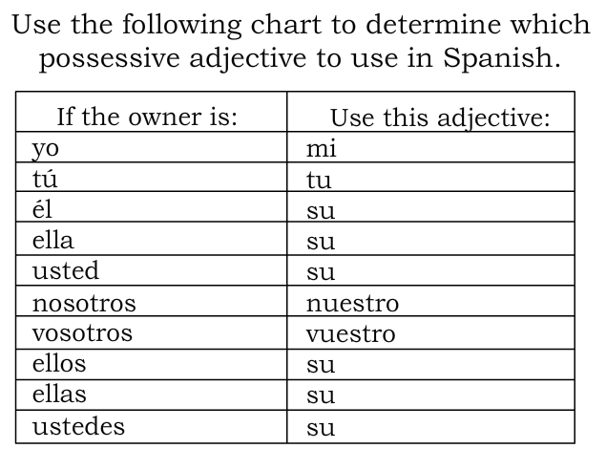

Slide 33
Possesive Adjectives
NOTA CLAVE** Gender and plurality changed based on the noun not the subject of the sentence.

Slide 34
-Matching-
1. I
2. You
3. He/ She (plural)
4. They
5. Us
A. Sus
B. Tu
C. Nuestro
D. Mi
E. Su

Slide 35
Rules for Possesive Adjectives
Adjectives in spanish change based on the gender and number of things they describe
Los pantalones amarillos
La camisa amarilla
Unlike other adjectives that come _________ the noun they describe, possesive adjectives come ________ before the noun they describe
Mi cuaderno (my notebook)
Nuestra maestra (our teacher)
Nuestros libros (our books)
*note the possesive adjective changes gender and number to match the noun

Slide 36
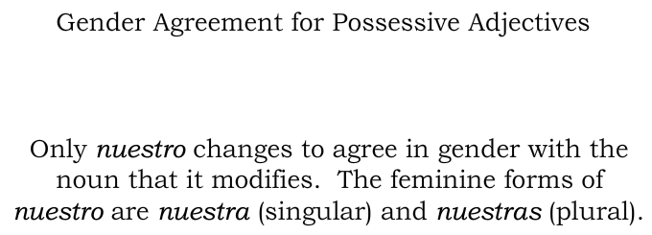

Slide 38
Possessive Adjectives
They are words (adjectives) use to indicate possession; WHO something belongs to.
What are they?
My
Mi (Singular) / Mis (plural)
Your
Tu (Singular) / Tus (plural)
His/Her/ Your(formal & plural)/their
Su (Singular) / Sus (plural)
Our
Nuestro/Nuestra (Singular) / Nuestros/Nuestras (plural)

Slide 39
Possessive Adjectives
What are they?
My
Mi (Singular)
Ex.=
My book
=
Mi libro
Mis (Plural)
Ex.=
My books
=
Mis libros

Slide 40
Possessive Adjectives
What are they?
Your
Tu (Singular)
Ex.=
Your book
=
Tu libro
Tus (Plural)
Ex.=
Your books
=
Tus libros

Slide 41
Possessive Adjectives
What are they?
His/Her/ Your(formal & plural)/their
Su (Singular)
Ex.=
His/Her/Your (formal)/ Their table
=
Su mesa
Sus (Plural)
Ex.=
His/Her/Your (formal plural)/their tables
=
Sus mesas

Slide 42
Possessive Adjectives
What are they?
Our
Nuestro (Singular)
Ex.=
Our book
=
Nuestro libro
Nuestra (Singular)
Ex.=
Our table
=
Nuestra mesa

Slide 43
Possessive Adjectives
What are they?
Our
Nuestros (Plural)
Ex.=
Our books
=
Nuestros libros
Nuestras (Plural)
Ex.=
Our tables
=
Nuestras mesas

Slide 44
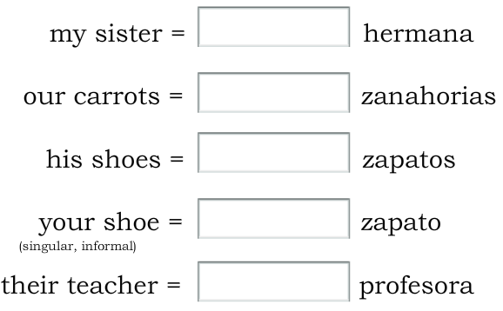

Slide 45
A PRACTICAR!
Take out your whiteboards
Translate the following phrases into spanish using the correct possesive pronouns
DO NOT PUT THEM UP UNTIL I SAY SO!

Slide 46
Our seat
Her pencil
your (informal) notebooks
Nuestra silla
Su lápiz
Tus cuadernos
My table
Your (informal) pencil
Mi mesa
our computers
Tu lápiz
Our map
Your (formal) book
Nuestras computadoras
Nuestro mapa
Su libro

Slide 47
DOL: Complete with the correct possesive adjective Modelo: tú __tu__ libro __tus_ carpetas
1. yo 2. tú
_______ mochila _________ bolígrafo
_______ lápiz _________ pegamento
_______ papeles _________ clases
_______ borradores _________ relojes
3. él/ ella/ usted 4. nosotros
ellos/ellas/ustedes
________ libro ___________ maestra
________ mapa ___________ almuerzo
________ computadoras __________ horarios
________ calculadoras __________ mochilas

Slide 48
Pg 35 realidades

Slide 50
Warmup: complete the following sentences with the correct possesive pronoun…
1. (our) ¿Donde esta _______ profesora?
2. (her) Ella no tiene ________ cuaderno.
3. (their) ¿Ellos tienen _______ libros?
4. (my) _________ clases son muy interesantes.
5. (their) Mis amigos tienen ______ mochilas.
6. (his) __________ escuela es grande.
7. (your) Tienes _______ tarea?
8. (our) ________ profesora es muy vieja.

Slide 51
Bienvenidos a nuestra clase Español 1
Hoy es viernes, el once de enero

Slide 52
OBJETIVO Y DOL
OBJ: LLWBAT use posesivos to describe ownership.
NL1.3a
DOL: 100% of LLW use posesivos to describe objects they and others own in a presentation with a rubric-based score of 80% or higher.

Slide 53
Repaso Classroom objects
https://create.kahoot.it/details/spanish-classroom-objects/7027db7f-9087-43eb-bea8-f230b42a4c71

Slide 54
Show n’ tell
Find 2 objects you would like to talk about. One of your own and one that belongs to someone else. Prepare a brief presentation of each object en Español. (7 mins)
Be sure to include:
Esto es mi _____. or Esto es su _____.
Como es? What’s it like?
Tiene una historia? Does it have a story?
Para que es? What is it for?
DOL: Turn in your paragraph w/ your name on it.

Slide 55
Repaso de vocabulario: A PESCAR
Get into groups of 4!
The oldest person will shuffle the card and deal 5 cards to each person- cards should be face down!
The remaining cards go in a pile in the middle, face down.
One by one ask a specific person in the group if they have a classroom item you have in attempt to make a pair.
Sra DeAlba, tienes la clase de arte? Mrs. DeAlba, do you have art class?
If the person you asks does have the card you will set down that pair.
If the person you asked does not have the card, they will say “’PESCA’ O ‘VAYA A PESCAR’ and you will draw a new card.
First person to pair all of their cards wins!

Slide 56
Go fish rules illustrated
https://www.wikihow.com/Play-Go-Fish-with-Any-Cards

Slide 57
