Slide 1
Bienvenidos a nuestra clase Español 1
^ CLICK ENABLE EDITING
SAVE THIS FILE TO YOUR DESKTOP
YOU WILL EDIT THE SLIDES WITH QUESTIONS

Slide 2
OBJETIVO Y DOL
OBJ: LLWBAT use posesivos to describe ownership.
NL1.3a
DOL: Given 16 objects and owners, 100% of LLW use posesivos to describe ownership with 87% accuracy.

Slide 3
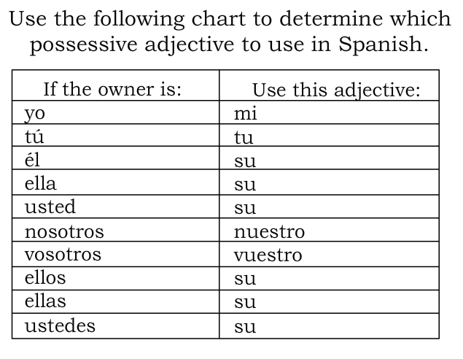

Slide 4
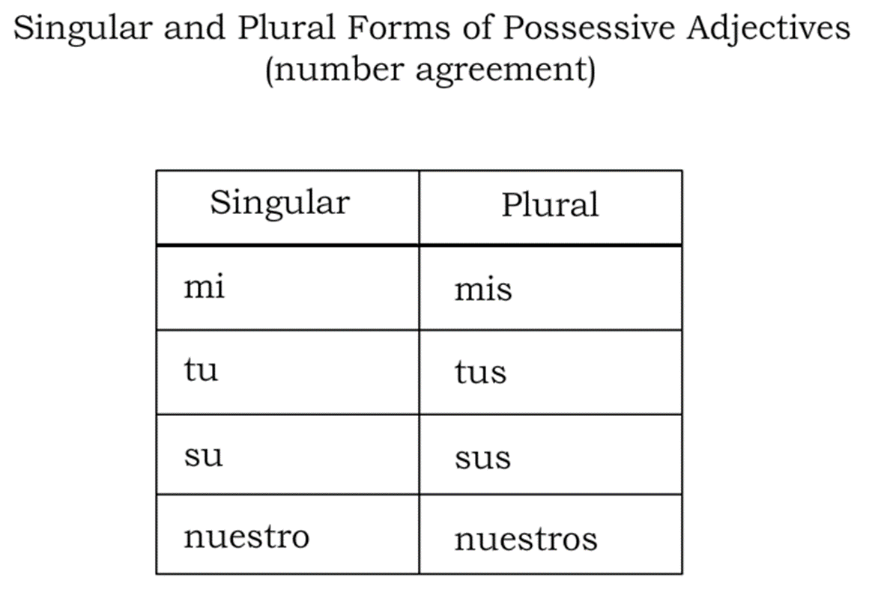
Possesive Adjectives
NOTA CLAVE** Gender and plurality changed based on the noun not the subject of the sentence.

Slide 5
-Matching- Type in the correct letter
1. Mine
2. Your
3. His/ Hers (plural)
4. Theirs
5. Our
A. Sus
B. Tu
C. Nuestro
D. Mi
E. Su

Slide 6
Rules for Possesive Adjectives
Adjectives in spanish change based on the gender and number of things they describe
Los pantalones amarillos
La camisa amarilla
Unlike other adjectives that come _________ the noun they describe, possesive adjectives come ________ before the noun they describe
Mi cuaderno (my notebook)
Nuestra maestra (our teacher)
Nuestros libros (our books)
*note the possesive adjective changes gender and number to match the noun

Slide 7
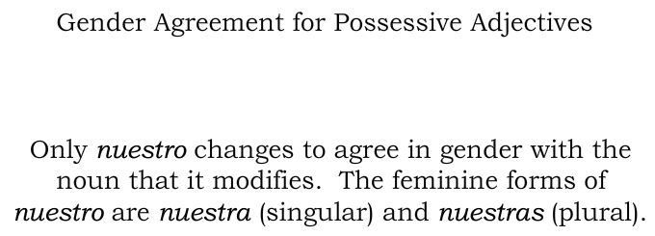

Slide 8
The school la escuela Our school [ ] escuela Our schools [ ] escuelas
Fill in the brackets
The problema el problema
Our problem [ ] problema Our problems [ ] problemas

Slide 10
Possessive Adjectives
They are words (adjectives) use to indicate possession; WHO something belongs to.
What are they?
My
Mi (Singular) / Mis (plural)
Your
Tu (Singular) / Tus (plural)
His/Her/ Your(formal & plural)/their
Su (Singular) / Sus (plural)
Our
Nuestro/Nuestra (Singular) / Nuestros/Nuestras (plural)

Slide 11
Possessive Adjectives
What are they?
My
Mi (Singular)
Ex.=
My book
=
Mi libro
Mis (Plural)
Ex.=
My books
=
Mis libros

Slide 12
Possessive Adjectives
What are they?
Your
Tu (Singular)
Ex.=
Your book
=
Tu libro
Tus (Plural)
Ex.=
Your books
=
Tus libros

Slide 13
My pen = [ ] boligrafo
Your ruler = [ ] regla

Slide 14
Possessive Adjectives
What are they?
His/Her/ Your(formal & plural)/their
Su (Singular)
Ex.=
His/Her/Your (formal)/ Their table
=
Su mesa
Sus (Plural)
Ex.=
His/Her/Your (formal plural)/their tables
=
Sus mesas

Slide 15
His school = [ ] escuela
Her pencil = [ ] lapiz
Their books = [ ] libros

Slide 16
Possessive Adjectives
What are they?
Our
Nuestro (Singular)
Ex.=
Our book
=
Nuestro libro
Nuestra (Singular)
Ex.=
Our table
=
Nuestra mesa

Slide 17
Possessive Adjectives
What are they?
Our
Nuestros (Plural)
Ex.=
Our books
=
Nuestros libros
Nuestras (Plural)
Ex.=
Our tables
=
Nuestras mesas

Slide 18
Our friend = [ ] amigo
Our female friend = [ ] amiga
Our friends = [ ] amigos
Our lady friends = [ ] amigas

Slide 19
DOL: Complete with the correct possesive adjective Modelo: tú __tu__ libro __tus_ carpetas
1. yo 2. tú
[ ] mochila [ ] bolígrafo
[ ] lápiz [ ] pegamento
[ ] papeles [ ] clases
[ ] borradores [ ] relojes
3. él/ ella/ usted 4. nosotros
ellos/ellas/ustedes
[ ] libro [ ] maestra
[ ] mapa [ ] almuerzo
[ ] computadoras [ ] horarios
[ ] calculadoras [ ] mochilas

Slide 20
Pg 35 realidades
Tomorrow please bring an object for show n’ tell.

