Slide 1


Saquen sus computadoras por favor ☺
1. Traduce tu carta – translate your letter
2. Responde! Respond!
You may use google translate and/or the following phrases….
Gracias por responderme – thanks for writing back
Que es tu _______ favorita? – what is your favorite____?
_______ es mi favorito. - _____ is my favorite.
Como están tus _________? – How are your _______?
Yo juego _______. – I play _____.
Hasta luego. - Later.

Slide 2
Bienvenidos a Nuestra clase español 1
Hoy es lunes, el veintiocho de enero

Slide 3
Objetivo y dol
LLWBAT describe the relevancy of and effective methods for learning a world language.
Given a KWLA chart, 100% of LLW describe the relevancy of and effective methods for learning a world language in each column with 100% accuracy.
IB Profile: Inquirers

Slide 4
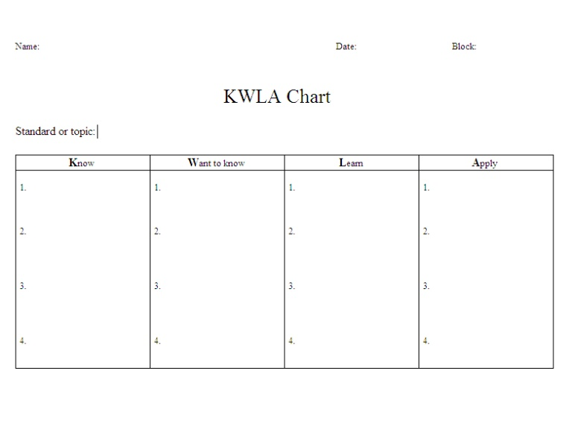
The why’s and how’s of language learning
Por que y como aprendemos un idioma

Slide 5


Por que aprendemos español?
Why do we learn Spanish?
Or any World language?

Slide 6
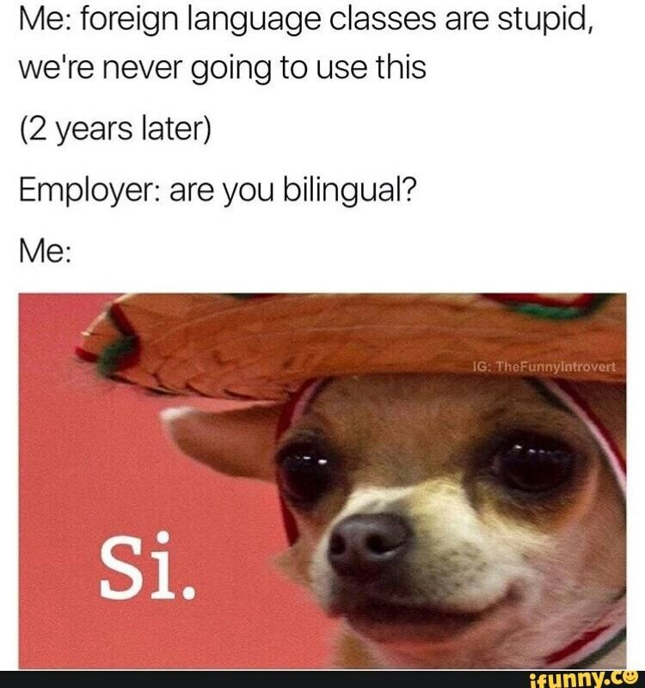

Slide 7
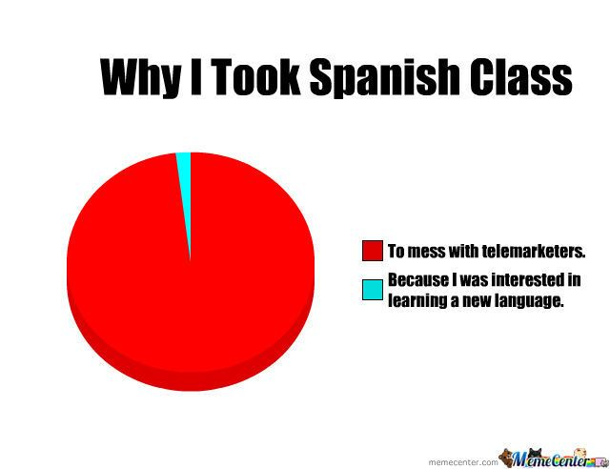

Slide 8
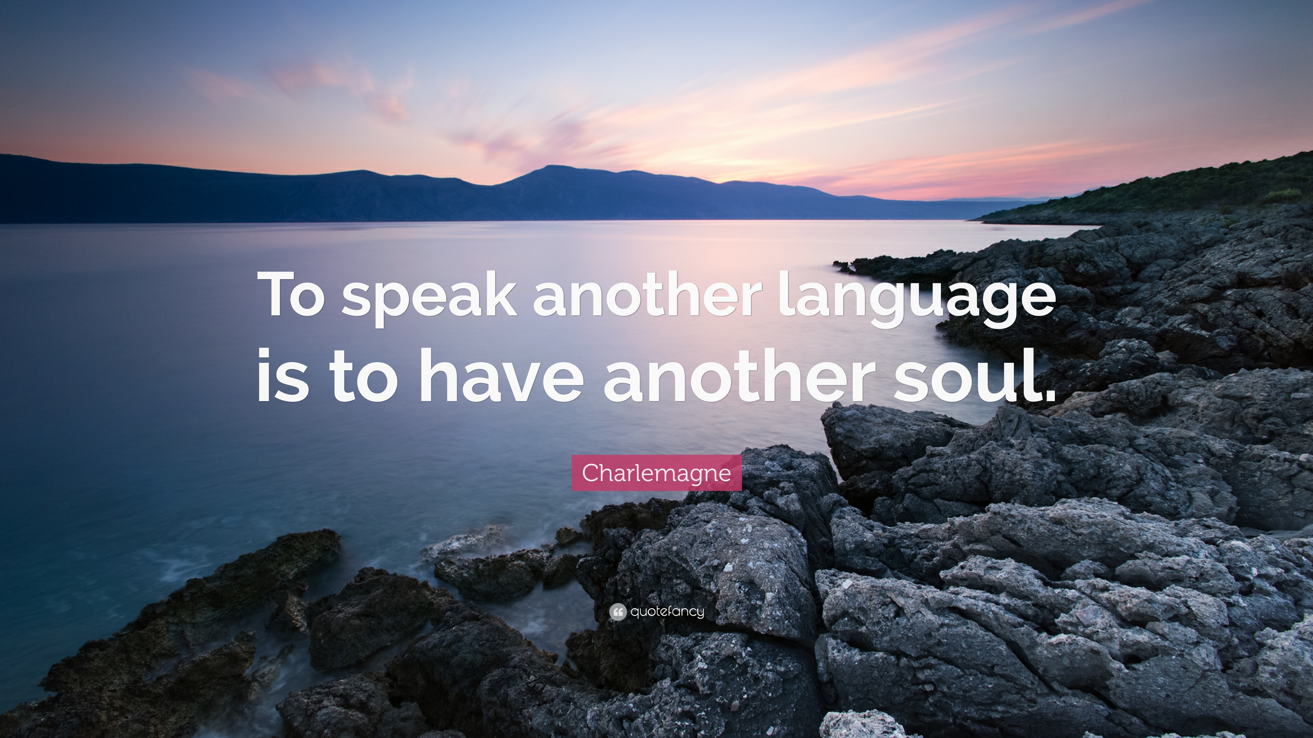
Notes:
Amor. Yo aprendi un poco en la escuela y mucho mas con mi novio, pero el te dira que mi abilidad aumento bastante, cuando servi un misión de servicio por un año y medio. Ahora estoy aprendiendo francés con un amigo en internet y empecé a tener mas progreso cuando me dijo que mi éxito fue su meta.

Slide 9
Que opinas? What’s your opinión?
What is the connotation or feeling behind these words? Are they same thing?
Foreign Language
World Language

Slide 10
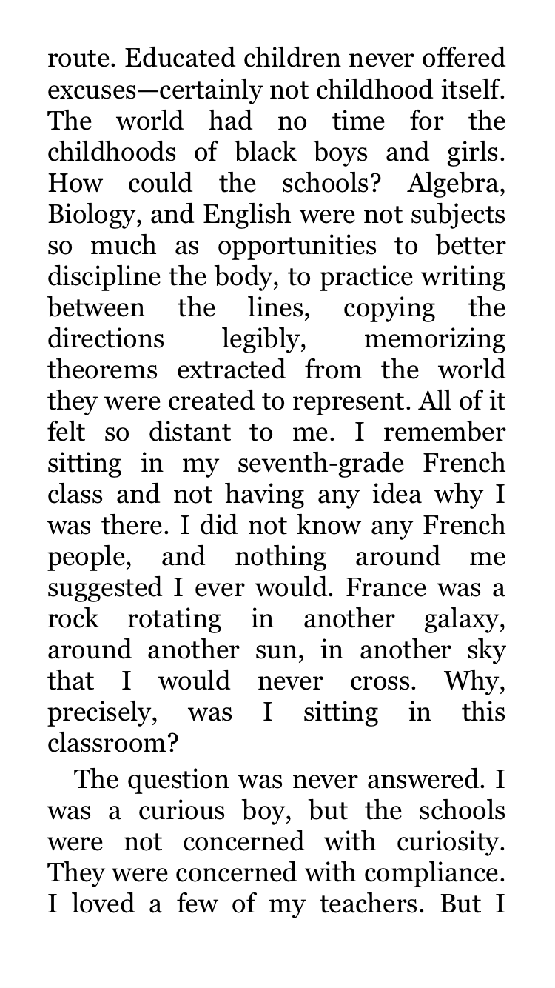


Slide 11
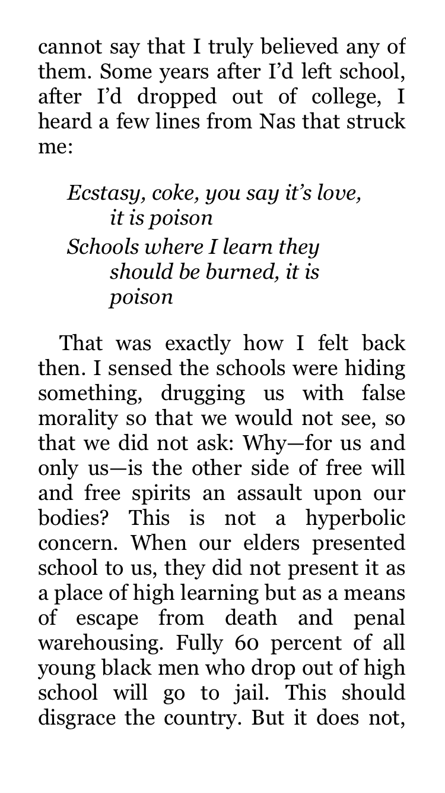

Slide 13
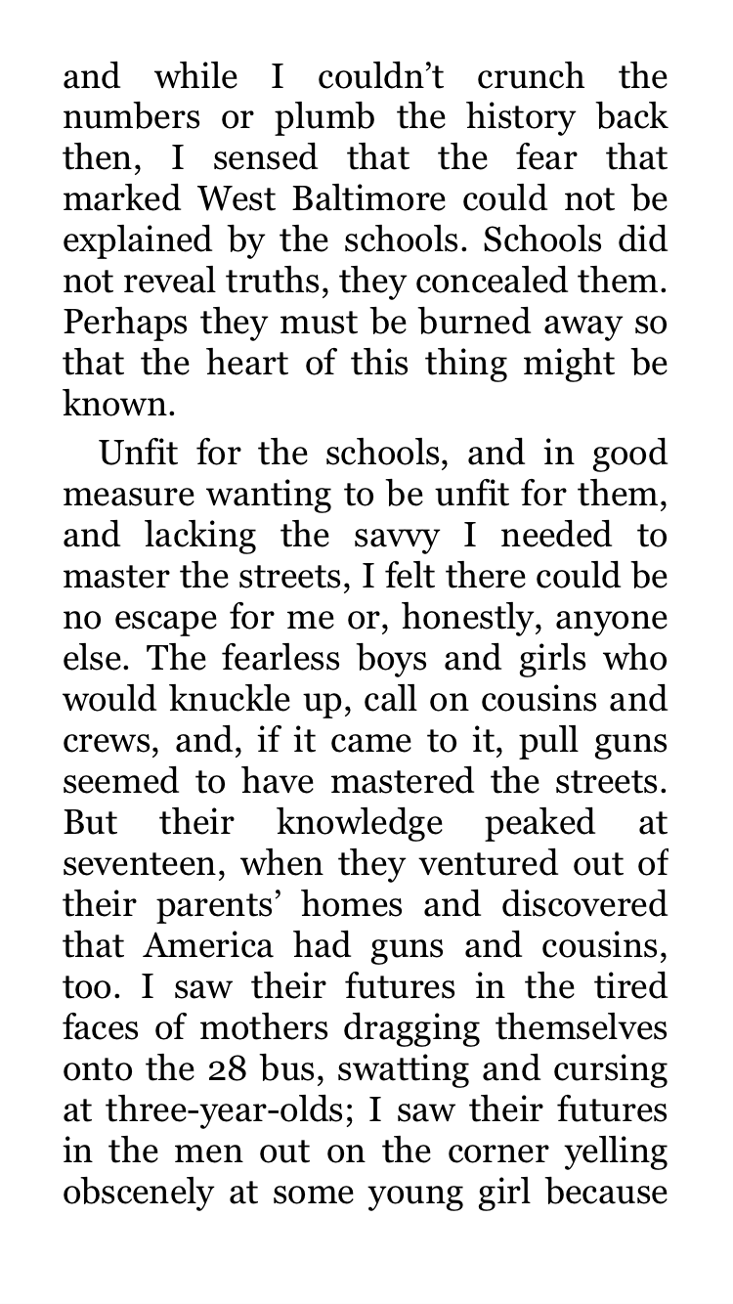

Slide 14
Raise your hand – Sube la mano
If you have ever left the country…
If you expect to travel to another country in the next 5 years…
If you hope to travel internationally someday…

Slide 15
https://www.youtube.com/watch?v=DKkJRRRaGfE
Begin at time 2:52 – 2:58 ‘but I had you..”
What are some key words he uses to describe the experience of visiting another country?
What does he learn?

Slide 16
“There’s no such thing as “ready” in language learning...you just need to use whatever you know, even if you have only been studying for a few hours. Speaking during the first hours of your very first one-on-one conversation is not about spitting out thousands of words, but knowing just enough to ask a couple of questions, hearing the first instances of the language used naturally, and challenging yourself to understand a little bit more the next time.
YOU LEARN BY DOING, by trying to speak, making mistakes and learning from them so the next time you make fewer mistakes.”
- Benny Lewis, Polyglot

Slide 17
HW: Busca a un amigo hispano – find a fluent friend
Mini-misión #3
Goal: Get confident introducing myself and making small talk in Spanish.
Plan: Introduce myself in Spanish, share some information about myself and ask a couple of questions to 5 people outside of class and get their signatures.
Reflexión:
¿Cómo te fue? How did it go for you? What was easy what was hard? Are you confident introducing yourself now?

Slide 18

DOL : Make a plan for your first conversation.
How are you?
What’s your name?
I don’t understand.
Can you speak slower?
What does ____ mean?
What do you like to do/to eat/to listen to/to watch on tv?
What are you doing?
Tell me about your family.
What’s your favorite ______?
DOL : Haz un plan para tu primera conversación.
Como estas?
Como te llamas?
No entiendo.
Mas despacio, por favor.
Que significa _____?
Que te gusta hacer/comer/escuchar/ver en la tele?
Que estas haciendo?
Cuéntame de tu familia.
Que es tu ______ favorito(a)?

Slide 19
Watch n’ learn
https://www.youtube.com/watch?v=gTYEz4DZOuk

Slide 21

Title, personalize and decorate your Spanish phrasebook
Decorar tu libreta de frases en español
Mi libreta de frases
Por Deb

Slide 22
Bienvenidos a Nuestra clase español 1
Hoy es martes, el veintinueve de enero
Anuncio: Necesitas tu computadora mañana y viernes

Slide 23
Objetivo y dol
LLWBAT determine the subject of a sentence based on context clues.
Given 5 Spanish sentences, 100% of LLW determine the subject of a sentence based on context clues with 4/5 accuracy.
NI1.2d Interpret meaning through knowledge of grammatical structures, cognates, and context
IB Profile: Curiosity

Slide 24
Los Verbos
1
-AR verbs
Hablar – to talk
[I] Hablo [we] Hablamos
[You] Hablas [thou] Habláis
[He] Habla [they] Hablan
-ER verbs
Leer – to read
Leo Leemos
Lees Leéis
Lee Leen
Estar – to be
Ser – to be
-IR verbs
Escribir – to write
Escribo Escribimos
Escribes Escribís
Escribe Escriben

Slide 25
Tener – to have
Poder – can
Querer – to want
Ir – to go

Slide 26
Matching con los verbos layout your cards face down work with a partner to find the pronoun that matches the verb, like “Ellos + hablan” as you flip the cards over, practice saying them outloud…
“tu cocinan? No.
Tu corres? Si!”

Slide 27
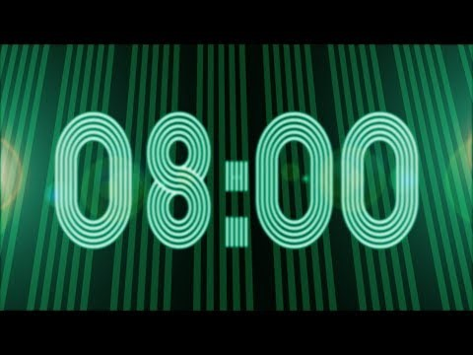
Verbal Pox
Levántense y contesten las preguntas en las paredes
Stand and answer the questions on the walls – the first 5 to answer 10 correctly will receive a prize!
You may use your verb charts

Slide 28
Los frases
Stuff Mrs. DeAlba says a lot:
On my way:
See you at:
I think that..:
I went:
I wonder:
..is working on:
Awesome:
Super:
Hey guys, listen up:
Aww, that’s cute.
Sounds good.
Check it out:
Not sure:
Ask around and check your phone for your top 10 -15 catch phrases

Slide 29
Why we need people and not just google translate to help us with our phrasebooks…
https://www.youtube.com/watch?v=stF6KdQ3NBE
https://www.youtube.com/watch?v=67mqkuDOU24

Slide 30
DOL: De quien hablamos? Who is the subject of the following sentences based on the verb endings?
Lee muchos libros.
Hablamos todos los días.
Escribo cartas a mis representantes políticos.
Sabes cocinar un flan?
Siempre nadan por la mañana?
[Hold onto your papers, we will trade & grade.]
Bank: Paulina, Ellos, Tu, Yo, Mis amigos y yo

Slide 31

DOL: conjugate the verb to match the subject of this sentnece
Paulina lee muchos libros.
Mis amigos y yo hablamos todos los días.
Yo escribo cartas a mis representantes políticos.
Tu sabes cocinar un flan?
Ellos siempre nadan por la mañana?
Put the grade out of 5 and hand it back.

Slide 34
-IR verbs
Escribir – to write
Escribo Escribimos
Escribes Escribís
Escribe Escriben
-AR verbs
Hablar – to talk
[I] Hablo [we] Hablamos
[You] Hablas [thou] Habláis
[He] Habla [they] Hablan
-ER verbs
Leer – to read
Leo Leemos
Lees Leéis
Lee Leen
Tener – to have
Tengo Tenemos
Tienes Tenéis
Tiene Tienen
Estar – to be
Estoy Estamos
Estás Estáis
Está Están
Ser – to be
Soy Somos
Eres Sois
Es Son

Slide 35
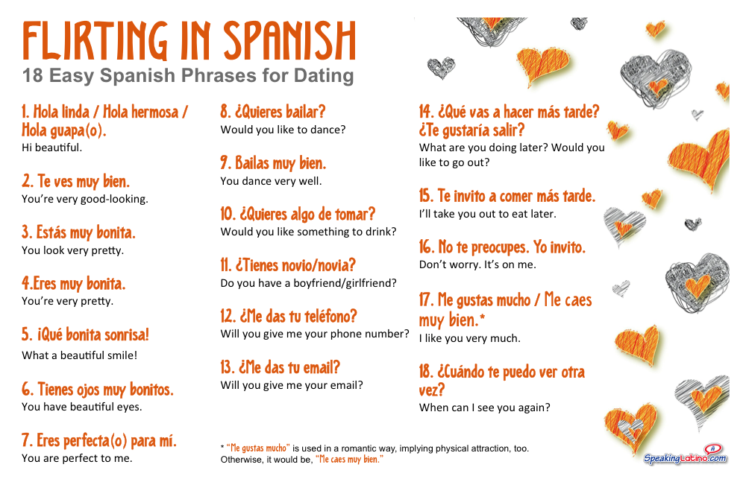

Slide 36
Bienvenidos a Nuestra clase español 1
Hoy es miercoles, el veintinueve de enero
Anuncio: Necesitas tu computadora hoy y viernes

Slide 37

Organize your binder into 5 units. We just finished Unit 3 and are starting Unit 4 – La familia.
Make sure goals and progress monitoring is at the front.
Test corrections due Viernes.

Slide 38
Vamos a hablar – let’s talk
Abren sus computadoras
1. Rocketlanguage.com
Username: smoore@hsd2.org
Password: 1derPhul
2. Haz clic en Module 1.6 Family matters
3. Open recorder & begin recording
4. Repeat every phrase – then do “play as Amy” and “play as Mauricio”
5. Upload recording to Canvas >> Assignments
*Be sure and add any useful new phrases to your Libreta de Frases

Slide 40
Bienvenidos a Nuestra clase español 1
Hoy es viernes, el primero de febrero

Slide 41
We disagree with opinions. Not people.
A lack of agreement is not the same as disrespect.

Slide 42
OBJETIVO Y DOL
LLWBAT explore Black Latin American culture. [NL.1.1c]
100% of LLW explore Black Latin American culture by creating a high quality (7/8) biographical diagram about an influential Afro-Latino.

Slide 43
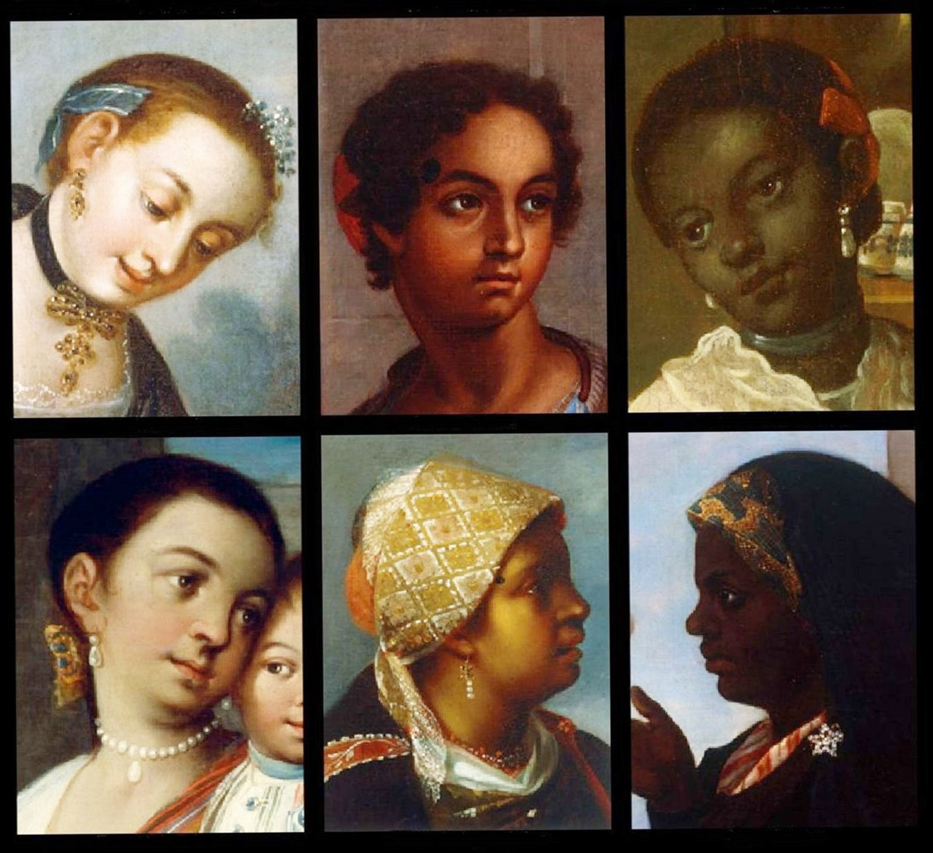
Hecho en Mexico
What year do you these were painted?
1821
What is the message?

Slide 44
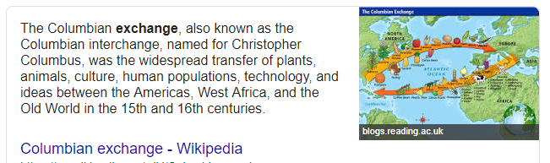

Slide 45
Black in latin america preview https://www.pbs.org/video/black-in-latin-america-black-in-latin-america/

Slide 46

Define Black.
Quien es una persona Negra?

Slide 47
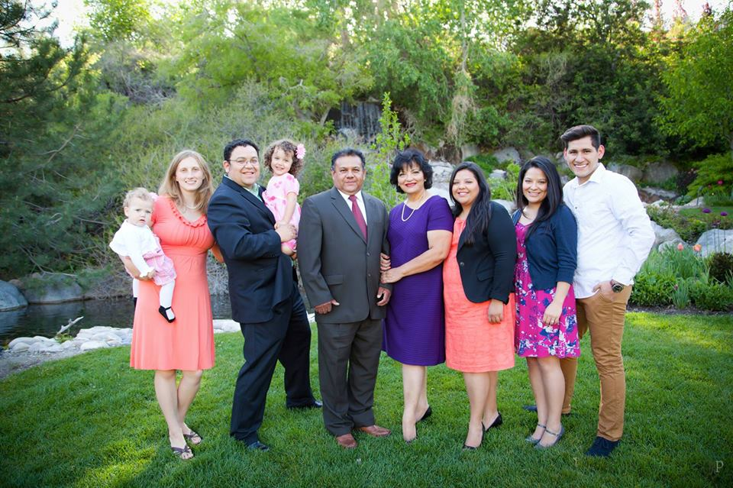

Slide 48
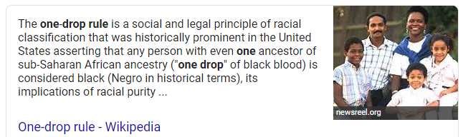

Slide 49
Afro-latinos
https://www.youtube.com/watch?v=joh6vUsHiq0

Slide 50
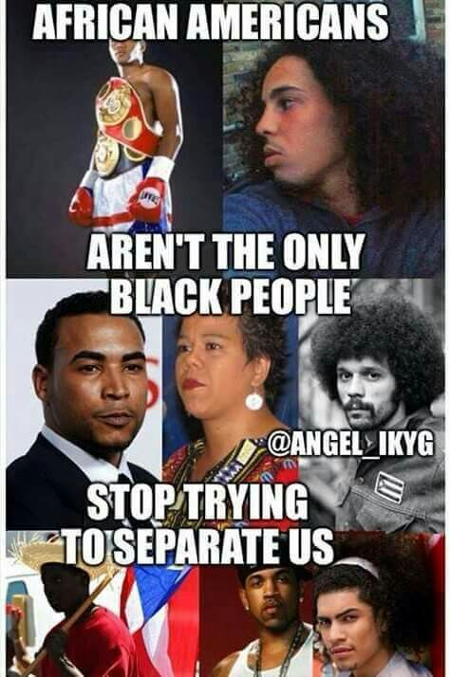
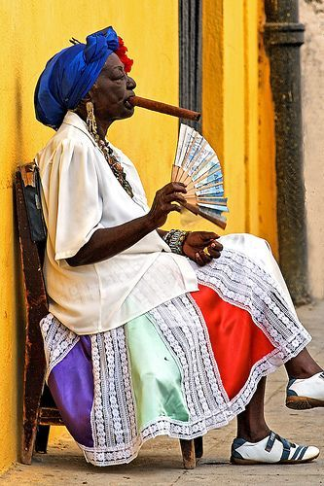
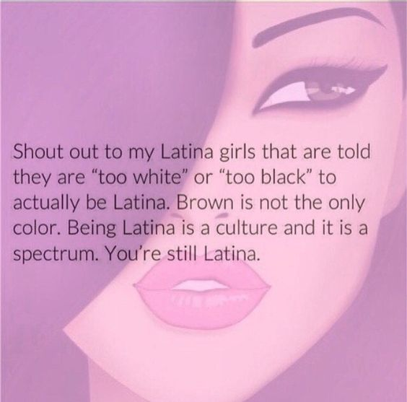
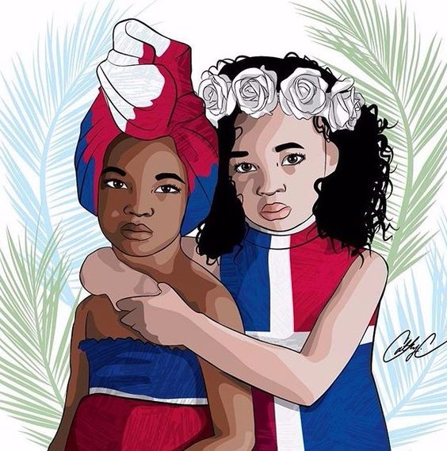
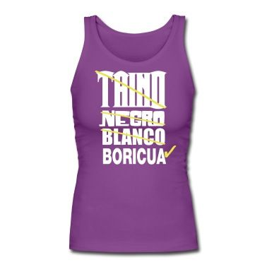

Slide 51
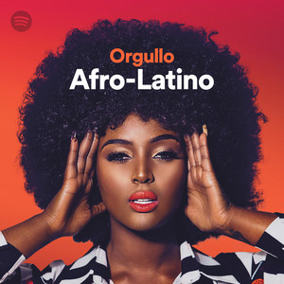

Slide 52
Ahora tu – now you
With a partner or alone, you will créate a Biographical flag about an influential Afro-Latino person.
Be prepared to present in English.

Slide 53
The list of people to present about. write on cards.
Afro Latinos:
Revolutionaries:
Yanga
José Morelos
Vicente Guerrero
Roots musicians:
Celia Cruz
Susana Baca
Johnny Pacheco
Athletes:
Pelé
David Ortiz
Roberto Clemente
Caterine Imbargüen
Athletes:
Ronaldinho
Alex Rodríguez
Rafaela Lopez Silva
Pop artists:
Belcalis Marlenis Almánzar
Mariah Carey
Peter Gene Hernandez
Activists:
Gilberto Gil
Tego Calderon
Argelia Laya
Activists:
The Mirabel Sisters - las 3 mariposas
Xica da Silva
Arturo Alfonso Schomburg
Writers newscasters:
Ursula Burns
John Carlos
Ilia Calderón
Politically active:
Gwen Ifill
Adriano Espaillat
Pedro Campos

