Slide 1

What vocabulary do
you already know
about “la familia”
Who do you consider family?
HAZLO AHORA

Slide 2
BIENVENIDOS A NUESTRA CLASE
ESPAÑOL 1
HOY ES MARTES, EL DOCE DE FEBRERO

Slide 3
Objetivo y DOL
OBJ: LLWBAT comprehend and apply family vocabulary. [NL.4.2.a, NL.4.2b, NL.4.2.c]
LLWBAT recognize cultural differences in families of Spanish speaking countries. [NL.4.2.a, NL.4.2b, NL.4.2.c]
DOL: LLW comprehend family vocabulary by recognizing and applying it to 5 family clues with 80% accuracy.
IB ATTITUDE: CARING

Slide 4
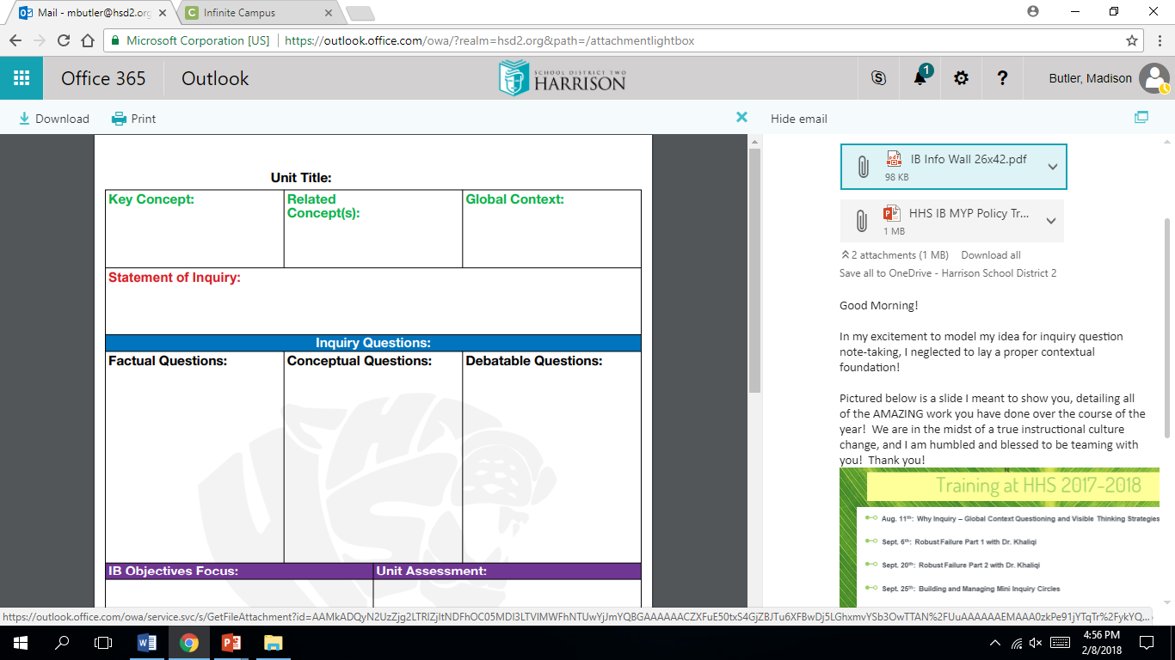
La Familia y El Hogar (Family & Home)
Relationships
Meaning
Identities and Relationships
Family members, Rooms of the house, Household items, Chores, Pets, Celebrations
Simple future (ir-to go), stem changing verbs. Tu commands
Architecture, traditions, music & dance, differences between family
The meaning of relationships helps in forming identities.
You can use words like define, tell, illustrate, memorize…focus on facts definitions and details.
You can use words like relate, show, categorize, interpret, modify, predict…focus on explaining how or why.
You can use words like develop, hypothesize, create, critique, prove…focus on planning, thinking, and real-world applications.
10 mins

Slide 5
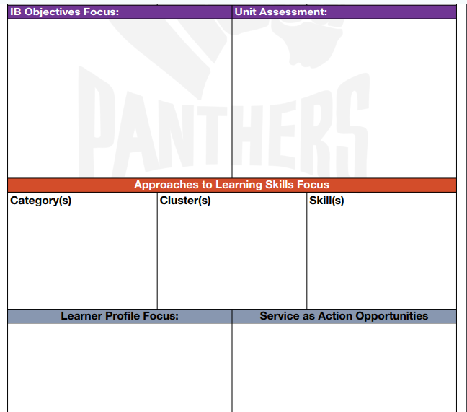
Ai, construct meaning and draw conclusions from information, main ideas and supporting details
Ci, respond appropriately to spoken, written and visual text
Cii, engage in rehearsed and unrehearsed exchanges to share ideas on topics of personal and global significance.
Ciii express ideas and feelings and communicate information in simple and complex texts.
G = The meaning of relationships help form identities.
R = Researcher, Architect
A = Global architecture company
S = A global architecture company has requested the facts and figures about homes and family dynamics in specific countries.
P = Create a home and family that accurately represents a culture of students choose with a written description to correspond.
S = Standards (rubric) expectation
Make connections between ideas
Collect, record and verify data
Access information to be informed and inform others
Thinking
Research
Creative Thinking Skills
Information Literacy Skills
Caring
Students will be caring when talking and learning about the family and different family dynamics of people in the classroom and around the world.

Slide 6
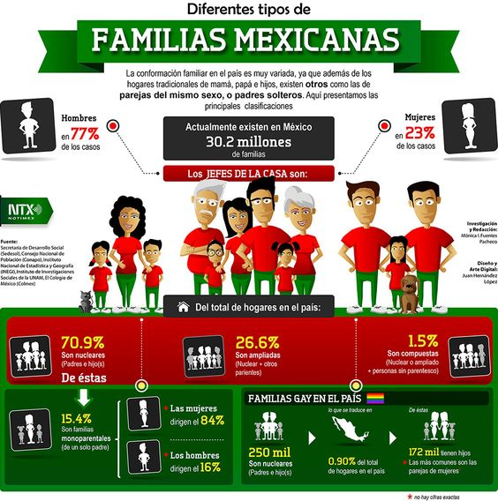
10 mins

Slide 7
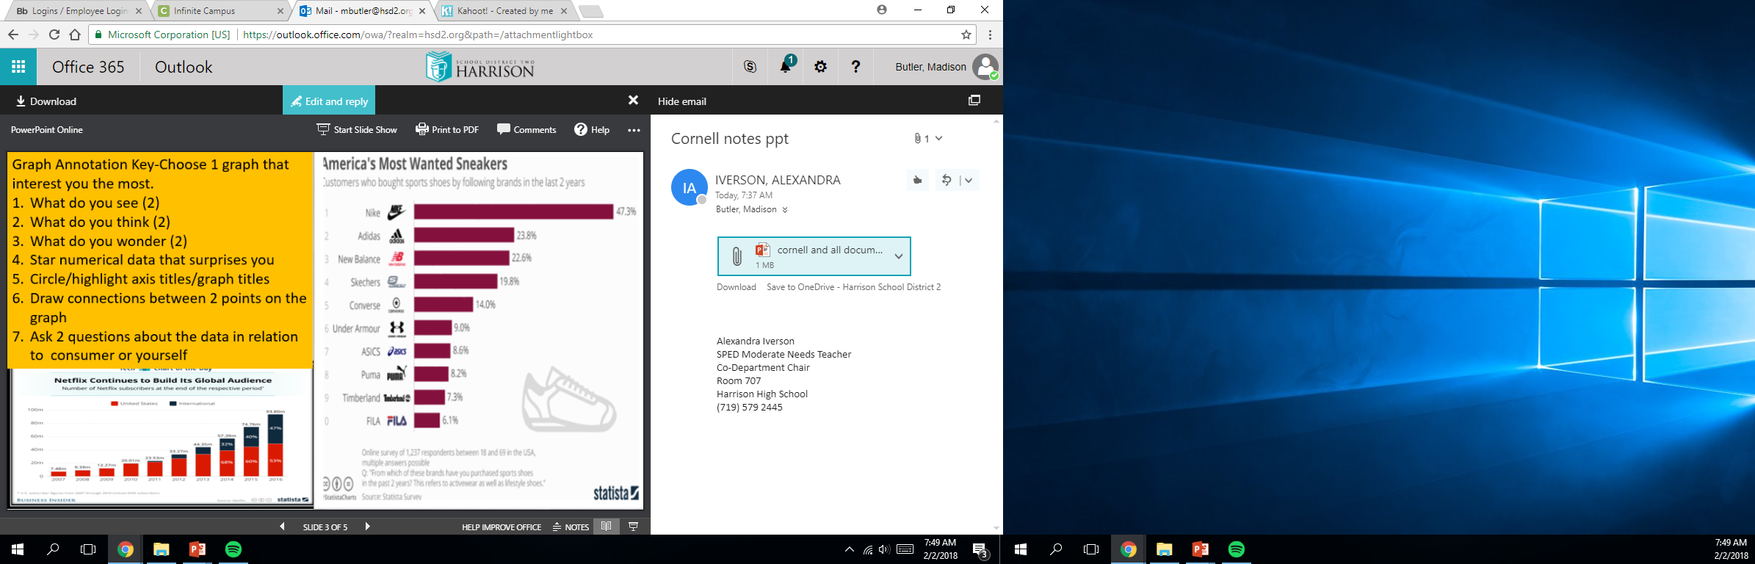

Slide 8
10 mins

Slide 9
10 mins

Slide 10

La familia

Slide 11
Tomamos turnos – leen como parejas!

Slide 12
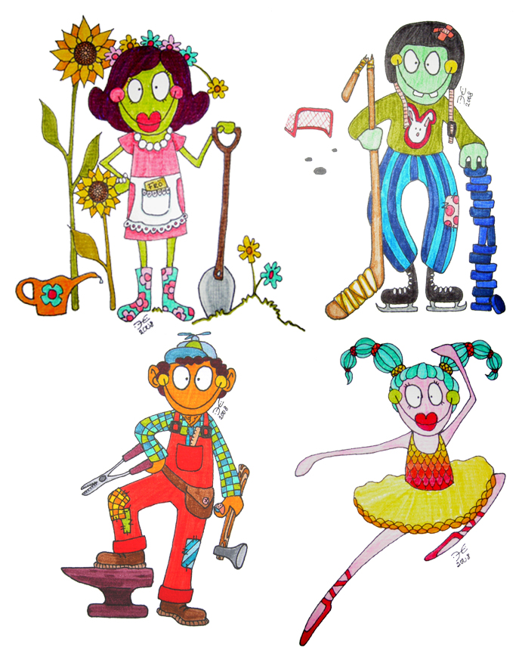
Parientes - relatives

Slide 13
los abuelos
grandparents

Slide 14
el abuelo, la abuela
grandfather, grandmother

Slide 15
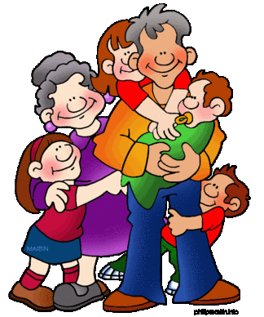
NIETO / NIETA
GRANDSON/ GRANDDAUGHTER

Slide 16
el esposo, la esposa
husband, wife

Slide 17
los padres (papás)
parents

Slide 18
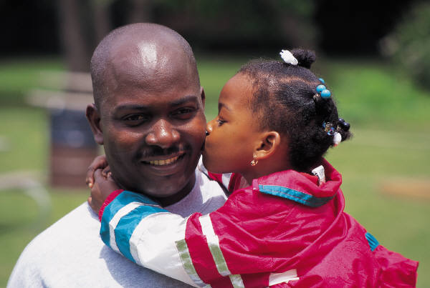
el padre (papá)
Father/
dad

Slide 19
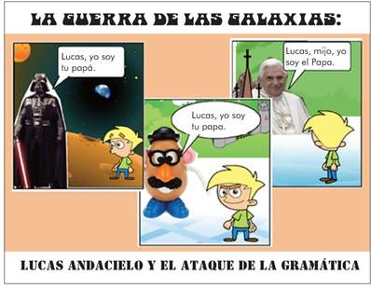
Acentos:
Papa vs.
Papá

Slide 20
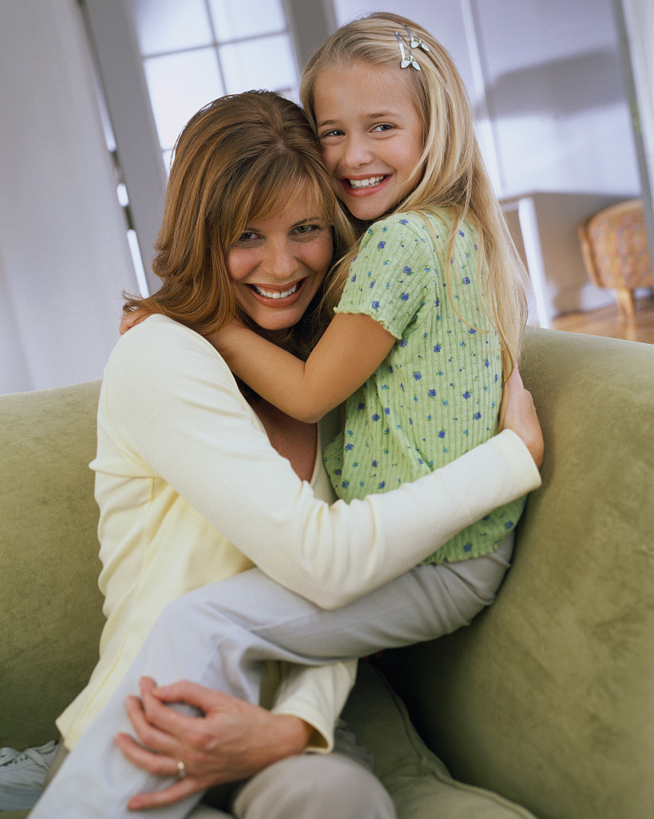
la madre (mamá)
mother/mom

Slide 21

EL PADRASTRO
STEP FATHER

Slide 22
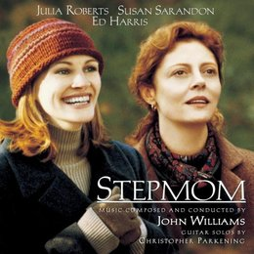
La madrastra
Step- mother

Slide 23
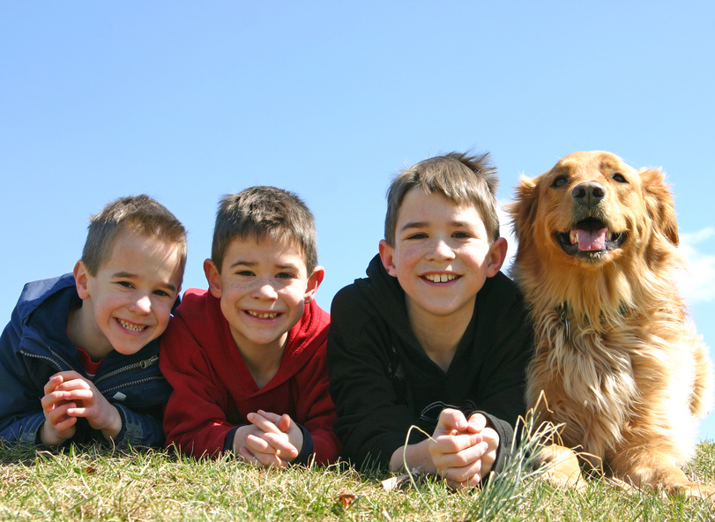
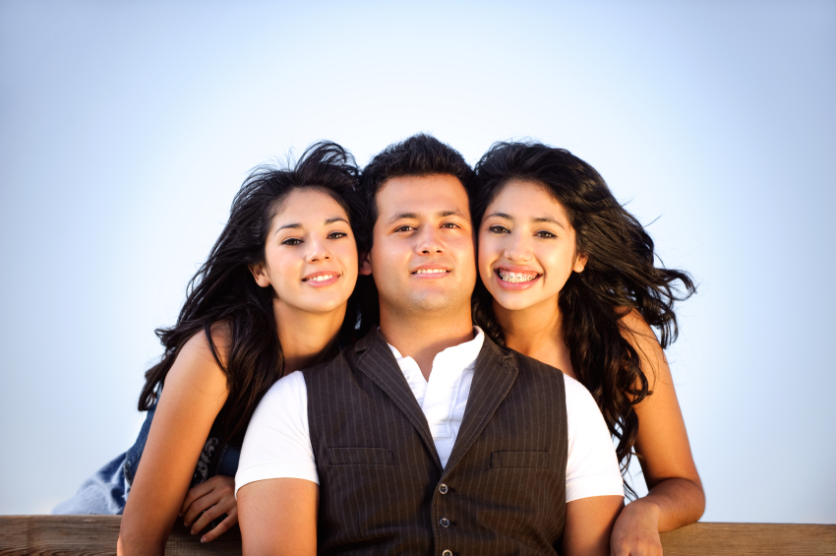
los hermanos
Brothers/siblings

Slide 24
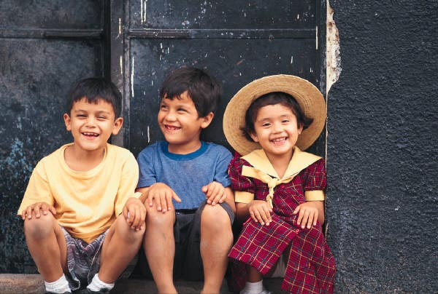
el hermano, la hermana
brother, sister

Slide 25
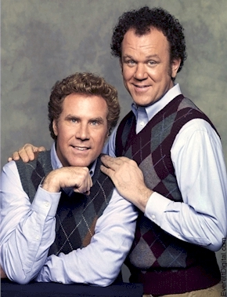
El hermanastro
STEP-BROTHER

Slide 26
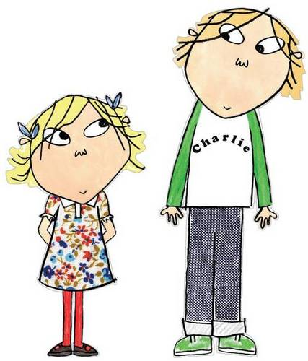
La hermanastra
STEP-SISTER

Slide 27
Turn and talk
#1. ¿Cuántos hermanos tienes?
Tengo…
1.5 mins

Slide 28
Todos juntos! Repite!
Solo son 10…

Slide 29
los hijos
Children, kids

Slide 30
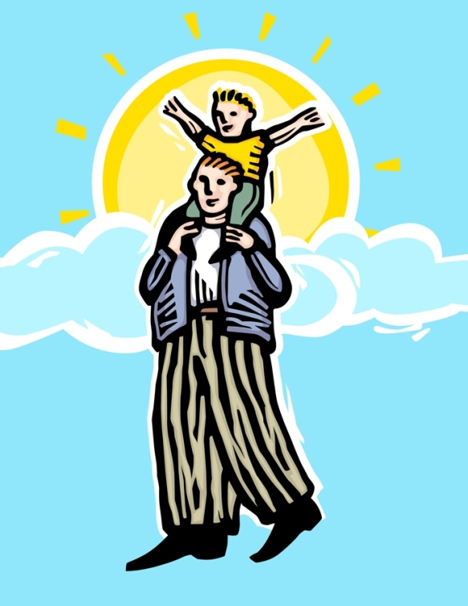
el hijo, la hija
son, daughter

Slide 31
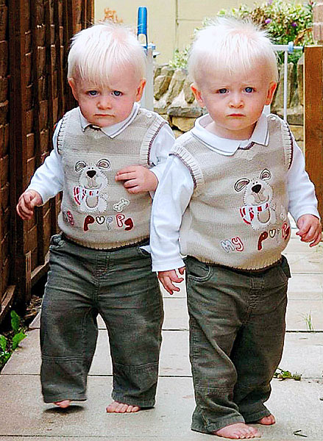
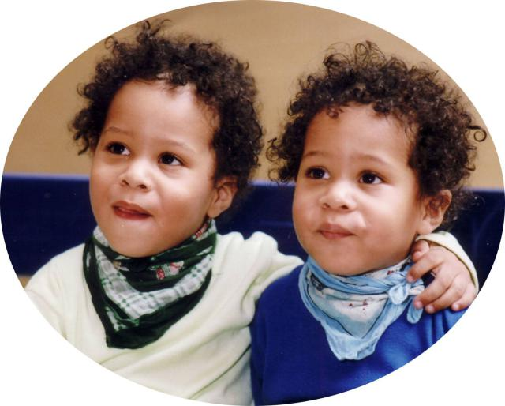
Los GEMELOS
TWINS

Slide 32
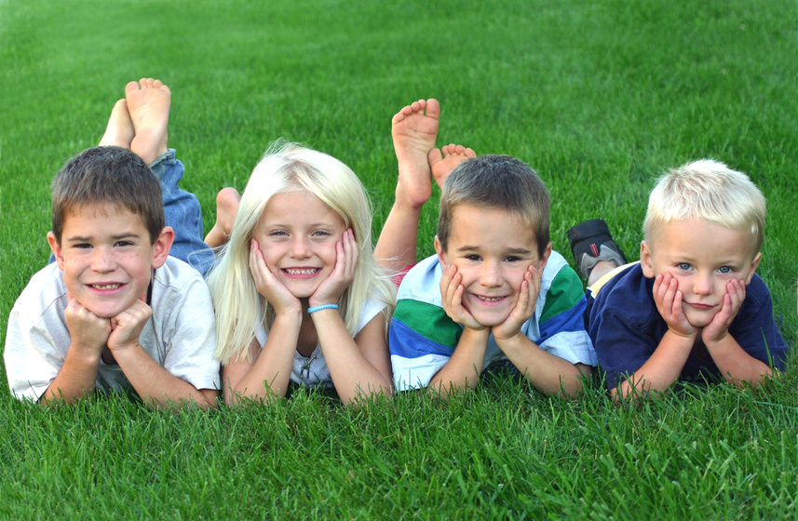
los primos
cousins

Slide 33
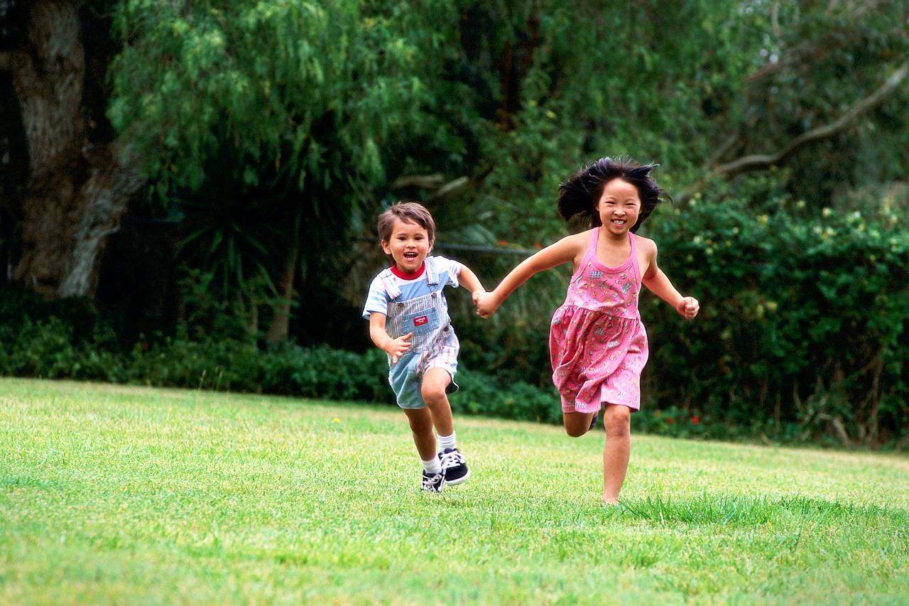
el primo, la prima
male cousin, female cousin

Slide 34

los tíos
uncles;
aunt(s) and
uncle(s)

Slide 35
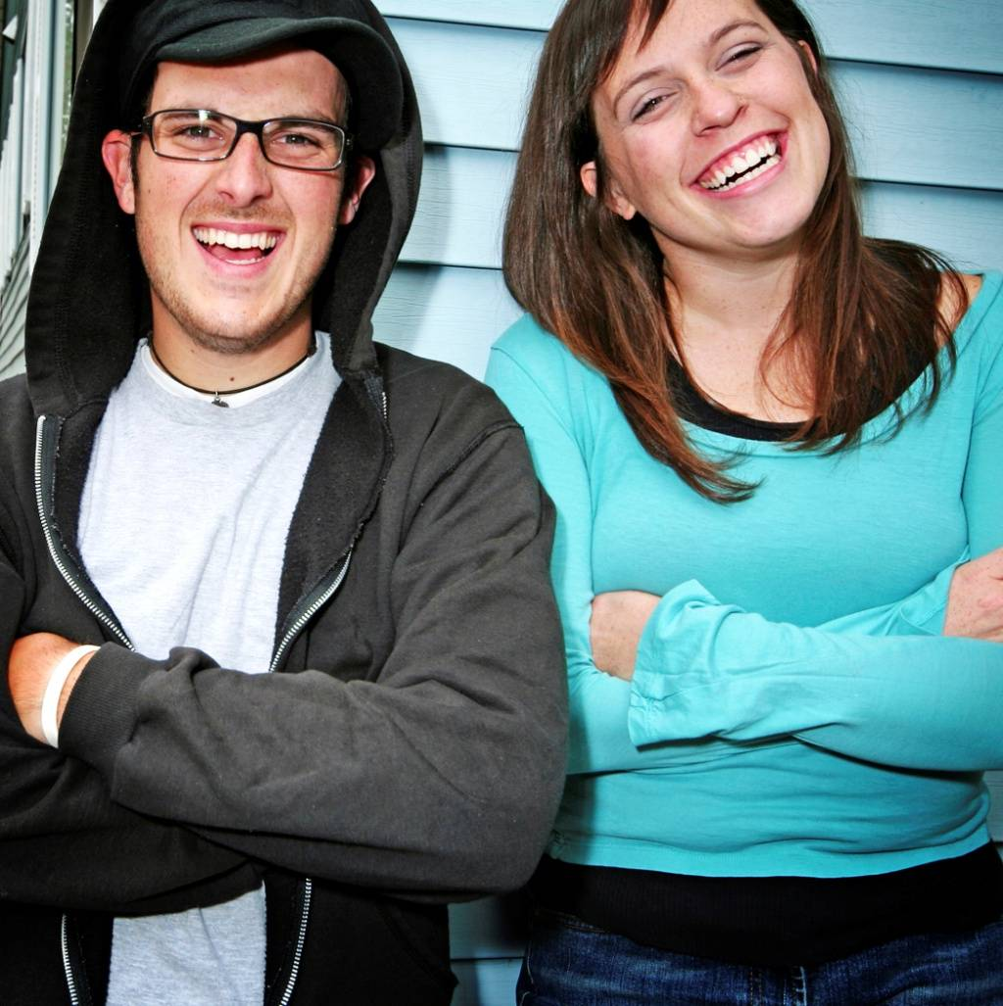
el tío, la tía
uncle, aunt

Slide 36
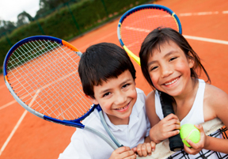
Sobrino/sobrina
Niece/ Nephew

Slide 37
mayor, mayores (pl.)
older

Slide 38
Turn and talk
#2 ¿Quién es tu tío mayor?

Slide 39
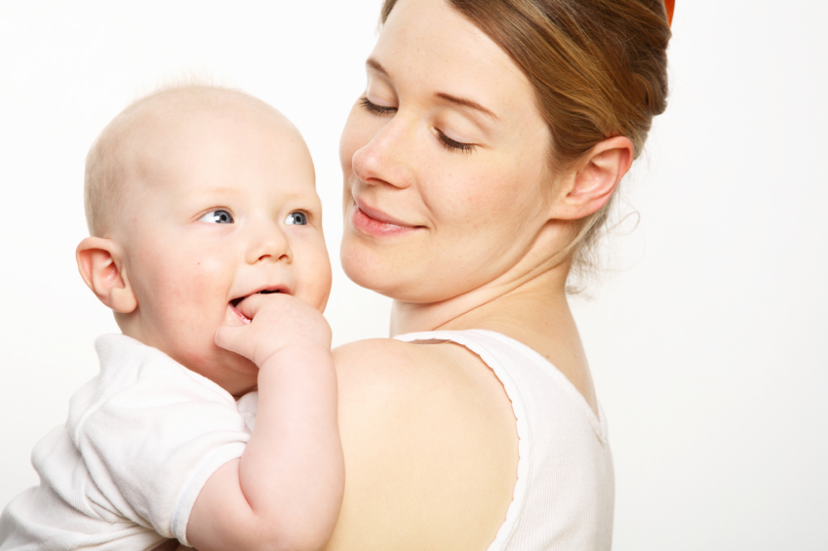
menor menores (pl.)
younger

Slide 40
Turn and talk
#3 ¿Cómo se llama uno de tus primos menores?

Slide 41
DOL: USING THE CLUES GIVEN LIST THE FAMILY MEMBERS WHO CORRELATE TO THESE DESCRIPTIONS
Los padres de mis padres
2. La esposa de mi padre
3. Mi padre es el ____ de mi madre.
4. Los hijos de mis tíos
5. La hija de mis padres.

Slide 42
Logramos la meta?
Did we recognize cultural differences in families of Spanish speaking countries?
Did we comprehend family vocabulary by recognizing and applying it to 5 family clues with 80% accuracy?

Slide 45
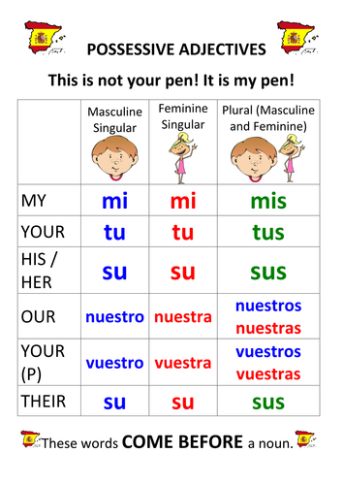
Warmup - FAMILIA CON POSESIVOS
1. My uncle
2. Your sisters
3. Her step-mom
4. Our cousins
5. His grandparents
1. ___ tío
2. ____ hermanas
3. _____ madrastra
4. _______ primos
5. _____ abuelos

Slide 46
FAMILIA CON POSESIVOS
1. My uncle
2. Your sisters
3. Her step-mom
4. Our cousins
5. His grandparents
1. Mi tío
2. Tus hermanas
3. Su madrastra
4. Nuestros primos
5. Sus abuelos

Slide 47
Bienvenidos a Nuestra Clase
Español 1
Hoy es miercoles, el trece de febrero

Slide 48
OBJETIVO Y DOL
OBJ: LLWBAT recall and utilize family member vocabulary in complete sentences in spanish.
DOL: Given a family tree, 100% of LLW recall family member vocabulary to identify who is who and utilize vocabulary in a full sentence answer with 80% accuracy.

Slide 49
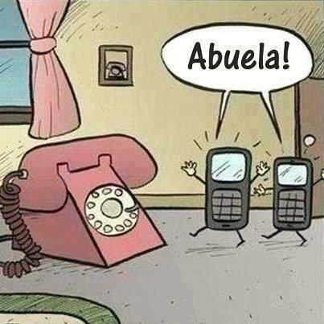

Slide 50
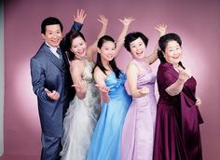
Awkward Family Photo Drills:
For each picture answer:
¿Cuántas personas hay?
Hay cinco personas.
¿ Quiénes son?
Son papá, tres hermanas y mamá.
If 10+ mins remaining

Slide 51
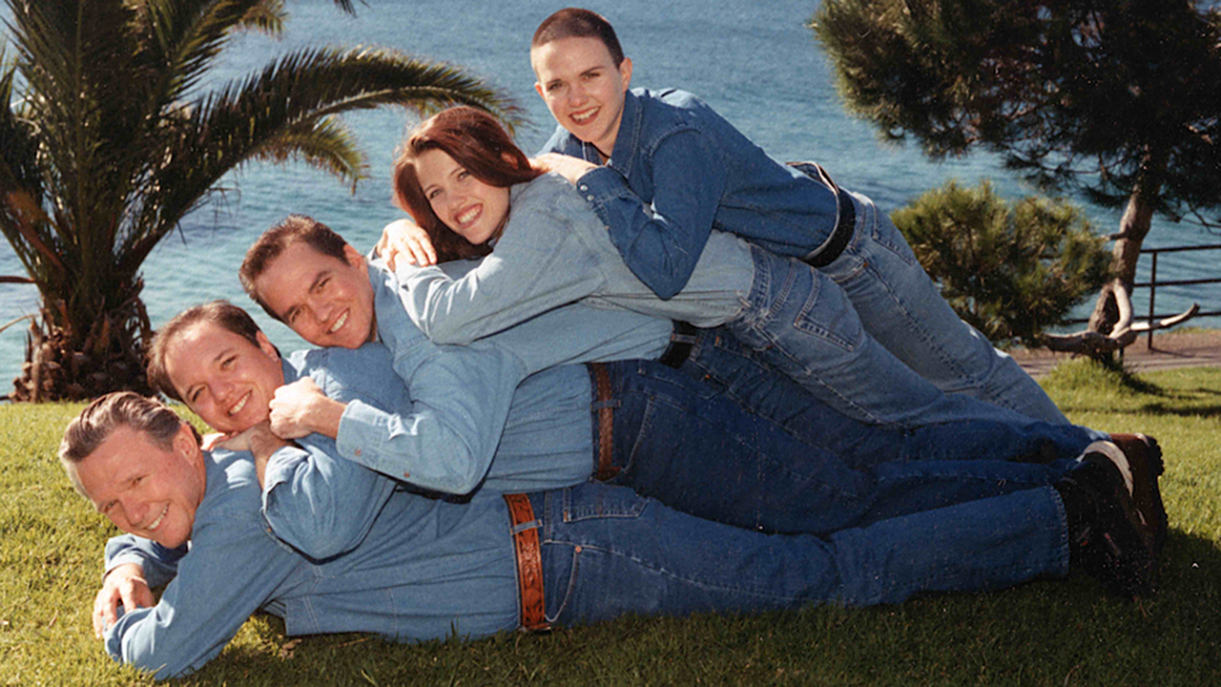
Awkward Family Photo Drills:
For each picture answer,
¿Cuántas personas hay?
Hay ___ personas.
¿ Quiénes son?
Son… (list family members)

Slide 52
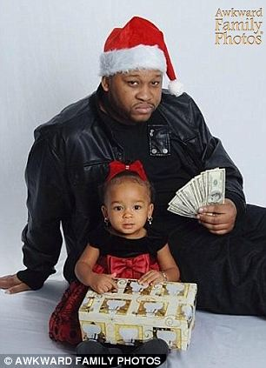
Awkward Family Photo Drills:
For each picture answer,
¿Cuántas personas hay?
Hay ___ personas.
¿ Quiénes son?
Son… (list family members)

Slide 53
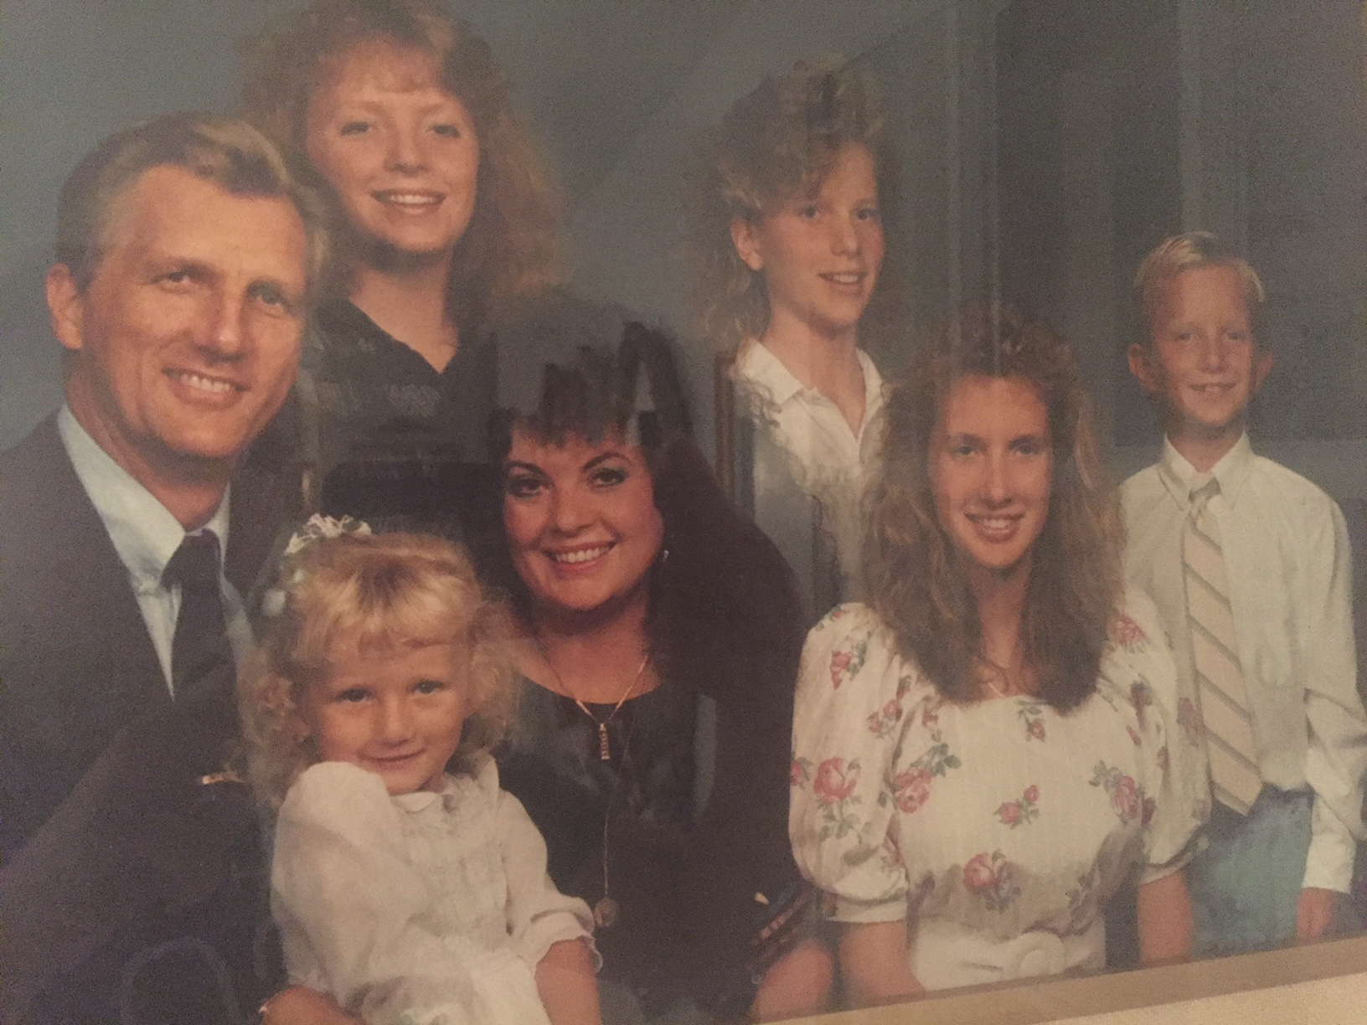
Awkward Family Photo Drills:
For each picture answer,
¿Cuántas personas hay?
Hay ___ personas.
¿ Quiénes son?
Son… (list family members)

Slide 54
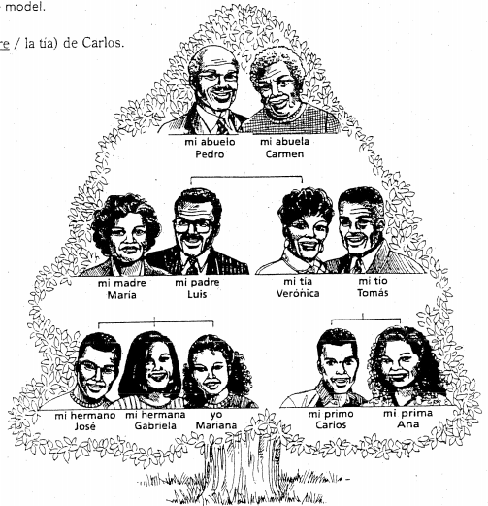
1. Luis es (el hijo/ el padre) de Gabriela.
2. Carmen es (la tía/ la abuela) de Ana.
3. José es (el hermano/ el primo) de Carlos.
4. Yo, Mariana, soy (la tía/ la hermana de José.
5. Ana es (la tía/ la prima) de José
6. Pedro es (el padre/ el abuelo) de Mariana
7. José es (el hermano/ el padre) de Gabriela
8. María es (la madre/la tía) de Carlos.
9. Verónica y Tomas son (los padres/ los tíos) de Gabriela.
10. Gabriela es (la hermana/ la prima) de José.

Slide 55
Entrevistas
Examples of questions are below.
Compete to see how many different family members you can ask about!! Don’t just ask about the mom!
You will need your notebook and a writing utensil.
You will mill about the room while music is playing with one arm in the air.
When the music stops, high five the person nearest you.
The younger person of the pair will ask his/her question first.
The older person will ask second.
BOTH partners are to write down the other person’s answer.
EXAMPLE: Lisa tiene ocho hermanos.
¿Cómo se llama tu _______?
¿Cuantos _______ tienes?
¿Cómo es tu ______?
Mi ____ se llama Jill.
Tengo cinco ______.
Mi _____ es bonita y trabajadora.

Slide 56
Complete the following sentences with the correct possesive pronoun…
1. (our) ¿Donde está _______ profesora?
2. (her) Ella no tiene ________ cuaderno.
3. (their) ¿Ellos tienen _______ libros?
4. (my) _________ clases son muy interesantes.
5. (their) Mis amigos tienen ______ mochilas.
6. (your) Tienes _______ tarea?
7. (our) ________ profesora es muy vieja.

Slide 57
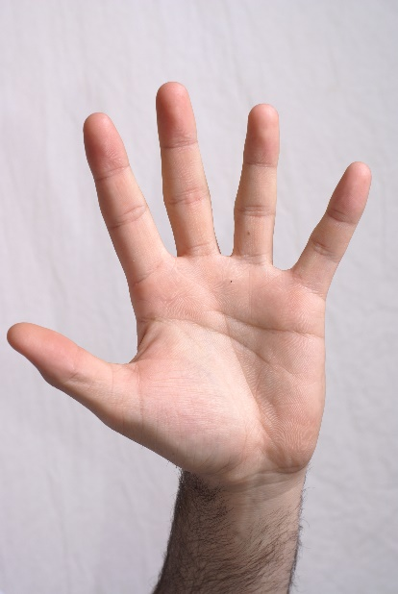
Complete the following sentences with the correct possesive pronoun…
1. (our) ¿Donde está ___nuestra____ profesora?
2. (her) Ella no tiene ____su____ cuaderno.
3. (their) ¿Ellos tienen ___sus____ libros?
4. (my) ____Mis____ clases son muy interesantes.
5. (their) Mis amigos tienen _sus___ mochilas.
6. (your) Tienes _tu____ tarea?
7. (our) ___Nuestra___ profesora es muy vieja.

Slide 58

Happy day of love and friendship!

Slide 60
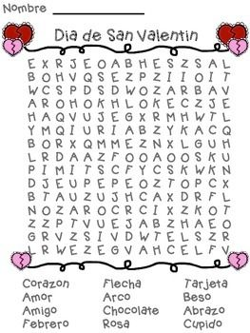
Sopa de letras

Slide 61
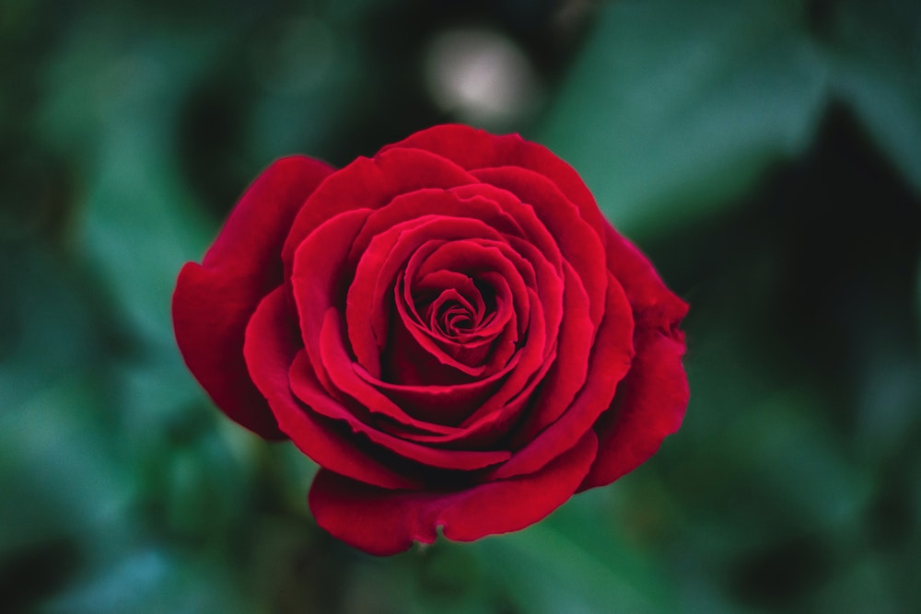
Bienvenidos a Nuestra Clase
Español 1
Hoy es jueves, el catorce de febrero
Feliz dia de amor y amistad!

Slide 62
Quien tiene el mejor acento?
https://www.youtube.com/watch?reload=9&v=6vmyShi4nGo
https://www.youtube.com/watch?v=bLp_1KtpG4k&t=21s
https://www.youtube.com/watch?v=3o9nLRRA1Ws&pbjreload=10

Slide 63
Y chicos, que opinan? And your opinion guys?
https://www.youtube.com/watch?v=tIpzfs5tBJU
https://www.youtube.com/watch?v=P2zOb0HGdxg
https://www.youtube.com/watch?v=ieBvA3kMJB4
https://www.youtube.com/watch?v=3VpvZodBb7g
https://www.youtube.com/watch?v=wTZ7A-h8yTs

Slide 64
Y chicos, que opinan? And your opinion guys?
https://www.youtube.com/watch?v=tIpzfs5tBJU (mexicana)
https://www.youtube.com/watch?v=P2zOb0HGdxg (espanola)
https://www.youtube.com/watch?v=ieBvA3kMJB4 (Puerto riquense)
https://www.youtube.com/watch?v=3VpvZodBb7g (dominicana)
https://www.youtube.com/watch?v=wTZ7A-h8yTs (colombiana)

Slide 65
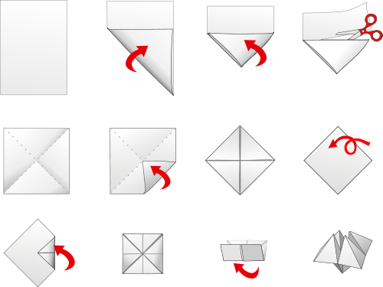

Slide 68
OBJETIVO Y DOL
OBJ: LLWBAT read and interpret a text relating to family members by creating family trees from a text.
[NL.3.1b, NL.2.1b]
DOL: LLW create a family tree from a text using 10 family member vocabulary terms with 100% accuracy.

Slide 69
Bienvenidos a Nuestra Clase
Español 1
Hoy es viernes, el quince de febrero

Slide 70
agenda
TIME | ACTIVITY
5 Minutes | Hazlo Ahora
5 Minutes | Repaso de Posesivos
15 Minutes | PESCA!
10 Minutes | Create 4 Questions
5 Minutes | Answer peer questions
10 Minutes | Family Tree DOL

Slide 71
Our aunt
Her dad
your (informal) brothers
Nuestra tia
Su padre
Tus hermanos
My cousin (female)
Your (informal) grandmother
Mi prima
our relatives
Tu abuela
Our grandfather
Your (formal) twin
Nuestros parientes
Nuestro abuelo
Su gemelo

Slide 72
DOL: Complete with the correct possesive adjective
Modelo: tú
__tu__ libro
__tus_ carpetas
Grupo 1. yo Grupo 2. tú
  _______ madre _________ padre
  _______ hermana _________ hermano
  _______ primos _________ sobrinas
  _______ amigas _________ abuelos
Grupo 3. él/ ella/ usted Grupo 4. nosotros
  ellos/ellas/ustedes
  ________ padrastro ___________ prima
  ________ madrastra ___________ tío
  ________ gemelos ___________ padres
  ________ parientes ___________ familias

Slide 73
DOL: Complete with the correct possesive adjective
Modelo: tú
__tu__ libro
__tus_ carpetas
Grupo 1. yo Grupo 2. tú
  __mi___ madre ____tu___ padre
  __mi___ hermana ____tu___ hermano
  _mis__ primos ____tus___ sobrinas
  __mis__ amigas ____tus___ abuelos
Grupo 3. él/ ella/ usted Grupo 4. nosotros
  ellos/ellas/ustedes
  __su____ padrastro _nuestra__ prima
  __su____ madrastra _nuestro___ tío
  __sus___ gemelos _nuestros__ padres
  __sus___ parientes _nuestras_ familias

Slide 74
Each player recieves 6 cards
Complete a family of the same color
Take turns asking people in your group if they have the card you are looking for.
Ask in Spanish!
EX: ¿Tienes la hija roja?
If they have the card, they give it to you!
If they don’t have the card. The say go Fish!
Person in the group with the First name closest to “A” shuffles/ deals
Person in the group with the first name closest to “Z” goes first.
Coninue clockwise.
Pesca

Slide 75
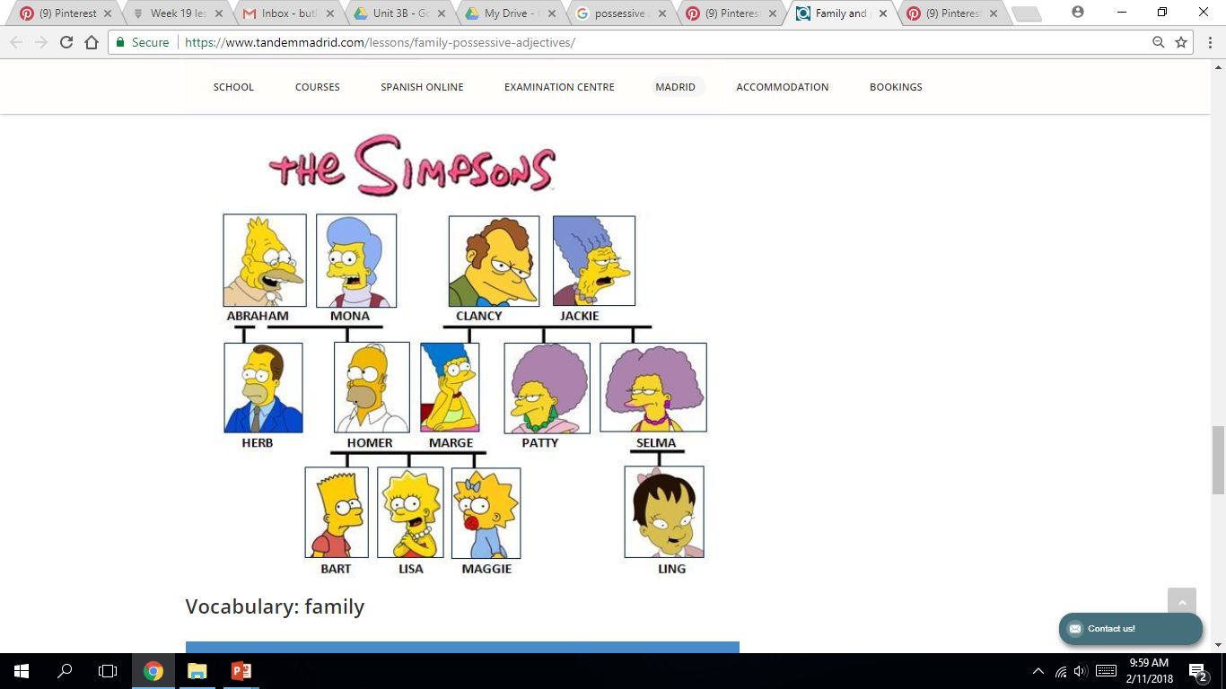
Use the family tree to create 2 questions.
*¿Quien es ________ de _______?

Slide 76
Quien es el padre de Homer?
El padre de Homer es Abraham

Slide 77
2 mins
Use the family tree to create 2 questions.
*¿Quien es ________ de _______?

Slide 78
Trade with your partner.
Answer their questions based on the family tree.

Slide 79
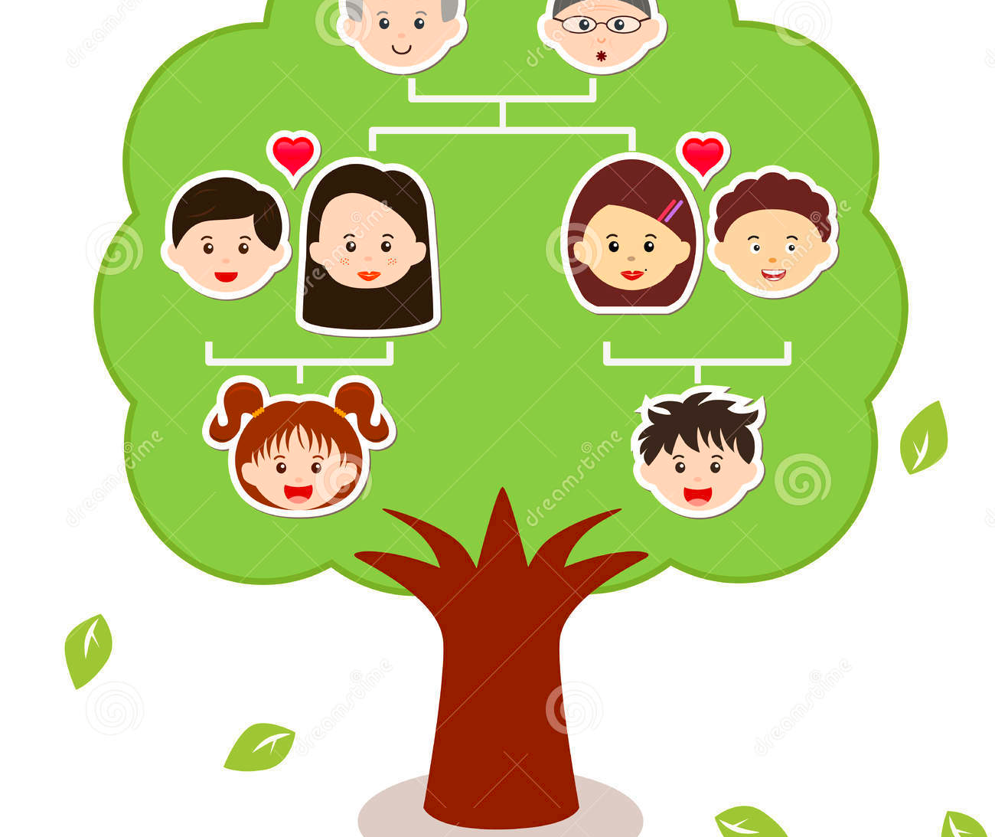
DOL
PEER GRADE
Create the correct family tree from the passage written.
1. Me llamo Charlie. Mi esposa se llama Clara
2. Jackie es mi hija y es la mama de mi nieta Sammy. Su esposo se llama Miguel.
3. También tengo una hija que se llama Marisol. Su esposo se llama John.
4. Ellos tienen un hijo, mi nieto, que se llama Clark.
Charlie
Clara
Miguel
Marisol
John
Jackie
Sammy
Clark

Slide 80
What was the most useful thing you learned today? What was applicable to your life? Do you know any Spanish-speaking families?
REFLECT

